Slide 1
CSC 3511 Security and Networking
Week 1, Lecture 1: Course Overview

Slide 2
Course Personnel
Instructor: Dr. Zhonghao Liao
Office: DH 436
Email: liao@msoe.edu
Office hours:
Monday, Tuesday: 10:00 am – 11:00 am, 2:00 pm - 3:00 pm
Thursday: 10:00 am - 11:00 am
Wednesday, Friday: Knock on door or by appointment
Please feel free to come over when I'm in the office
Watch the Canvas
Assignments, reading materials, lecture notes

Slide 3
Course Materials
Textbook:
Computer Networking A Top-Down Approach, 9th edition (ISBN: 9780135429334)
Internet Security: A Hands-on Approach 3rd Edition (ISBN: 978-17330039-6-4)
Free: An Introduction to Computer Networks by Peter L. Dordal
Link: https://intronetworks.cs.luc.edu/current2/html/index.html
Free: Computer Networks: A Systems Approach by Larry Peterson and Bruce Davie
Link: https://book.systemsapproach.org/index.html
Lecture slides, notes, quizzes, homework, labs, etc.: Canvas
Prerequisites: working knowledge of Python and Linux (Don’t worry if you don’t have a working knowledge)

Slide 4
What’s the “Internet”?
Internet

Slide 5
What can “Internet” do?
Infrastructure that provides services to applications:
Web, streaming video, multimedia teleconferencing, email, games, e-commerce, social media, inter-connected appliances, …
mobile network
national or global ISP
local or regional ISP
Provides programming interface to distributed applications:
“hooks” allowing sending/receiving apps to “connect” to, use Internet transport service
provides service options, analogous to postal service
home network
content
provider
network
datacenter
network
enterprise
network

Slide 6
Postal System Analogy – Building Block 1: Something that moves data
Postal service needs a way to deliver letters: mailman, carrier pigeon, Pony Express, trucks, airplanes, etc.
Internet also needs a way to move bits: wires, fiber optics, radio waves, satellites, etc.
Risks in delivery: letters may get lost, opened by others, or delayed. Similarly, network packets can be lost, intercepted, or exposed.

Slide 7
Postal System Analogy – Building Block 2: Talking to the apartment complex (Local Communication)
Within one apartment complex, the mailman delivers letters room-to-room
This is like a Local Area Network (LAN), connecting devices inside the same building
People can talk to their neighbors without involving the post office.

Slide 8
Postal System Analogy – Building Block 3: Post offices connect complexes (Wide Communication)
A post office connects multiple apartment complexes
Letters can travel between complexes through the post office
This is like a Wide Area Network (WAN), connecting LANs together.

Slide 9
Postal System Analogy – Internet Scale: Connecting the whole world
Multiple post offices around the world connect into a giant global system
A letter may pass through several post offices before reaching its destination
The Internet is the same: messages (packets) hop across multiple routers/ISPs before arriving.

Slide 10
Internet: Layers of abstraction
Postal system layers:
Letter (content you wrote)
Envelope (addressing)
Mail carrier (physical delivery)
Post office routing (deciding the next hop)
Internet layers:
Application (email, web page)
Transport (TCP, UDP)
Network (IP)
Link (WiFi, Ethernet)
Physical (cables, wireless signals)
Layer 3: Connect many local networks to form a global network
Layer 2: Create links in a local area
Layer 1: Move bits across space => within single computer, or between computers
A change in one layer (e.g., switch pigeons to trucks) doesn’t break the others.

Slide 11

Internet layering
Internet design is partitioned into various layers. Each layer…
Has protocols
Relies on services provided by the layer below it
Provides services to the layer above it
Analogous to the structure of an application and the “services” that each layer relies on and provides
Code You Write
Run-Time Library
System Calls
Device Drivers
Fully isolated from user programs
Hardware

Slide 12
Internet layering: OSI vs. TCP/IP model
Open Systems Interconnection (OSI) model:
A theoretical, academic model of Internet communication
Originally divided into 7 layers - But layers 5 and 6 aren’t used in the real world, so we ignore them
Same reliance upon abstraction
A layer can be implemented in different ways without affecting other layers
A layer’s protocol can be substituted with another protocol without affecting other layers
7. Application Layer
6. Presentation Layer
5. Session Layer
4. Transport Layer
3. Network Layer
2. Data Link Layer
1. Physical Layer

Slide 13
Internet layering: OSI vs. TCP/IP model
Transmission Control Protocol/Internet Protocol (TCP/IP) model:
Practical model used on today’s Internet ➔ Layers 5 (Session) + 6 (Presentation) are usually bundled into Application in TCP/IP
Different models, same idea ➔ networking is layered abstraction, where each layer provides services to the one above
We follow the TCP/IP model (aka the Internet protocol suite model)to organize course content

Slide 14
The Internet: a “nuts and bolts” view
mobile network
Internet: “network of networks”
Interconnected ISPs
national or global ISP
Protocols are everywhere
Control sending, receiving of messages
e.g., HTTP (Web), streaming video, Skype, TCP, IP, WiFi, 4/5G, Ethernet
local or regional ISP
home network
content
provider
network
Internet standards
RFC: Request for Comments
IETF: Internet Engineering Task Force
datacenter
network
enterprise
network

Slide 15
What’s a protocol?
Human protocols:
“what’s the time?”
“I have a question”
introductions
Network protocols:
computers (devices) rather than humans
all communication activity in Internet governed by protocols
Rules for:
… specific messages sent
… specific actions taken when message received, or other events

Slide 16


What’s a protocol – A Human Analogy
A human protocol and a computer network protocol:
Q: other human protocols?

Slide 17
Network security
Internet not originally designed with (much) security in mind
original vision: “a group of mutually trusting users attached to a transparent network” ☺
Internet protocol designers playing “catch-up”
security considerations in all layers!
We now need to think about:
how bad guys can attack computer networks
how we can defend networks against attacks
how to design architectures that are immune to attacks

Slide 18
Bad guys: packet interception
packet “sniffing”:
broadcast media (shared Ethernet, wireless)
promiscuous network interface reads/records all packets (e.g., including passwords!) passing by
A
C
B

Slide 19
Bad guys: denial of service
Denial of Service (DoS): attackers make resources (server, bandwidth) unavailable to legitimate traffic by overwhelming resource with bogus traffic
1. select target
2. break into hosts around the network (see botnet)
3. send packets to target from compromised hosts
Introduction: 1-19

Slide 20
Network Threats & Attacks
Phishing attacks, usability
people
email, Web, NFS
Sendmail, FTP, NFS bugs, chosen-protocol and version-rollback attacks
application
RPC
RPC worms, portmapper exploits
session
TCP
SYN flooding, RIP attacks,
sequence number prediction
transport
IP
IP smurfing and other
address spoofing attacks
network
802.11
data link
WEP attacks
physical
RF
RF fingerprinting, DoS
Only as secure as the single weakest layer…
… or interconnection between the layers

Slide 21
Network Defenses
People
End uses
Password managers,
company policies…
Implementations
Firewalls, intrusion
detection…
Systems
Protocols and policies
TLS, IPsec, access control…
Blueprints
Building blocks
Cryptographic primitives
RSA, DSS, SHA-1…
All defense mechanisms must work correctly and securely

Slide 22
Why do we need security and HOW TO?
Scenarios: Trade secrets, medical records
Requirements: Protect vital information secret while still allowing access to those who need it (Confidentiality)
How to: Encrypted communications, secure transactions
Scenarios: Ensure data integrity and prevent unauthorized modification
Scenarios: Financial transactions, software updates, legal documents
Requirements: Ensure data integrity and prevent unauthorized modification
How to: Digital signatures, Message authentication codes (MAC)

Slide 23
Why do we need security and HOW TO?
Scenarios: Online banking, confidential email access, restricted databases
Requirements: Provide authentication and access control for resources
How to: Multi-factor authentication (MFA), public key infrastructure (PKI), biometric verification
Scenarios: Cloud services, e-commerce platforms, critical infrastructure systems
Requirements: Guarantee availability of resources
How to: Redundant systems, load balancing

Slide 24
CSC 3511 Security and Networking
Week 10, Lecture 1: One-Time Pads, Stream Cipher, and Block Cipher

Slide 25
Cryptography Roadmap

Slide 26
Roadmap
One-Time Pads
Stream Cipher
Block Cipher

Slide 27
Review: XOR
The XOR operator takes two bits and outputs one bit:
Useful properties of XOR:

Slide 28
One-Time Pads: Key Generation
The key K is a randomly-chosen bitstring;
The key length is equal to the message length.
Recall: We are in the symmetric-key setting, so we assume Alice and Bob both know this key

Slide 29
One-Time Pads: Encryption
The plaintext M is the bitstring that Alice wants to encrypt
Encrypt: XOR each bit of K with the matching bit in M
The ciphertext C is the encrypted bitstring that Alice sends to Bob over the insecure channel.

Slide 30
One-Time Pads: Decryption
Bob receives the ciphertext C. Bob knows the key K. How does Bob recover M?
Decrypt: XOR each bit of K with the matching bit in C
For one-time pads, we generate a new key for every message

Slide 31
One-Time Pads: Summary
KeyGen():
Randomly generate an n-bit key, where n is the length of your message
Recall: we assume that Alice and Bob can securely share this key
For one-time pads, we generate a new key for every message
Enc(K, M) = K ⊕ M:
Bitwise XOR M and K to produce C
In other words: XOR the i-th bit of the plaintext with the i-th bit of the key ➔ Ci = Ki ⊕ Mi
Dec(K, C) = K ⊕ C:
Bitwise XOR C and K to produce M ➔ Mi = Ki ⊕ Ci

Slide 32
Two-Time Pads?
Eve sees two ciphertexts over the insecure channel
C0 ⊕ C1
What if Alice use the same key K to encrypt two different messages?
What if Alice use the same key K to encrypt the same messages?

Slide 33
Impracticality of One-Time Pads
Problem 1: Key generation
Keys must be randomly generated for every message, and never reused
Randomness is expensive
Problem 2: Key distribution
To communicate an n-bit message, we need to securely communicate an n-bit key first
But if we have a way to securely communicate an n-bit key, we could have communicated the message directly!
Communicate keys in advance:
How to establish a shared secret key over an insecure channel? ➔ Diffie-Hellman key exchange (next time)

Slide 34
Roadmap
One-Time Pads
Stream Cipher
Block Cipher

Slide 35
Pseudorandomness and PRGs
What does “pseudorandom” mean?
Informal: cannot be distinguished from uniform (i.e., random)
Informal:
Fix some distribution D on n-bit strings: x  D means “sample x according to D”
D is pseudorandom if it passes all efficient statistical tests
Pseudorandom generators (PRGs)
A PRG is an efficient, deterministic algorithm that expands a short, uniform (random) seed into a longer, pseudorandom output
seed
G
output

Slide 36
Pseudorandom Generators

Slide 37
PRGs & Stream Ciphers
Gen(1n): output uniform n-bit key k
Security parameter n ➔ message space {0,1}p(n)
Enck(m): output G(k)  m
Deck(c): output G(k)  c
Correctness follows as in the OTP…
“Pseudo” One-Time Pad
Key reuse problem?

Slide 38
ChaCha20
Designed by Dan Bernstein in 2008
Conceptually, it’s very simple ➔ uses arithmetic operations: integer addition modulo , XOR, and left rotations
Extremely fast (>600 MB/sec) in software and does not require any special hardware
No security weakness have been found
ChaCha20 is widely used in practice, including in TLS

Slide 39
ChaCha20: Workflow
64 bytes
of plaintext stream
ChaCha20
Keystream generator
State
64 bytes
of keystream
⊕
64 bytes
of ciphertext
update state

Slide 40
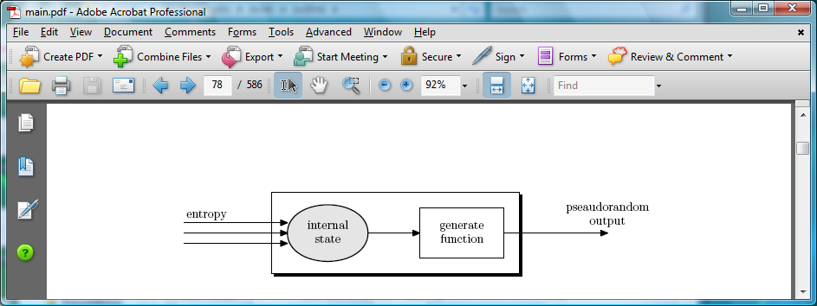
Generating Randomness (e.g. keys, IV)
Pseudorandom generators in practice: (e.g. /dev/random)
Continuously add entropy (uncertainty) to internal state
Entropy sources:
Hardware RNG: Intel RDRAND instruction (Ivy Bridge, 2012). 3Gb/sec.
Timing: hardware interrupts (keyboard, mouse)
NIST SP 800-90A: NIST approved generators

Slide 41
Roadmap
One-Time Pads
Stream Cipher
Block Cipher

Slide 42
Block Ciphers
Block cipher: A cryptographic scheme consisting of encryption/decryption algorithms for a fixed-sized block of bits
Enc(K, M) → C:
Inputs: k-bit key K and an n-bit plaintext M
Output: An n-bit ciphertext C
Sometimes written as: {0, 1}k × {0, 1}n → {0, 1}n
Dec(K, C) → M:
Inputs: a k-bit key, and an n-bit ciphertext C
Output: An n-bit plaintext
Sometimes written as: {0, 1}k × {0, 1}n → {0, 1}n
The inverse of the encryption function

Slide 43
Block Cipher Primitives: Confusion & Diffusion
Claude Shannon: There are two primitive operations with which strong encryption algorithms can be built:
Confusion: An encryption operation where the relationship between key and ciphertext is obscured (or, hidden)
Today, a common element for achieving confusion is substitution, which is found in both AES and DES. E.g., S-box
Diffusion: An encryption operation where the influence of one plaintext symbol is spread over many ciphertext symbols with the goal of hiding statistical properties of the plaintext.
A simple diffusion element is the bit permutation, which is frequently used within DES.
Both operations by themselves cannot provide security. The idea is to concatenate confusion and diffusion elements to build so called product ciphers

Slide 44
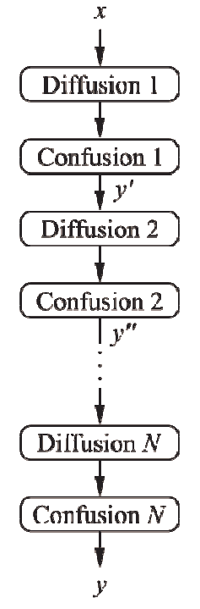
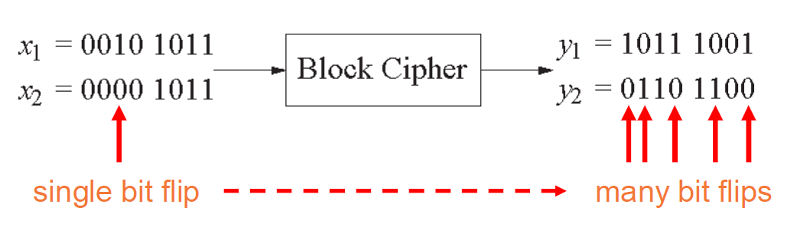
Product Ciphers
Most of today’s block ciphers are product ciphers as they consist of rounds which are applied repeatedly to the data
Can reach excellent diffusion: changing of one bit of plaintext results on average in the change of half the output bits
Example:

Slide 45
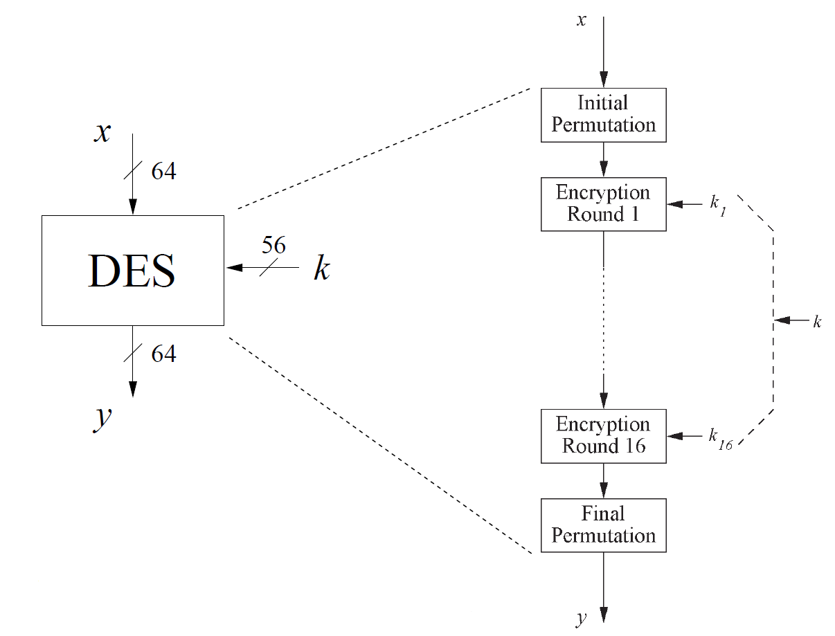
Overview of the DES (Data Encryption Standard)
Developed by IBM and adopted by NBS (now NIST) in 1977
Encrypt blocks of size 64 bits
Use a key of size 56 bits
Use the same key for Enc/Dec
Use 16 rounds which all perform the identical operation
Different subkeys in each round derived from encryption key
DES is insecure; do not use it!

Slide 46
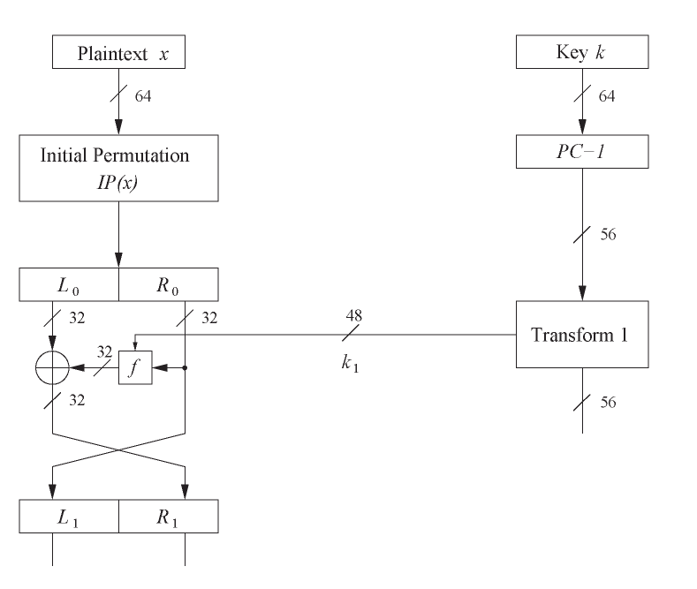
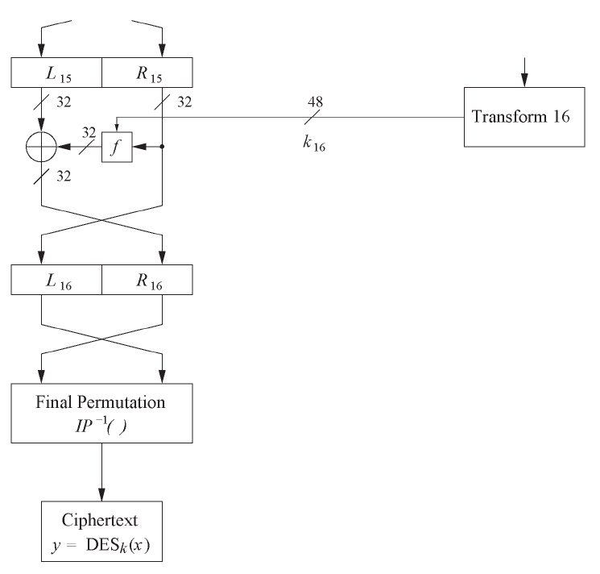
DES internals: Feistel network
Round 1
……
Round 16

Slide 47
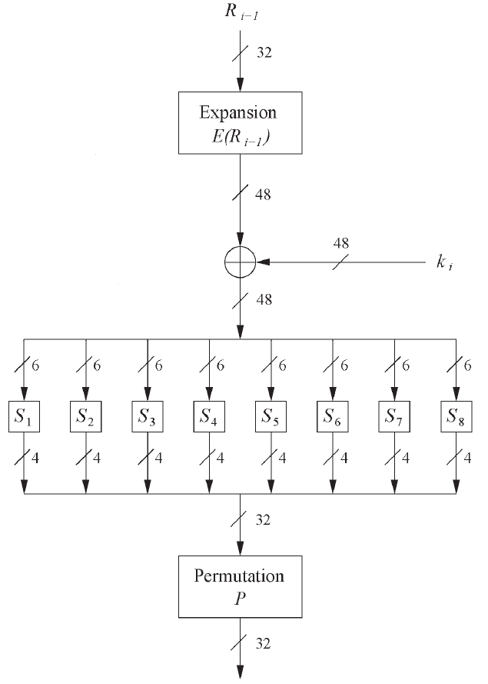
DES internals: the f-Function

Slide 48
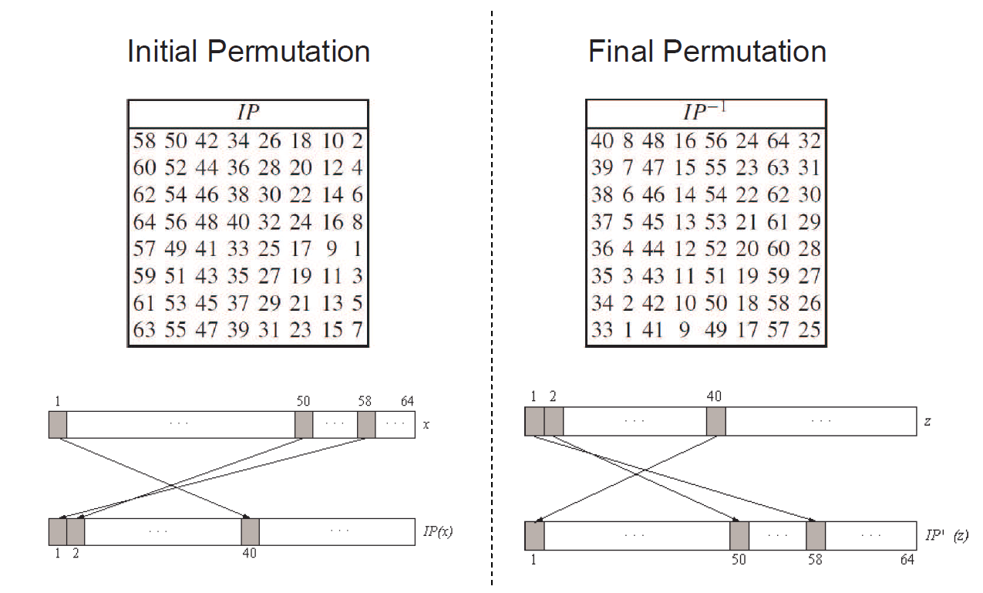
DES internals: IP and IP-1
Bitwise permutations
Described by tables IP and IP-1

Slide 49
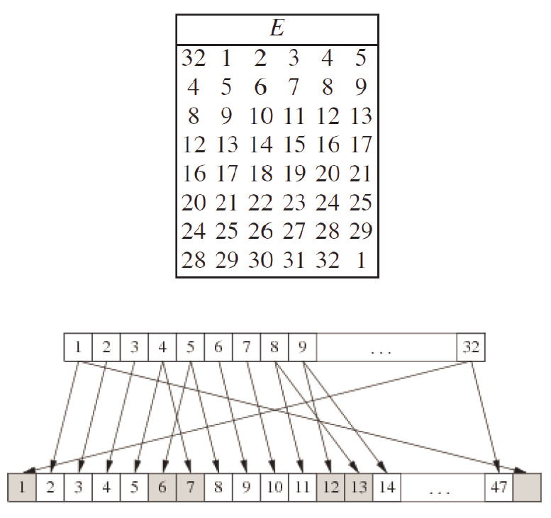
f-Function: 1. the expansion function E
Main purpose: increases diffusion
Diffusion: the influence of one plaintext symbol is spread over many ciphertext symbols; hide statistical properties of the plaintext

Slide 50
f-Function: 2. add round key
Bitwise XOR of the round key and the output of the expansion function E
Round keys are derived from the main key in the DES keyschedule algorithm (in a few slides)

Slide 51
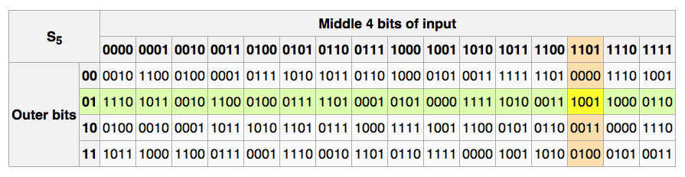
f-Function: 3. S-box
Eight substitution tables
Si: {0,1}6 ⟶ {0,1}4
Non-linear and resistant to differential cryptanalysis
Crucial element for DES security ➔ heart of DES!
Provide confusion
Relationship between key and ciphertext is obscured (or, hidden)

Slide 52
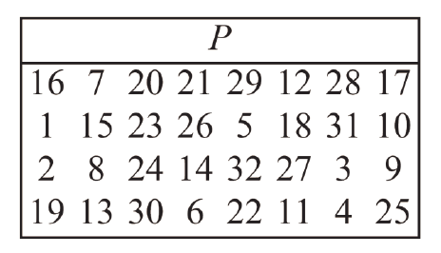
f-Function: 4. permutation P
Bitwise permutation
Introduce diffusion
Diffusion: the influence of one plaintext symbol is spread over many ciphertext symbols; hide statistical properties of the plaintext
Output bits of one S-Box effect several S-Boxes in next round
E, S-Boxes, and P guarantee that after Round 5 every bit is a function of each key bit and each plaintext bit.

Slide 53
Advanced Encryption Standard (AES)
The need for a new block cipher announced by National Institute of Standards and Technology (NIST) in January 1997
15 candidate schemes accepted in August 1998 ➔ Rijndael was chosen as the AES in October 2000
AES was formally approved as a US federal standard in November 2001 (FIPS 197)
Key lengths: 128, 192, and 256 bits
Block length: 128 bits
2025: No attacks have been found on AES that are (significantly) faster than exhaustive key search
AES is an example of a substitution-permutation network

Slide 54
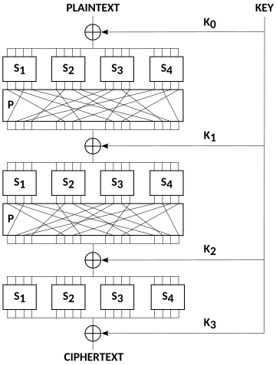
Substitution-permutation Networks (SPN)
A SPN is an iterated block cipher where a round consists of a substitution operation followed by a permutation operation

Slide 55
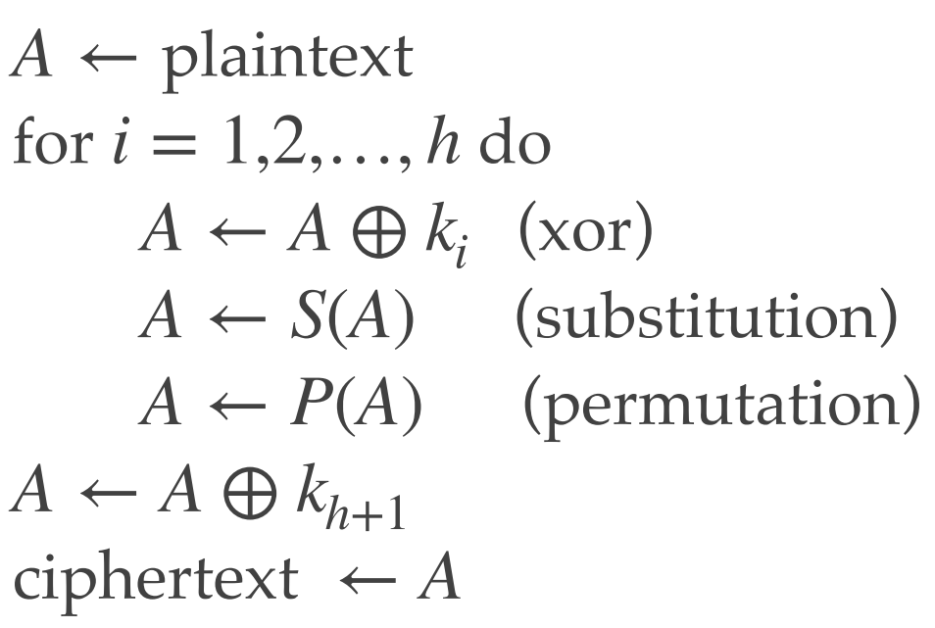
Substitution-permutation Networks (SPN)
Here is a description of encryption
Decryption is the reverse of encryption
AES is an SPN, where the permutation operation is comprised of two invertible linear transformations (ShiftRows & MixColumns )

Slide 56
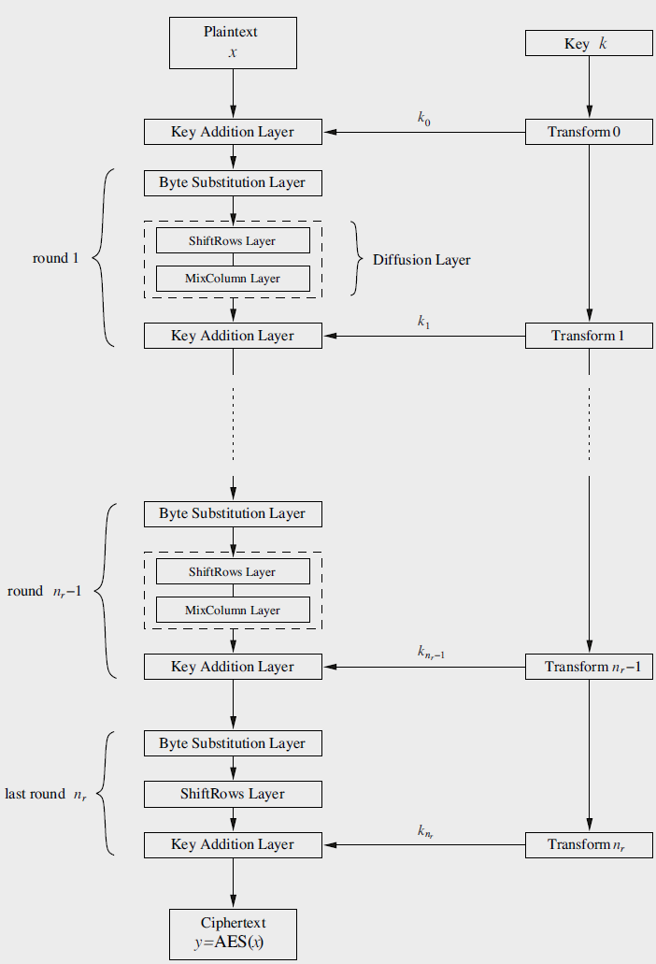
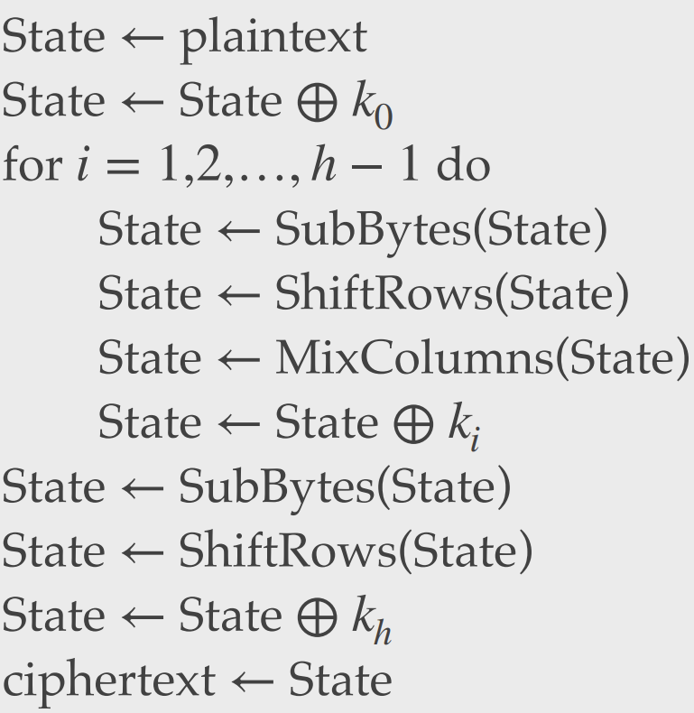
AES: structural information

Slide 57
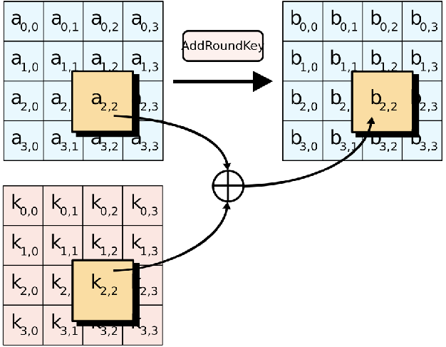
AES Algorithm: AddRoundKey()
XOR the 16-byte block with the 16-byte round key

Slide 58
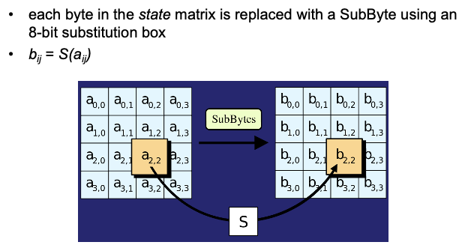
AES Algorithm: SubBytes()
Replace each byte in the block with another byte using an 8-bit substitution box

Slide 59
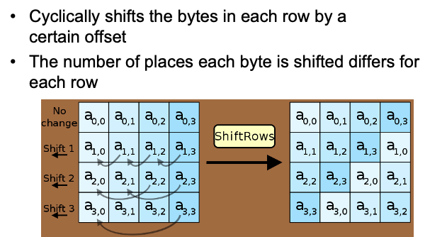
AES Algorithm: ShiftRows()
Cyclically shifts the bytes in each row by a certain offset
The number of places each byte is shifted differs for each row

Slide 60
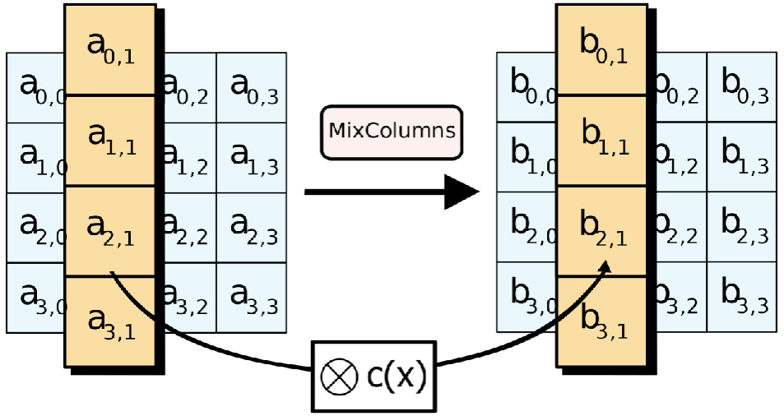
AES Algorithm: MixColumns()
Treats the 16-byte block as a 4 × 4 matrix and multiply it by another matrix

Slide 61
Encryption with Block Ciphers: Modes of Operation
Message is divided into blocks
Each block is encrypted separately
Lack of diffusion

Slide 62
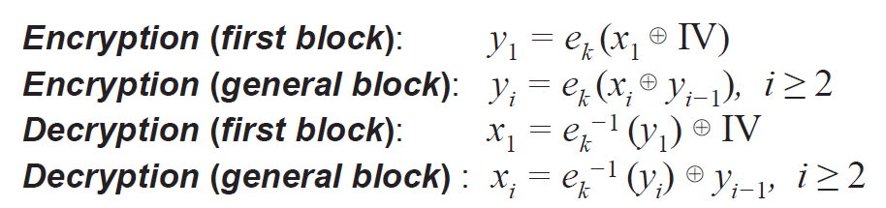
Cipher Block Chaining Mode (CBC)

Slide 63
CSC 3511 Security and Networking
Week 10, Lecture 2: Public Key Cryptography, RSA

Slide 64
Cryptography Roadmap

Slide 65
Roadmap
Public-Key Cryptography
RSA Encryption
Hybrid Encryption

Slide 66
Public Key Cryptography
In public-key schemes, each person has two keys
KeyGen(): output a pair of public key and private key; every public key corresponds to one private key
Public key: available to anyone
Private key: known only to individual
Use cases
Confidentiality:
Encrypt using public key, decrypt using private key
Key management problem: Share symmetric key K
Integrity/Authentication:
Encrypt using private key, decrypt using public one
Digital Signature

Slide 67
Public-Key Encryption: Definition
Three parts:
KeyGen() → PK, SK: Generate a public/private keypair, where PK is the public key, and SK is the private (secret) key
Enc(PK, M) → C: Encrypt a plaintext M using public key PK to produce ciphertext C
Dec(SK, C) → M: Decrypt a ciphertext C using secret key SK
Properties
Correctness: Decrypting a ciphertext should result in the message that was originally encrypted ➔ Dec(SK, Enc(PK, M)) = M for all PK, SK ← KeyGen() and M
Efficiency: Encryption/decryption should be fast
Security:
Computationally infeasible to derive the private key from the public key
Computationally infeasible to determine the private key from a chosen plaintext attack

Slide 68
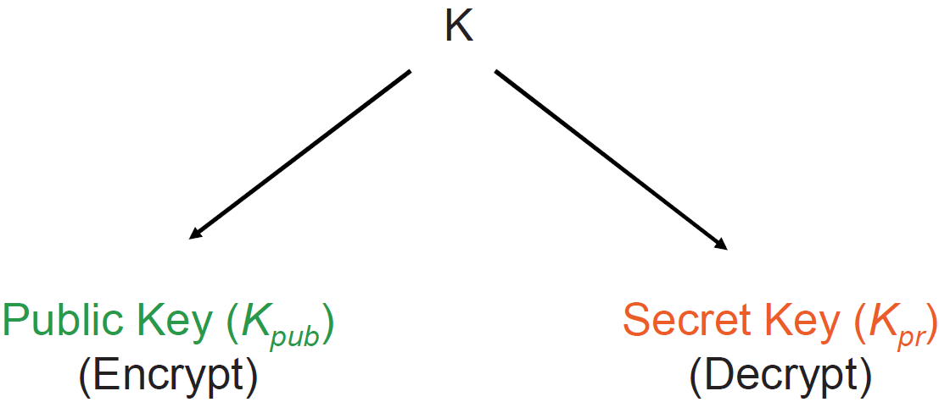

Idea Behind Public-Key Encryption

Slide 69
Public Key Encryption: Constructions
Note: The problems are considered mathematically hard, but no proof exists (so far)

Slide 70
Roadmap
Public-Key Cryptography
RSA Encryption
Hybrid Encryption

Slide 71
RSA Encryption: Key Generation

Slide 72
Euclidean algorithm

Slide 73
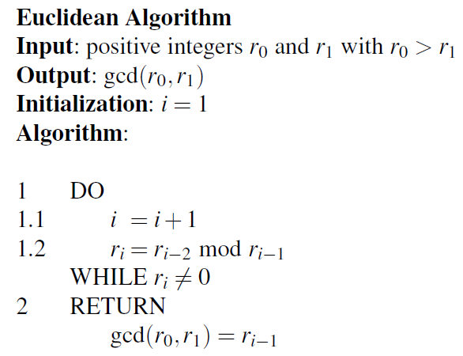
Euclidean algorithm
Note: very efficient method even for long numbers ➔ The complexity grows linearly with the number of bits

Slide 74
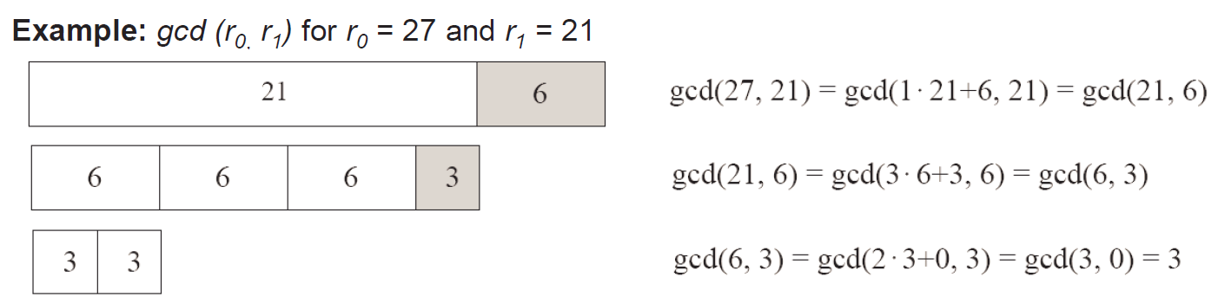
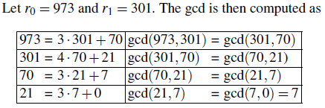
Euclidean algorithm
Note: very efficient method even for long numbers ➔ The complexity grows linearly with the number of bits

Slide 75
Extended Euclidean algorithm (EEA)

Slide 76
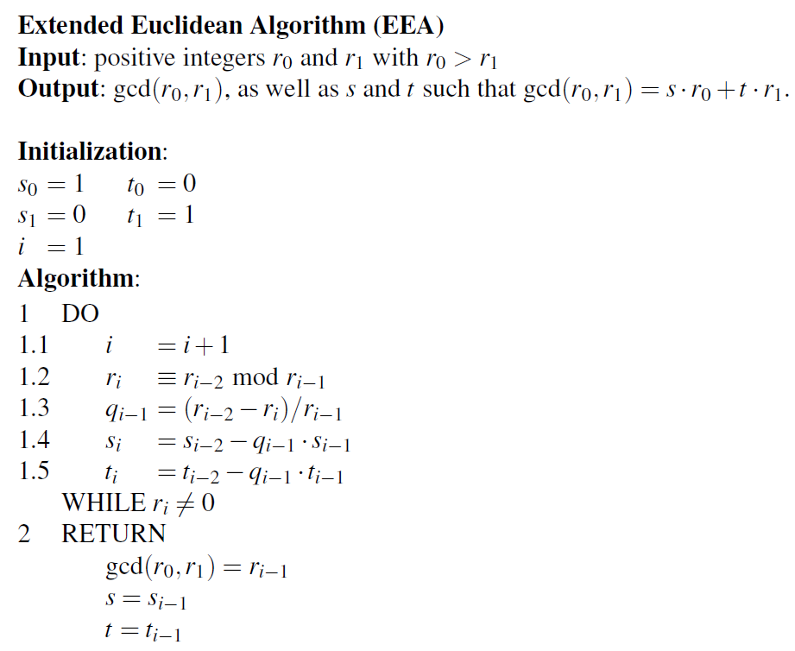
Extended Euclidean algorithm (EEA)

Slide 77
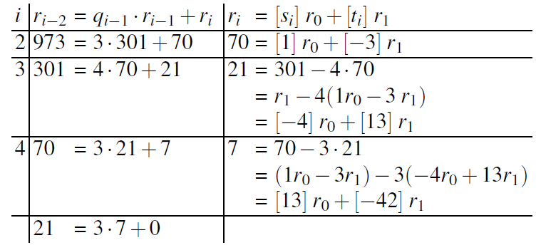
Extended Euclidean algorithm (EEA)

Slide 78
RSA Encryption: Encryption and Decryption
Enc(e, N, M):
Output Me mod N
Dec(d, C):
Output Cd = (Me)d mod N

Slide 79
RSA encryption: Correctness

Slide 80
RSA Encryption: Security
RSA problem: Given large N = pq and C = Me mod N, it is hard to find M
Given the public key (𝑁,𝑒) and the ciphertext 𝐶, it is computationally infeasible to reverse-engineer the message 𝑀 without knowing the private key 𝑑
No harder than the factoring problem (if you can factor N, you can recover p and q, then use φ(N) and e to derive d)
Current best solution is to factor N, but unknown whether there is an easier way
Factoring problem is assumed to be hard (if you don’t have a massive quantum computer, that is)

Slide 81
RSA Encryption: Issues
Is RSA encryption described above secure?
No (Textbook RSA). It’s deterministic: No randomness was used at any point!
The same plaintext always produces the same ciphertext under a given public key
Sending the same message encrypted with different public keys also leaks information
Small m and e leaks information ➔ e is usually small (~16 bits) and often constant (3, 17, 65537)
Therefore, we need a probabilistic padding scheme (e.g., OAEP padding scheme)

Slide 82
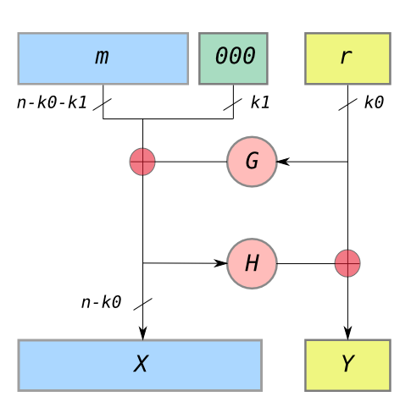
Optimal Asymmetric Encryption Padding (OAEP): Padding
k0 and k1 constants defined in the standard, and G and H are hash functions
The parameter n is the RSA modulus size in bits (e.g., 2048 bits); For 2048-bit RSA with SHA-256, k₀=256, k₁=256
M can only be n - k0 - k1 bits long (shorter than modulus size)
G produces a (n - k0)-bit hash, and H produces a k0-bit hash
Pad M with k0 0’s
Idea: We should see 0’s here when unpadding, or else someone tampered with the message
Generate a random, k0-bit string r; The randomness in r ensures identical messages encrypt differently
Compute X = M || 00...0 ⊕ G(r) (⊕ means XOR)
Compute Y = r ⊕ H(X)
Result: m’ = X || Y
Encrypt m’ using RSA: c = m’^e mod N

Slide 83
OAEP: Unpadding
Decrypt m’ using RSA: m’ = c^d mod N; Split m’ into X and Y: First (n - k₀) bits = X; Last k₀ bits = Y
Compute r = Y ⊕ H(X)
Compute M || 00...0 = X ⊕ G(r)
Verify that M || 00...0 actually ends in k1 0’s
Error if not
The k₁ zero-check detects tampering because attacker cannot predict the correct padding
Return the first (n - k₀ - k₁) bits as message M

Slide 84
OAEP
Even though G and H are irreversible, we can recover their inputs using XOR and work backwards
This structure is called a Feistel network
Can be used for encryption algorithms if G and H depend on a key; Example: DES
Takeaway: To fix the problems with RSA (it’s only secure encrypting random numbers and isn’t semantically secure), use RSA with OAEP, abbreviated as RSA-OAEP

Slide 85
Roadmap
Public-Key Cryptography
RSA Encryption
Hybrid Encryption

Slide 86
Hybrid Encryption
Disadvantages of public-key encryption: Much slower than symmetric-key encryption (~1000-10,000x Difference)
AES-128 (CBC mode): ~150 MB/s (without hardware acceleration)
ChaCha20-Poly1305: 400-720 MB/s (software implementation)
RSA-2048 can encrypt a maximum of ~250 bytes per operation; ~10,000-23,000 public key operations (encryption/verification) per second ➔ 0.25~0.6 MB/s
Advantages of public-key cryptography:
No requirement for a secured channel
Hybrid encryption: Randomly generate a key K, encrypt message under key K using symmetric encryption, and encrypt K using public-key encryption
Now we can encrypt large amounts of data quickly using symmetric encryption, and we still have the benefits of public-key encryption
Almost all cryptographic systems use the idea of hybrid encryption (more or less)

Slide 87
Establishing a Shared Secret
Alice
Bob

Slide 88
Strawman Key Exchange and Data Transfer Protocol
Example: Hybrid protocol with AES as the symmetric cipher
Alice
Bob
Key exchange
(asymmetric, e.g., RSA)
Data encryption
(symmetric, e.g., AES)

Slide 89
Insecure Against MITM
The above protocol is insecure against MITM attacks
Alice
MITM
Bob

Slide 90
CSC 3511 Security and Networking
Week 11, Lecture 1: Digital Signatures, Certificates, and PKI

Slide 91
Roadmap
Digital Signatures and RSA Signature
Certificates and Chain of Trust
Public Key Infrastructure

Slide 92
Cryptography Roadmap
Hash functions
Pseudorandom number generators
Public key exchange (e.g. Diffie-Hellman)
Key management (certificates)

Slide 93
Last Week: Strawman Key Exchange and Data Transfer Protocol
Alice
Bob
Key exchange
(asymmetric, e.g., RSA)
Data encryption
(symmetric, e.g., AES)

Slide 94
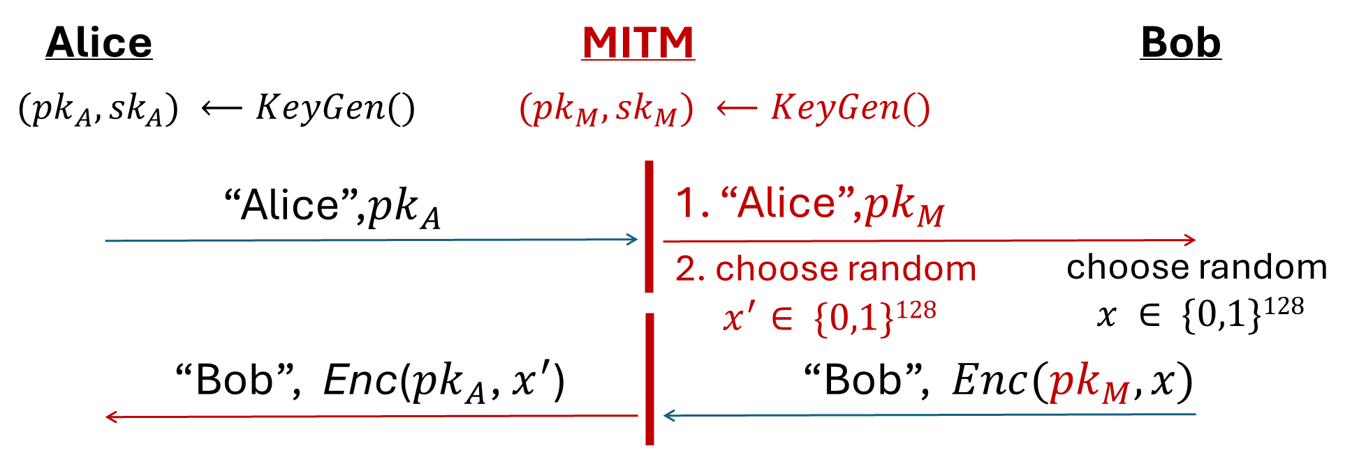
Last Week: MITM Targeting the Strawman Key Exchange and Data Transfer Protocol
The above protocol is insecure against MITM attacks
Root cause: Bob has no way to tell the message is from Alice or Mallory
Solution: Find a way to verify the integrity & authenticity of the received information

Slide 95



Digital Signatures
Digital signatures are the asymmetric way of providing integrity and authenticity to data
Assume that Alice and Bob can communicate public keys without Mallory changing them
We will see how to fix this limitation later using certificates
Only the owner of the private key can sign messages with the private key
Everybody can verify the signature with the public key

Slide 96
Digital Signatures: Definition
Three parts:
KeyGen() → PK, SK: Generate a public/private keypair, where PK is the verify (public) key, and SK is the signing (secret) key
Sign(SK, M) → sig: Sign the message M using the signing key SK to produce the signature sig
Verify(PK, M, sig) → {0, 1}: Verify the signature sig on message M using the verify key PK and output 1 if valid and 0 if invalid
Properties
Correctness: Verification should be successful for a signature generated over any message ➔ Verify(PK, M, Sign(SK, M)) = 1 for all PK, SK ← KeyGen() and M
Efficiency: Signing/verifying should be fast
Security: EU-CPA (existentially unforgeable under chosen plaintext attack)

Slide 97
Defining Integrity: EU-CPA
Mallory may send messages to Alice and receive their tags
Eventually, Mallory creates a message-signature pair (M', sig')
M' cannot be a message that Mallory requested earlier
If sig' is verifies with PK for M', then Mallory wins. Otherwise, she loses.
A scheme is EU-CPA secure if for all polynomial time adversaries, the probability of winning is 0 or negligible
Mallory (adversary)
Alice (challenger)
PK
Keygen(): SK, PK
M
sign(SK, M)
(repeat)
Output (M', sig')

Slide 98
Digital Signatures in Practice: Sign
If you want to sign message M:
First hash message M using cryptographic hash function H() (e.g., SHA-1, SHA-2, etc.)
Then sign (Enc) H(M): Sign(SK, H(M)) → sig
Send M and sig to the receiver
Why do digital signatures use a hash?
Asymmetric encryption/decryption is slow! ➔ “Encrypt” a short message
Allows signing arbitrarily long messages

Slide 99
Digital Signatures in Practice: Verify
sig
M
Jrf843kjfgf*£$&Hdif*7oUsd*&@:<CHDFHSD(**
This is a really really long message about Bob’s bill
If you want to verify the signature of message M:
Decrypt sig using singer’s public key
Hash M using the same cryptographic hash function (e.g., SHA-1, SHA-2, etc.)
Compare results in step 1 and 2
Dec(PK, sig)
Hash Function H(M)
Py75c%bn&*)9|fDe^bDFaq#xzjFr@g5=&nmdFg$5knvMd’rkvegMs”
Py75c%bn&*)9|fDe^bDFaq#xzjFr@g5=&nmdFg$5knvMd’rkvegMs”
Digital signatures provide integrity and authenticity for M
The digital signature acts as proof that the private key holder signed H(M), so you know that M is authentically endorsed by the private key holder
Are they same?
==?
1/0

Slide 100
RSA Signatures: Definition
KeyGen():
Same as RSA encryption:
Public key: N and e
Private key: d
Sign(d, M):
Compute: sig = H(M)d mod N
Verify(e, N, M, sig):
Verify that H(M) ≡ sige mod N
Correctness: sige mod N ≡ H(M)de mod N ≡ H(M) mod N
Because recall xde mod N ≡ x mod N for all x)
Recall RSA encryption: Med ≡ M mod N
Last week:
Enc(e, N, M) → C
Dec(d, C) → M
There is nothing special about using e first or using d first!
If we encrypt using d, then anyone can “decrypt” using e
Given x and xd mod N, can’t recover d because of discrete-log problem, so d is safe

Slide 101
Summary: Public-Key Cryptography
Public-key cryptography: Two keys, private and public
Public-key encryption: One key encrypts, the other decrypts
Security properties similar to symmetric encryption
RSA Enc: Produce a pair e and d such that Med = M mod N
Hybrid encryption: Encrypt a symmetric key, and use the symmetric key to encrypt the message
Digital signatures: Integrity and authenticity for asymmetric schemes
RSA Sigature: Sign (Encrypt) the hash with the private key
Other popular signature schemes: DSA, ECDSA, EdDSA, BLS…

Slide 102
Roadmap
Digital Signatures and RSA Signature
Certificates and Chain of Trust
Public Key Infrastructure

Slide 103
Certificates
Public-key cryptography is great! We can communicate securely without a shared secret
Public-key encryption: Everybody encrypts with the public key, but only the owner of the private key can decrypt
Digital signatures: Only the owner of the private key can sign, but everybody can verify with the public key
How do we know the public key of an entity?
How do we distribute public keys securely?

Slide 104
Problem: Distributing Public Keys
Public-key cryptography alone is not secure against man-in-the-middle attacks

Slide 105
Problem: Distributing Public Keys
Root cause: No mechanism to verify that a public key belongs to its claimed owner
Idea: Sign Bob’s public key to prevent tampering ➔ Do no trust, verify!
Problem: who should sign Bob’s public key?
If Bob signs his public key, we need his public key to verify the signature
But Bob’s public key is what we were trying to verify in the first place!
Chicken-and-egg problem: Alice can never trust any public key she receives
Solution: You cannot gain trust if you trust nothing. You need a root of trust!
Trust anchor: Someone that we implicitly trust (e.g., DNS root name server?)
From our trust anchor, we can begin to trust others

Slide 106
Certificates
Certificate: A signed endorsement (a signature) of someone’s public key and identity/attributes
A certificate contains at least two things: The identity (Alice, Bob, David, etc.) of the person, and the key (PKA, PKB, PKD)
Abbreviated notation
Encryption under Alice’s public key PK: {“Message”}PKA
Signing with Alice’s private key SK: {“Message”}SKA-1
Recall: A signed message must contain the message along with the signature; you can’t check the signature by itself!
Scenario: Alice wants Bob’s public key. Alice trusts EvanBot (PKE, SKE)
EvanBot is our trust anchor (root of trust)
If we trust PKE, a certificate we would trust is {“Bob’s public key is PKB”}SKE-1

Slide 107
Certificates
Q1: How to use EvanBot?
Suppose Alice wants Bob's key. Alice trusts EvanBot (PKE, SKE)
Alice -> EvanBot: "What is Bob's public key?"
EvanBot -> Alice:
Message M: “Bob’s public key is PKB”
Signature: {M}SKE-1
Q2: How to build EvanBot?
Idea 1: Make a central, trusted directory (a powerful server) from where you can fetch anybody’s public key
Idea 2: A hierarchical trust chain

Slide 108
Idea 1: A Central Trusted Directory
Idea: Make a central, trusted directory (TD) from where you can fetch anybody’s public key
The TD has a public/private keypair PKTD, SKTD
The directory publishes PKTD so that everyone knows it (baked into computers, phones, OS, etc.)
When you request Bob’s public key, the directory sends a certificate for Bob’s public key
What do we have to trust?
We have received TD’s key correctly
TD won’t sign a key without verifying the identity of the owner

Slide 109
Idea 1: A Central Trusted Directory
Problem: Scalability
One directory won’t have enough compute power to serve the entire world
Problem: Single point of failure
If the directory fails, services depending on this become unavailable
If the directory is compromised, you can’t trust anyone
If the directory is compromised, it is difficult to recover
Any ideas? ➔ Drawing inspiration from the DNS name server hierarchy

Slide 110
Idea 2: A Hierarchical Trust Chain
Addressing scalability: Hierarchical trust
The root of trust (trusted directory) may delegate trust and signing power to other authorities
{“John Walz’s public key is PKJW, and I trust him to sign for MSOE”}SKTD-1
{“Chris Taylor’s public key is PKCT, and I trust him to sign for the DSAC”}SKJW-1
{“Zhonghao Liao’s public key is PKZL (but I don’t trust him to sign for anyone else)”}SKCT-1
{“Sean Jones’s public key is PKSJ (but I don’t trust him to sign for anyone else)”}SKCT-1
TD is still the root of trust (root certificate authority, or root CA)
JW and CT receive delegated trust (intermediate CAs)
ZL’s identity and public key can be trusted
SJ’s identity and public key can be trusted

Slide 111
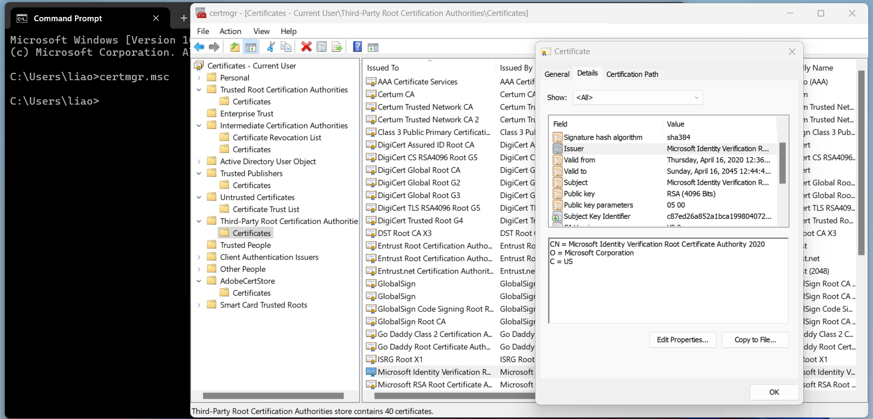
Idea 2: A Hierarchical Trust Chain
Addressing scalability/Single point of failure: Multiple trust anchors
There are ~150 root CAs who are implicitly trusted by most devices
Public keys are hard-coded into operating systems and devices
Each delegation step can restrict the scope of a certificate’s validity
Browse certificates on your machine:
Open cmd and type “certmgr.msc”

Slide 112
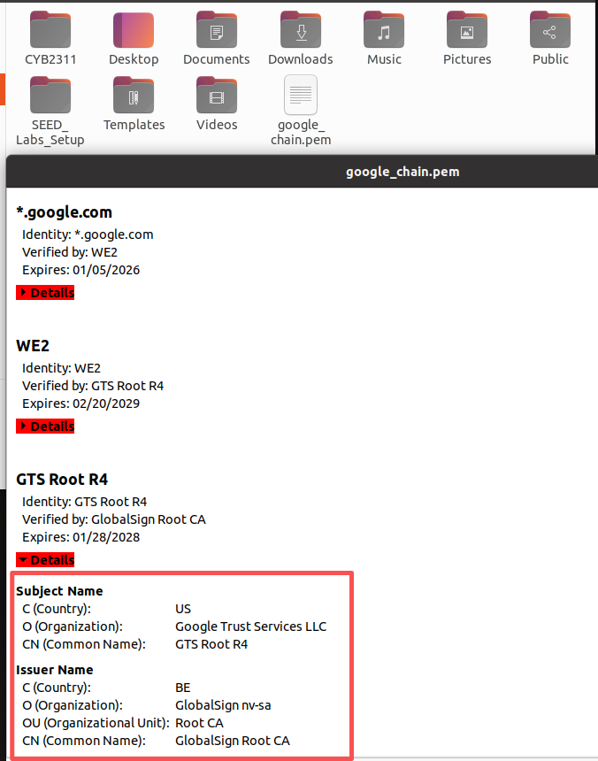
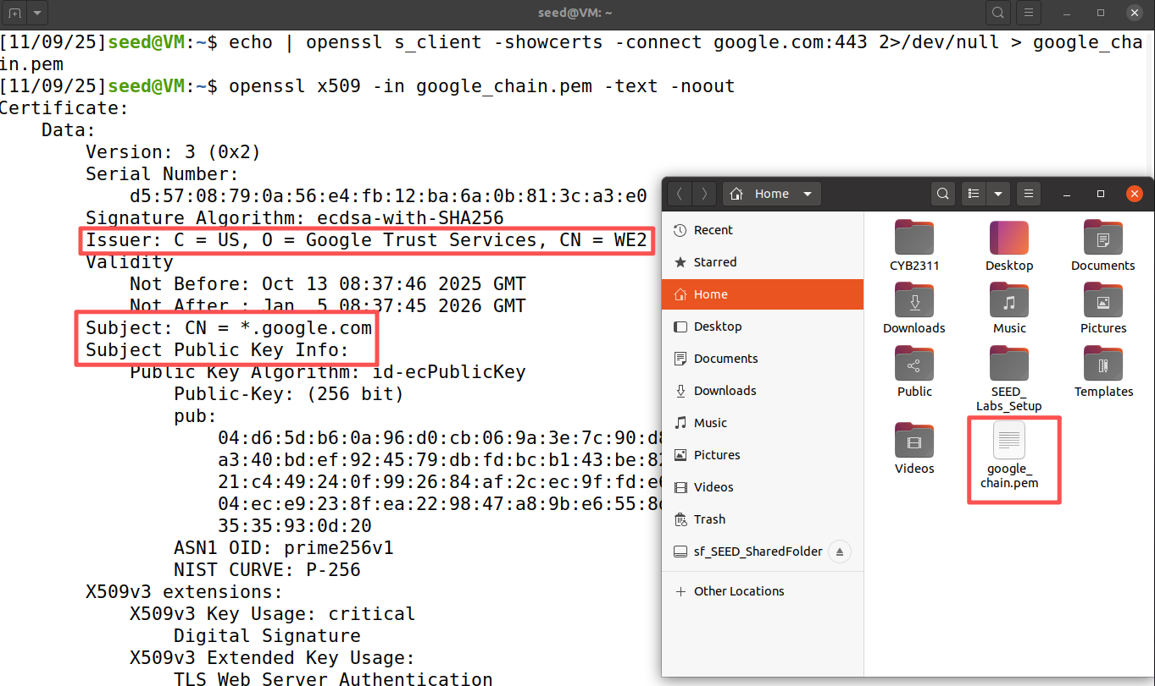
Browse Digital Certificates
Let's use OpenSSL on the SEED virtual machine to obtain Google's certificate chain
# Get the entire certificate chain and save them to the file google_chain.pem
$ echo | openssl s_client -showcerts -connect google.com:443 2>/dev/null > google_chain.pem
# Use the following command decode this file and print the first certificate out
$ openssl x509 -in google_chain.pem -text -noout

Slide 113
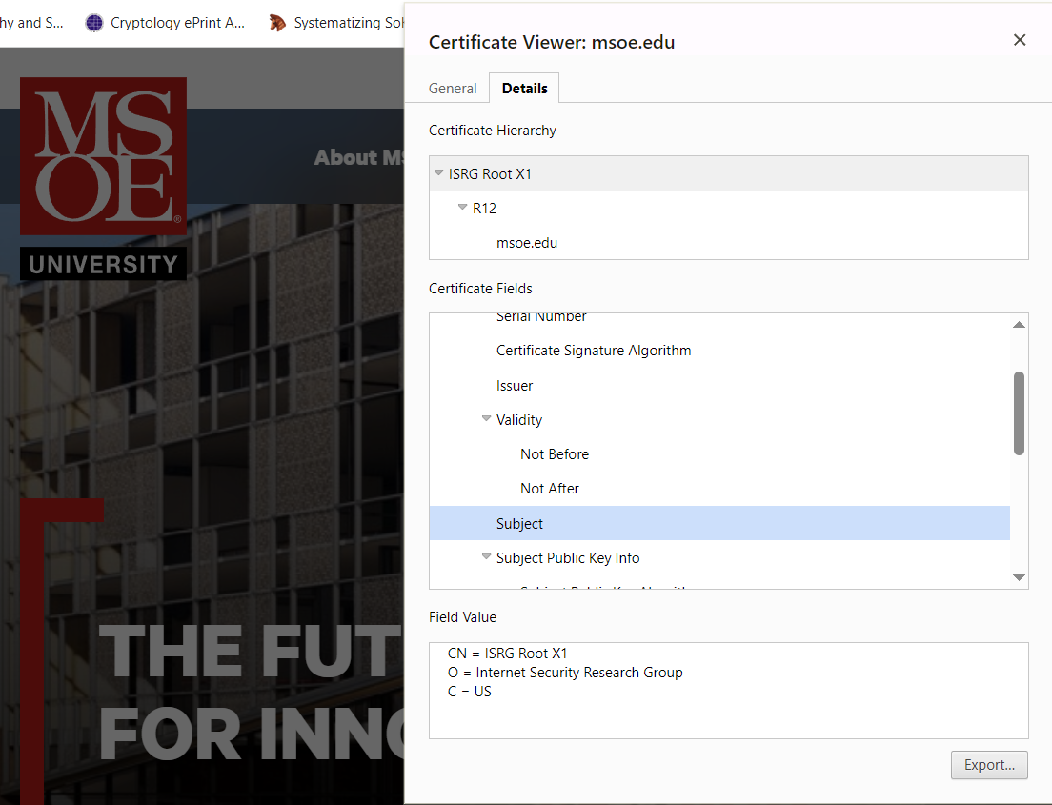
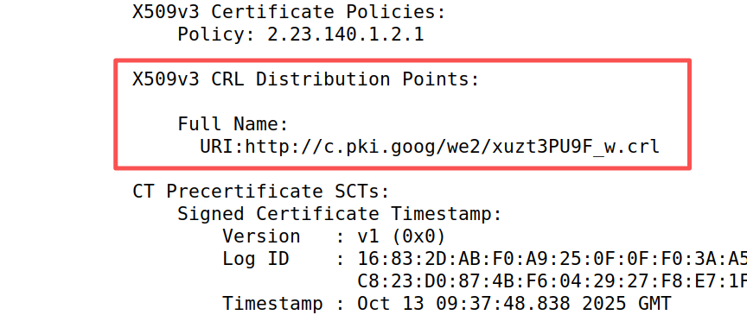
Certificate Validation Process
When you connects to https://www.msoe.edu:
Step 1: Receive Certificate Chain
www.msoe.edu cert
↓ (signed by)
R12 Let’s Encrypt Server CA
↓ (signed by)
ISRG Root CA
Step 2: Validate each certificate
Check validity period: Not expired or not yet valid?
Verify signature
Check revocation: Is this certificate revoked? (certificate revocation list (CRL) )
Verify domain name: Does the certificate match the requested domain?
Check trust chain: Can we trace back to a trusted root CA?

Slide 114
Roadmap
Digital Signatures and RSA Signature
Certificates and Chain of Trust
Public Key Infrastructure

Slide 115
What is PKI?
A comprehensive framework for managing digital certificates and public-key cryptography system
Core Functions:
Create cryptographic keys
Distribute public keys securely
Verify identities
Revoke compromised certificates
Store certificates and keys
Archive historical records

Slide 116
What is PKI?
A comprehensive framework for managing digital certificates and public-key cryptography system
Certificate Authority (CA):
The trusted issuer and signer of digital certificates
Manages certificate lifecycle: issuance, renewal, and revocation
Types: Root CA (self-signed, top-level) and Intermediate CA (delegated authority)
Examples: DigiCert, Let's Encrypt, GlobalSign

Slide 117
What is PKI?
A comprehensive framework for managing digital certificates and public-key cryptography system
Registration Authority (RA):
Validates Certificate Signing Requests (CSRs) for authenticity
Authorizes or rejects certificate requests based on identity verification
Usually, a department or an automated system within the CA company. E.g., Let's Encrypt ACME protocol API

Slide 118
What is PKI?
A comprehensive framework for managing digital certificates and public-key cryptography system
Certificate Repository:
Stores issued certificates and Certificate Revocation Lists (CRLs)
Implemented as web-based databases: When you visit HTTPS sites, server sends certificates
Try this page: https://crt.sh/
A public certificate repository anyone can search!
Search "msoe.edu“: see every certificate ever issued!

Slide 119
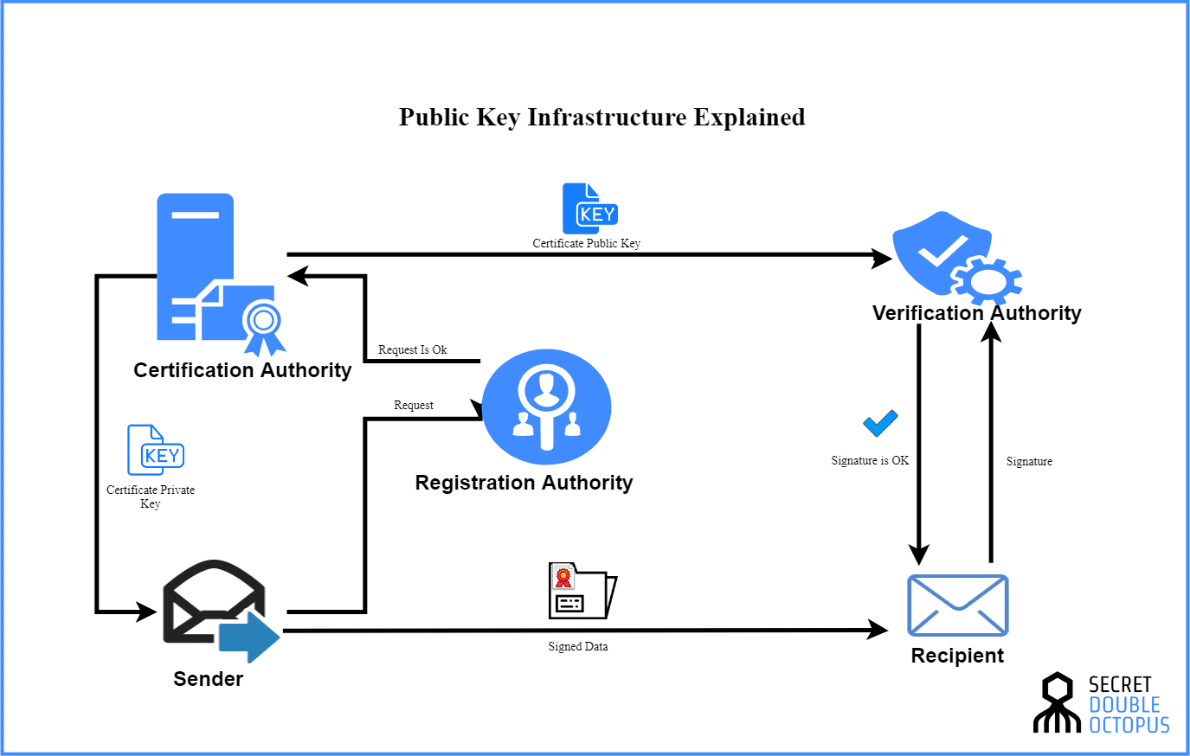
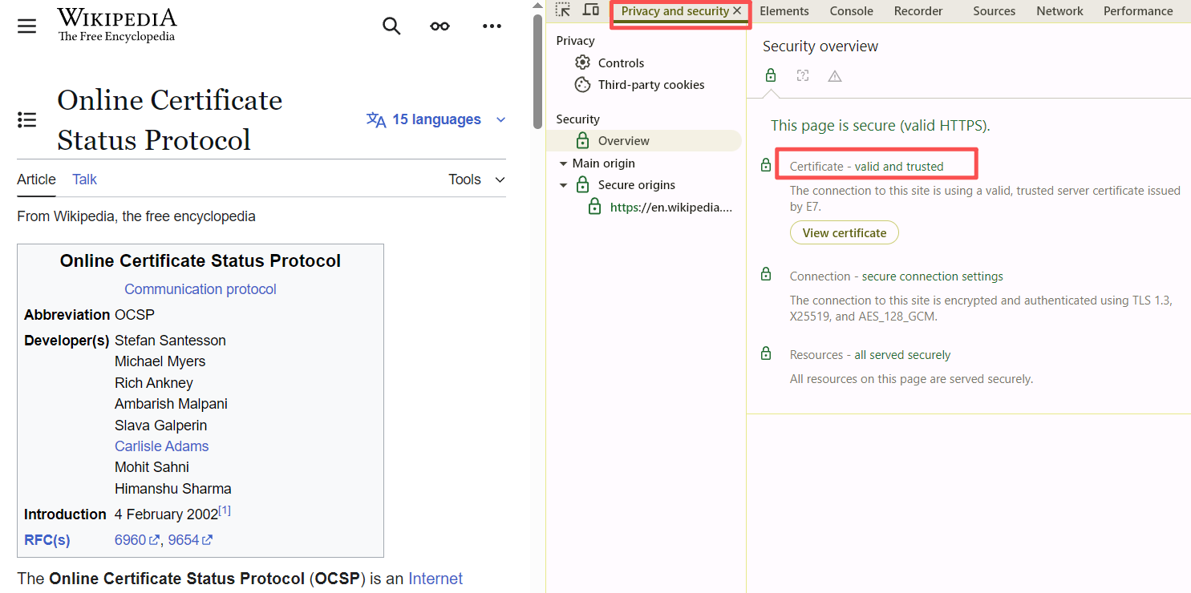
What is PKI?
Verification Authority (VA):
Provides online certificate status checking via OCSP protocol
Responds with certificate status: Valid, Revoked, or Unknown
More efficient than downloading large CRLs
Used by browsers and applications for real-time verification (see in DevTools)
Note: Optional component (some PKIs use only CRLs)

Slide 120
CSC 3511 Security and Networking
Week 11, Lecture 2: Cryptographic Hash, MACs, and Diffie-Hellman Key Exchange

Slide 121
Roadmap
Cryptographic Hash
Message Authentication Codes (MACs)
Diffie-Hellman Key Exchange

Slide 122
Cryptography Roadmap
Hash functions
Pseudorandom number generators
Public key exchange (e.g. Diffie-Hellman)
Key management (certificates)

Slide 123
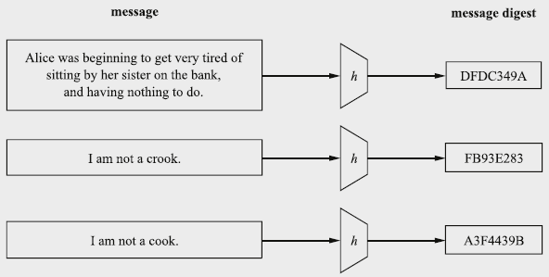
Cryptographic Hash Function: Definition

Slide 124
Cryptographic Hash Function: Properties
Correctness: Deterministic ➔ Hashing the same input always produces the same output
Efficiency: Efficient to compute
Security: Random/unpredictability, no predictable patterns for how changing the input affects the output
Changing 1 bit in the input causes the output to be completely different
Also called “random oracle” assumption
Security: One-way-ness (“preimage resistance”)
Security: Collision-resistance

Slide 125
Hash Function: One-way-ness or Preimage Resistance
Informal description of “One-way-ness”:
Given an output y, it is infeasible to find any input x such that H(x) = y
e.g., SHA-256(a) = ca978112ca1bbdcafac231b39a23dc4da786eff8147c4e72b9807785afee48bb
Here’s an output. Can you find an input that hashes to this output? NO!
Note: The adversary just needs to find any input, not necessarily the input that was actually used to generate the hash
Counterexample: Is H(x) = x2 one-way?
No, because given output 100, an attacker can return a number x, s.t. H(x) = 100

Slide 126
Hash Function: Collision Resistance
Informal description of Collision:
Two different inputs with the same hash value
x ≠ x' and H(x) = H(x’)
Can we design a hash function with no collisions?
No! because there are more inputs than outputs
How many inputs? ➔ Infinite
How large is the output space? ➔ Fixed, e.g., SHA-256(), n = 256, 2256 outputs
However, we want to make finding collisions infeasible for an attacker
Collision resistance: It is infeasible to find any pair of inputs x' ≠ x such that H(x) = H(x')
Intuition: Can you find any two inputs that collide with the same hash output for any output?

Slide 127
Hash Function: Intuition
A hash function provides a fixed-length “fingerprint” over a sequence of bits
Example: Document comparison
If Alice and Bob both have a 1 GB document, they can both compute a hash over the document and (securely) communicate the hashes to each other
If the hashes are the same, the files must be the same, since they have the same “fingerprint”
If the hashes are different, the files must be different
Example: Lab 10, Task 5
Do you remember Bob’s bill? How can Bob prevent Trudy from altering his bills?
Use a Hash function instead of a checksum!

Slide 128
Hash Function: Examples
MD5:
Security: Completely broken
SHA-1:
Security: Completely broken in 2017; Was known to be weak before, but still used sometimes
SHA-2:
Output: 256 (SHA-256), 384, or 512 bits (sometimes labeled SHA-256, SHA-384, SHA-512)
Not currently broken, but some variants are vulnerable to a length extension attack (demo)
Current standard
SHA-3 (Keccak):
Output: 256, 384, or 512 bits
Current standard (not meant to replace SHA-2, just a different construction)
Widely used in the blockchain ecosystem

Slide 129
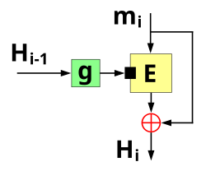
Hash Function: Algorithms
Block cipher-based construction:
e.g, Matyas–Meyer–Oseas
Usually somewhat slower than using a specially designed one-way compression function in the hash function
In some cases, it is easier because a single implementation of a block cipher can be used for both a block cipher and a hash function (e.g., save code space in very tiny embedded systems )
The Matyas–Meyer–Oseas one-way compression function

Slide 130
Does Hash Provide Integrity?
Integrity: An adversary cannot change our messages without being detected
It depends on your threat model. For example:
Alice and Bob want to communicate over an insecure channel
Mallory might tamper with messages
Idea: Use cryptographic hashes
Alice sends her message with a cryptographic hash over the channel
Bob receives the message and computes a hash on the message
Bob checks that the hash he computed matches the hash sent by Alice
Threat model: Mallory can modify the message and the hash
No integrity!
Why? There is no secret key being used as input, so any attacker can compute a hash on any value
Next: Use hashes to design schemes that provide integrity
Alice
Bob
X
H(M’)
M, H(M)
X
M’

Slide 131
Roadmap
Cryptographic Hash
Message Authentication Codes (MACs)
Diffie-Hellman Key Exchange

Slide 132


How to Provide Integrity
Alice and Bob want to communicate over an insecure channel
Reminder: We’re in the symmetric-key setting
Assume that Alice and Bob share a secret key, and attackers don’t know the key
We want to attach some piece of information to prove that someone with the key sent this message
This piece of information can only be generated by someone with the key

Slide 133
Message Authentication Codes (MACs): Usage
Integrity: An adversary cannot change our messages without being detected
Alice wants to send M to Bob, but doesn’t want Mallory to tamper with it
Alice and Bob share a secret key
Alice sends M and T = MAC(K, M) to Bob
Bob receives message, recomputes MAC(K, M) and checks that it matches T
If the MACs match, Bob is confident the message has not been tampered

Slide 134
MACs: Definition
Two parts:
KeyGen() → K: Generate a key K
MAC(K, M) → T: Generate a tag T for the message M using key K
Inputs: A secret key and an arbitrary-length message
Output: A fixed-length tag on the message
Properties
Correctness: Determinism
Note: Some more complicated MAC schemes have an additional Verify(K, M, T) function that don’t require determinism, but this is out of scope
Efficiency: Computing a MAC should be efficient
Security: EU-CPA (existentially unforgeable under chosen plaintext attack)

Slide 135
Defining Integrity: EU-CPA
A secure MAC is existentially unforgeable: without the key, an attacker cannot create a valid tag on a message
Mallory cannot generate MAC(K, M') without K
Mallory cannot find any M' ≠ M such that MAC(K, M') = MAC(K, M)
Formally defined by a security game: existential unforgeability under chosen-plaintext attack, or EU-CPA
MACs should be unforgeable under chosen plaintext attack
Intuition: Like IND-CPA, but for integrity and authenticity
Even if Mallory can trick Alice into creating MACs for messages that Mallory chooses, Mallory cannot create a valid MAC on a message that she hasn't seen before

Slide 136
Defining Integrity: EU-CPA
Mallory may send messages to Alice and receive their tags
Eventually, Mallory creates a message-tag pair (M', T')
M' cannot be a message that Mallory requested earlier
If T' is a valid tag for M', then Mallory wins. Otherwise, she loses.
A scheme is EU-CPA secure if for all polynomial time adversaries, the probability of winning is 0 or negligible
Mallory (adversary)
Alice (challenger)
Keygen(): K
M
MAC(K, M)
(repeat)
Output (M', T')

Slide 137
MAC Instantiation: NMAC (Nested MAC)
Can we use secure cryptographic hashes to build a secure MAC?
Intuition: Hash output is unpredictable and looks random, so let’s hash the key and the message together
KeyGen():
Output two random, n-bit keys K1 and K2, where n is the length of the hash output
NMAC(K1, K2, M):
Output H(K1 || H(K2 || M))
NMAC is EU-CPA secure if the two keys are different
Provably secure if the underlying hash function is secure
Intuition: Using two hashes prevents a length extension attack
Otherwise, an attacker who sees a tag for M could generate a tag for M || M'

Slide 138
MAC Instantiation: HMAC (Hash-based MAC)
Issues with NMAC:
Recall: NMAC(K1, K2, M) = H(K1 || H (K2 || M))
We need two different keys, and the length of the keys must be the same as the length of the hash output (n bits).
HMAC(K, M):
Compute K' as a version of K that is the length of the hash output
If K is too short, pad K with 0’s to make it n bits (be careful with keys that are too short, e.g., < 80 bits, and lack randomness, not recommended)
If K is too long, hash it so it’s n bits
Recommended key length: For example, HMAC-SHA256, a key length of 64 bytes (512 bits) is recommended to achieve the full 256-bit security level
Output H((K' ⊕ opad) || H((K' ⊕ ipad) || M))

Slide 139
MAC Instantiation: HMAC (Hash-based MAC)
HMAC(K, M) = H((K' ⊕ opad) || H((K' ⊕ ipad) || M))
Use K' to derive two different keys
opad (outer pad) is the hard-coded byte 0x5c repeated until it’s the same length as K’
ipad (inner pad) is the hard-coded byte 0x36 repeated until it’s the same length as K’
As long as opad and ipad are different, you’ll get two different keys
For paranoia, the designers chose two very different bit patterns, even though they theoretically need only differ in one bit
HMAC is a hash function, so it has the properties of the underlying hash too:
It is collision resistant
Given HMAC(K, M) and K, an attacker can’t learn M
If the underlying hash is secure, HMAC doesn’t reveal M, but it is still deterministic
You can’t verify a tag T if you don’t have K
The attacker can’t brute-force the message M without knowing K (HMAC-SHA256: 1/2256)

Slide 140
Do MACs provide integrity?
Do MACs provide integrity?
Yes! An attacker cannot tamper with the message without being detected
Do MACs provide confidentiality?
MACs are deterministic ⇒ Same M & K lead to the same tag T
MACs in general have no confidentiality guarantees; they can leak information about the message
Do MACs provide authenticity?
It depends on your threat model
If a message has a valid MAC, you can be sure it came from someone with the secret key, but you can’t narrow it down to one person
If only two people have the secret key, MACs provide authenticity: it has a valid MAC, and it’s not from me, so it must be from the other person

Slide 141
Roadmap
Cryptographic Hash
Message Authentication Codes (MACs)
Diffie-Hellman Key Exchange

Slide 142
The Diffie-Hellman Key Exchange Protocol (informally)
Generate a symmetric cryptographic key over a public channel
Fix a large prime p (e.g. 2048 digits)
Fix an integer (generator) g in {1, …, p}
Alice
Bob
choose random a in {1,…,p-1}
choose random b in {1,…,p-1}
Ba (mod p) = (gb)a =
kAB = gab (mod p)
= (ga)b = Ab (mod p)

Slide 143
Discrete Log Problem and Diffie-Hellman Problem
Assume everyone knows a large prime p (e.g. 2048 bits long) and a generator g
Don’t worry about what a generator g is; just treat it as a number.
Discrete logarithm problem (discrete log problem):
Given g, p, ga mod p for random a, it is computationally hard to find a

Slide 144
Diffie-Hellman Key Exchange Protocol
Public: g, p
Eve
Alice
Bob
Generate a
Calculate ga mod p
Receive gb mod p
Calculate (gb)a mod p
Mallory
Generate b
Calculate gb mod p
Receive ga mod p
Calculate (ga)b mod p
Private parameter
Public parameter
a, ga, gb ⇒ gab
b, ga, gb ⇒ gab
Shared symmetric key is
K=gab
Shared symmetric key is
K=gab

Slide 145
Diffie-Hellman Key Exchange Protocol
Public: g, p
Alice
Bob
Mallory
Q: What if Mallory can actively change messages (malicious attacker)?
Private parameter
Generate a
Calculate ga mod p
Receive gb mod p
Calculate (gb)a mod p
Generate b
Calculate gb mod p
Receive ga mod p
Calculate (ga)b mod p
Public parameter
a, ga, gb ⇒ gab
b, ga, gb ⇒ gab
Shared symmetric key is K=gab
Shared symmetric key is K=gab

Slide 146

Diffie-Hellman: Man-in-the-middle Attack
Alice
Mallory
Bob
Public: g, p
Generate a
Calculate ga mod p
Receive gm mod p
Calculate (gm)a mod p
Generate b
Calculate gb mod p
Receive gm mod p
Calculate (gm)b mod p
Generate m
Calculate gm mod p
Receive ga mod p
Calculate (ga)m mod p
Receive gb mod p
Calculate (gb)m mod p
a, ga, gm ⇒ gam
m, gm, ga ⇒ gam
m, gm, gb ⇒ gbm
b, gb, gm ⇒ gbm

Slide 147
Diffie-Hellman: Issues
Issues:
No Authentication: DH doesn't verify who you're exchanging keys with
Vulnerable to Man-in-the-Middle (MITM) attacks
Active Protocol: Both parties must be online simultaneously
Cannot encrypt a message for someone who's offline
Solutions to MITM Attacks:
Digital Signatures: Sign DH public parameters (ga mod p, gb mod p) with certificate-based authentication
Used in TLS/HTTPS (next week)
Pre-Shared Keys (PSK): Authenticate DH public parameters using MAC
PSK provides authentication, DH provides forward secrecy
Used in VPNs and IoT devices

Slide 148
Summary: Diffie-Hellman Key Exchange
Algorithm:
Alice chooses a and sends ga mod p to Bob
Bob chooses b and sends gb mod p to Alice
Their shared secret is (ga)b = (gb)a = gab mod p
Diffie-Hellman provides forward secrecy: Nothing is saved or can be recorded that can ever recover the key
Forward secrecy (aka Perfect forward secrecy): a cryptographic feature that ensures past encrypted communications remain secure even if current session keys or long-term private keys are compromised
Diffie-Hellman can be performed over other mathematical groups, such as Elliptic-curve Diffie-Hellman (ECDH)
Issues
Does not provide authenticity
Not secure against MITM
Both parties must be online

Slide 149
CSC 3511 Security and Networking
Week 12, Lecture 1: Transport Layer Security

Slide 150
Roadmap
Transport Layer Security (TLS)
TLS Handshake Protocol
TLS: Security Guarantees and Summary
TLS: Application (HTTPS)

Slide 151
Recap: TCP and UDP
Transmission Control Protocol (TCP): Reliably sending packets
Provides reliability, ordering, and byte stream abstraction
3-way handshake
Packet’s sequence number and ACK number
Flow control and congestion control
Attack: TCP DoS attack by launching a SYN Flooding attack
Attack: TCP reset attack by injecting TCP Reset (RST) packets
Blind attacks must guess the client’s or server’s sequence numbers
Attack: TCP session hijacking attack through data injection
Blind attacks must guess the client’s or server’s sequence numbers
User Datagram Protocol (UDP): Non-reliably sending packets
No reliability or ordering, only datagram abstraction
Similar injection and spoofing attacks as TCP, but easier

Slide 152
Transport Layer Security (TLS)
TLS (Transport Layer Security): A protocol for creating a secure communication channel over the Internet
Replaces SSL (Secure Sockets Layer), which is an older version of the protocol
TLS is built on top of TCP
Relies upon: Byte stream abstraction between the client and the server
Provides: Byte stream abstraction between the client and the server
The abstraction appears the same to the end client, but TLS provides confidentiality, integrity and (server) authenticity!

Slide 153
Secure Internet Communication: Goals of TLS
Confidentiality: Ensure that attackers cannot read your traffic
Symmetric encryption
Protects against eavesdropping
Integrity: Ensure that attackers cannot tamper with your traffic
HMAC
Prevent replay attacks ➔ The attacker records encrypted traffic and then replays it to the server
Example: Replaying a packet that sends “Pay $10 to Mallory”
Authenticity: Make sure you’re talking to the legitimate server
Asymmetric encryption/Digital signature & Certificate
Defend against an attacker impersonating the server
Prevents man-in-the-middle (MITM) attacks

Slide 154
Roadmap
Transport Layer Security (TLS)
TLS Handshake Protocol
TLS: Security Guarantees and Summary
TLS: Application (HTTPS)

Slide 155
TLS Handshake Step 1: Exchange Hellos
Assume an underlying TCP connection has already been formed; Use TLS 1.2 as an example.
The client sends ClientHello with
A 256-bit random number RC (“client random”)
A list of supported cryptographic algorithms (Cipher Spec)
The server sends ServerHello with
A 256-bit random number RS (“server random”)
The algorithms to use (chosen from the client’s list)
RC and RS prevent replay attacks
RC and RS are randomly chosen for every handshake
This guarantees that two handshakes will never be exactly identical

Slide 156
TLS Handshake Step 2: Certificate
The server sends its certificate
Recall certificates: The server’s identity and public key (PKserver), signed by a trusted certificate authority (CA)
The client validates the certificate
Verify the signature in the certificate
The client now knows the server’s public key
The client is not yet sure that they are talking to the legitimate server (not an impersonator)
Recall: Certificates are public. Anyone can provide a certificate for anybody

Slide 157
TLS Handshake Step 3: Premaster Secret
This step has two main purposes
Make sure the client is talking to the legitimate server (not an impersonator)
The attacker can collect legitimate certificates
The server must prove that it owns the private key corresponding to the public key in the certificate
Give the client and server a shared secret
An attacker should not be able to learn the secret
This will help the client and the server secure messages later
Two approaches to sharing a premaster secret: RSA or Diffie-Hellman (DHE)

Slide 158
TLS Handshake Step 3: Premaster Secret (RSA)
The client randomly generates a premaster secret (PS)
The client encrypts PS with the server’s public key and sends it to the server
The client knows the server’s public key from the certificate
The server decrypts the premaster secret PS
The client and server now share a secret
Recall RSA encryption: Nobody except the legitimate server can decrypt the premaster secret
Proves that the server owns the private key (otherwise, it could not decrypt PS)

Slide 159
Recap: Diffie-Hellman Key Exchange
Public: g, p
Alice
Eve
Bob
Generate a
Calculate ga mod p
Receive gb mod p
Calculate (gb)a mod p
Mallory
Generate b
Calculate gb mod p
Receive ga mod p
Calculate (ga)b mod p
Private
Public
a, ga, gb ⇒ gab
b, ga, gb ⇒ gab
Shared symmetric key is
K=gab
Shared symmetric key is
K=gab

Slide 160
TLS Handshake Step 3: Premaster Secret (DHE)
The server generates a secret a and computes ga mod p
The server signs ga mod p with its private key (SKserver) and sends the message and signature
The client verifies the signature
PKI and chain of certificates
Proves that the server owns the private key
The client generates a secret b and computes gb mod p
The client and server now share a premaster secret (PS): gab mod p
Recall Diffie-Hellman: an attacker cannot compute gab mod p

Slide 161
TLS Handshake Step 4: Derive Symmetric Keys
The server and client each derive symmetric keys from random numbers RC, RS, and premaster secret PS
Usually derived by seeding a PRNG (reproducible random numbers) with the three values
Changing any of the values results in different symmetric keys
Four symmetric keys are derived
CC: For encrypting client-to-server messages
CS: For encrypting server-to-client messages
IC: For MACing client-to-server messages
IS: For MACing server-to-client messages
Note: Both client and server know all four keys

Slide 162
TLS Handshake Step 5: Exchange MACs
The server and client exchange MACs on all the messages of the handshake so far
Recall MACs: Any tampering on the handshake will be detected
Not to be confused with MAC addresses
Why Do We Need This Step
Ensures message integrity & Validates key agreement:
Verifying that no tampering occurred during the handshake process
Synchronization:
Confirming that both the client and server agree on the handshake messages and cryptographic parameters

Slide 163
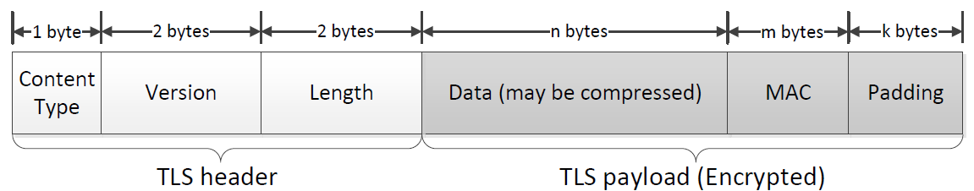
TLS Handshake Step 6: Send Messages
Messages can now be sent securely
Encrypted AND MAC’d
Note: TLS (up to version 1.2) uses MAC-then-encrypt, as shown in the right figure
Modern cryptographic best practices favor Encrypt-then-MAC, where the message is first encrypted, and the MAC is calculated over the ciphertext. Send ciphertext and MAC
This is generally considered more secure but is not used in earlier versions of TLS for legacy compatibility

Slide 164
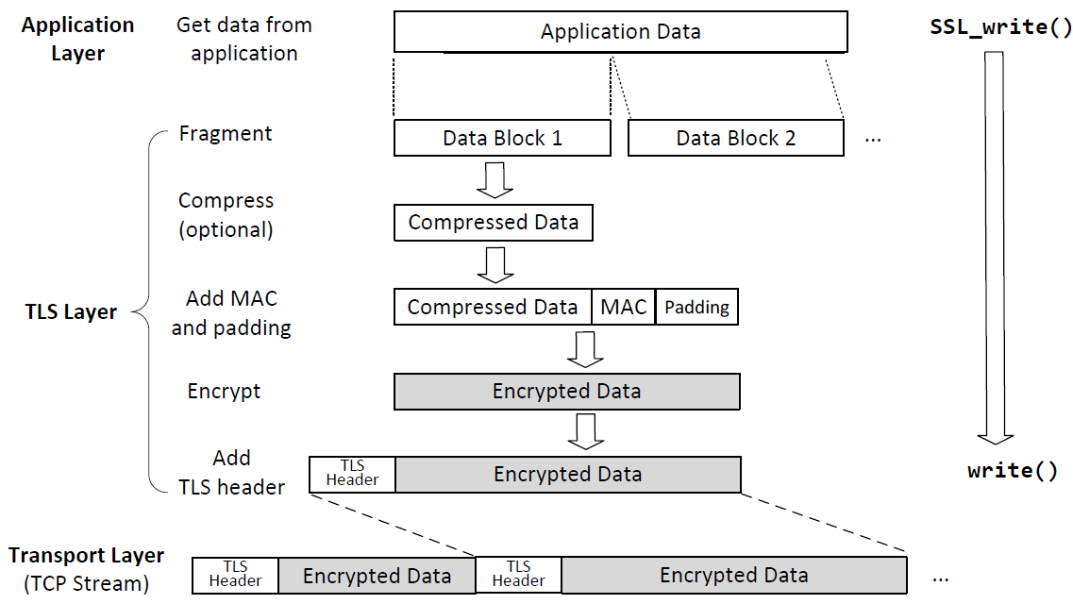
Sending Data with the TLS Protocol
TCP Header: Contains transport-layer metadata (e.g., ports, sequence numbers)
TCP Payload: Includes the TLS Header (unencrypted) and the Encrypted Data

Slide 165
Roadmap
Transport Layer Security (TLS)
TLS Handshake Protocol
TLS: Security Guarantees and Summary
TLS: Application (HTTPS)

Slide 166
TLS: Talking to the Legitimate Server
How can we be sure we are talking to the legitimate server (server authentication)?
The server sent its certificate, so we know the server’s public key
The server proved that it owns the corresponding private key
RSA: The server decrypted the PS
DHE: The server signed its half of the exchange
An attacker impersonating the server would not have the server’s private key (assuming they have not compromised the server)
Client
Server
ClientHello
ServerHello
Certificate
{ga mod p}SK-1server
Or RSA exchange
gb mod p
{M, MAC(IC, M)}CC
{M, MAC(IS, M)}CS

Slide 167
TLS: Securing Messages
How can we be sure that network attackers can’t read or tamper with our messages?
The attacker doesn’t know PS
RSA: PS was encrypted with the server’s public key
DHE: An attacker cannot learn the Diffie-Hellman secret
The symmetric keys are derived from PS
The attacker doesn’t know the symmetric keys used to encrypt and MAC messages
Encryption and MACs provide confidentiality and integrity
Client
Server
ClientHello
ServerHello
Certificate
{ga mod p}SK-1server
Or RSA exchange
gb mod p
{M, MAC(IC, M)}CC
{M, MAC(IS, M)}CS

Slide 168
TLS: Replay Attacks
Client
Server
How can we be sure that the attacker hasn’t replayed old encrypted messages from a past TLS connection?
Replaying a packet that sends “Pay $10 to Mallory”
Every handshake uses a different RC and RS
The symmetric keys are derived from RC and RS
The symmetric keys are different for every connection
ClientHello
ServerHello
Certificate
{ga mod p}SK-1server
Or RSA exchange
gb mod p
{M, MAC(IC, M)}CC
{M, MAC(IS, M)}CS

Slide 169
TLS: Replay Attacks
How can we be sure that the attacker hasn’t replayed old messages from the current TLS connection?
Add record numbers (in the encrypted TLS message)
Every message uses a unique record number (used in MAC calculation, not explicitly transmitted)
If the attacker replays a message, the record number will be repeated
TLS record numbers are not TCP sequence numbers
Record numbers are used for security: ensure M is not replayed or reordered by attackers
Sequence numbers are used for correctness, in the layer below
Client
Server
ClientHello
ServerHello
Certificate
{ga mod p}SK-1server
Or RSA exchange
gb mod p
{M, MAC(IC, M)}CC
{M, MAC(IS, M)}CS

Slide 170
TLS: Forward Secrecy
Forward secrecy: If an attacker records a connection now and compromises secret values later, they cannot compromise the recorded connection
RSA TLS: No forward secrecy is guaranteed
The adversary can record RC, RS, and the encrypted PS
If the adversary later compromises the server’s private key, they can decrypt PS and derive the keys!
TLS Handshake Step 3: Premaster Secret (RSA)

Slide 171
TLS: Forward Secrecy
Forward secrecy: If an attacker records a connection now and compromises secret values later, they cannot compromise the recorded connection
DHE TLS: Guaranteed forward secrecy
Diffie-Hellman provides forward secrecy: ga is deleted after the TLS session is over
Adversary can’t learn the keys, even if they later compromise the server’s private key
TLS Handshake Step 3: Premaster Secret (DHE)

Slide 172
TLS Provides End-to-End Security
TLS provides end-to-end security: Secure communication between the two endpoints, with no need to trust intermediaries
End-to-end security does not help if one of the endpoints is malicious (e.g. communicating with a malicious server)
Even if everybody between the client and the server is malicious, TLS provides a secure communication channel
Example: A local network attacker (on-path) tries to read our Wi-Fi session, but can’t read TLS messages
Example: A man-in-the-middle tries to inject TCP packets, but packets will be rejected because the MAC won’t be correct
Using TLS defends against most lower-level network attacks

Slide 173
TLS 1.3 Changes
TLS 1.3: The latest version of the TLS protocol (2018)
RSA no longer supported (only DHE)
Guarantees forward secrecy
Performance optimization: The client sends gb mod p in ClientHello
If the server agrees to use DHE, the server sends ga mod p (with signature) in ServerHello message
Potentially saves two messages later in the handshake
Only supports AEAD mode encryption
AEAD (authenticated encryption with additional data): a block cipher mode that guarantees confidentiality and integrity at the same time
Eliminates attacks associated with the insecure MAC-then-encrypt pattern

Slide 174
TLS Does Not Provide Anonymity
Anonymity: Hiding the client’s and server’s identities from attackers
An attacker can figure out who is communicating with TLS
The certificate is sent during the TLS handshake, containing the server’s name
The client may also indicate the name of the server in the ClientHello (called Server Name Indication, or SNI)
An attacker can see IP addresses and ports of the underlying IP and TCP protocols

Slide 175
TLS Does Not Provide Availability
Availability: Keeping the connection open in the face of attackers
An attacker can stop a TLS connection
MITM can drop encrypted TLS packets
On-path attacker can still do RST injection to abort the underlying TCP connection
Result: A TLS connection can still be censored
The censor can block TLS connections

Slide 176
TLS: Summary
TLS Handshake
Nonces make every handshake different (prevents replay attacks across connections)
Certificate proves server’s public key
RSA or DHE proves that the server owns the private key
RSA or DHE helps client and server agree on a shared secret key
MAC exchange ensures no one tampered with the handshake
Messages are sent with symmetric encryption and MACs
TLS record numbers prevent replay attacks within a connection
Client
Server
ClientHello
ServerHello
Certificate
{ga mod p}SK-1server
Or RSA exchange
gb mod p
{M, MAC(IC, M)}CC
{M, MAC(IS, M)}CS

Slide 177
TLS Handshake Protocol: Workflow
See the slide notes at the bottom of this page for details

Slide 178
Roadmap
Transport Layer Security (TLS)
TLS Handshake Protocol
TLS: Security Guarantees and Summary
TLS: Application (HTTPS)

Slide 179
TLS for Applications
TLS provides services to higher layers (the application layer)
HTTPS: The HTTP protocol run over TLS
In contrast, HTTP runs over plain TCP, with no TLS added
Other secure application-layer protocols besides HTTPS exist
Pretty much anything that runs over TCP can also run over TLS, since the byte stream abstraction is maintained
Example: Email protocol can use the STARTTLS command to uses TLS to secure communications
TLS does not defend against application-layer vulnerabilities
Example: SQL injection, XSS, CSRF, and buffer overflow vulnerabilities in the application are still exploitable over TLS

Slide 180

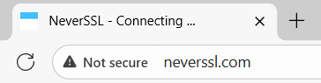
TLS in Browsers
Original design:
When your browser communicates with a server over TLS, your browser displays a lock icon
If TLS is not used, there is no lock icon
What the lock icon means
Communication is encrypted (TLS guarantee)
You are talking to the legitimate server (TLS guarantee)
Any external images or scripts are also fetched over TLS
This website uses HTTP: no lock icon
This website uses HTTPS: lock icon

Slide 181
CSC 3511 Security and Networking
Week 12, Lecture 2: DNS Security

Slide 182
Roadmap
Review
DNS over TLS
DNSSEC: Design Ideas
DNSSEC: Implementation
DNS Security: Summary

Slide 183
Week 3 Lecture 1: DNS
Stub Resolver
(Laptop)
. (root)
Root
Recursive Resolver
(Router)
.edu
.org
.com
TLD
msoe.edu
mit.edu
cs101.org
piazza.com
google.com
Authoritative

Slide 184
Week 9 Lecture 1: DNS Cache Poisoning Attacks
Cache poisoning attack:
Returning a false information into the DNS cache
The victim will cache the malicious records, “poisoning” it
Later, DNS queries return an incorrect response, and users are directed to the wrong websites
Example: Supply a malicious record mapping the attacker’s IP address to a legitimate domain
Now when the victim visits google.com, they’ll actually be sending packets to the attacker (6.6.6.6), who can launch the MITM attack!

Slide 185
Week 9 Lecture 1: Kaminsky Attack
What is the IP address of fake_photo.google.com
2a
.(root)
Attacker’s client
1
Victim Recursive Resolver
3
4
.com
2b
5
Attacker’s name server
6
7
google.com
Flood of forged answers with randomly guessed Query IDs
“fake_photo.google.com doesn’t exist! This response has ID 774.”

Slide 186
Roadmap
Review
DNS over TLS
DNSSEC: Design Ideas
DNSSEC: Implementation
DNS Security: Summary

Slide 187
Securing DNS Lookups: What do we Really Need?
We want integrity on the response
Recall: Integrity means an attacker can’t tamper with the results
Prevent cache poisoning attacks through cryptographic verification
We want authenticity on the response
Recall: Authenticity means verifying the response came from the legitimate DNS server
Mitigate Kaminsky attacks and MITM attacks
We do not need confidentiality on the response
DNS results are public: The attacker can always look up the results themselves!
Even if the attacker couldn’t see the DNS response, they can see which IP you connect to later (source and destination IPs are visible regardless, really?)
DNS queries leak information about user activities to network observers

Slide 188
DNS over TLS
DNS over TLS (DoT) is one way to send DNS queries over an encrypted connection
Idea: TLS is end-to-end secure, so let’s send all DNS requests and responses over TLS
DNS traditionally uses UDP (port 53), but can use TCP; DoT uses TLS over TCP (port 853)
Two resolvers make a TLS connection; DoT encrypts the link between resolvers.
Optional: Recursive resolver MAY use DoT when querying authoritative servers (not widely deployed)
Does DoT solve our problems?

Slide 189
DNS over TLS: Issues
Performance: DNS needs to be lightweight and fast
Recall: TLS requires a long handshake
Security: DoT only secures the link between the stub resolver and the recursive resolver
Malicious RR has full MITM capability
Can modify any responses before encryption
User must trust their recursive resolver
Security: DoT doesn't authenticate authoritative responses
Active attackers can still poison the DNS cache
No cryptographic verification of DNS data

Slide 190
DNS over TLS in Practice
Implemented by Google and Cloudflare:
Google Public DNS (8.8.8.8): DoT available on port 853
Cloudflare (1.1.1.1): DoT available on port 853
Want to try DoT? Install Knot DNS tools on SEED VM and follow Cloudflare tutorial
Benefits:
Prevents on-path tampering of DNS traffic
Modern networks minimize TLS overhead (TLS 1.3); The overhead is not a big deal.
Limitations:
Only defends against network attackers
Malicious recursive resolver can still poison responses
Does not authenticate DNS data from authoritative name servers
DNS over TLS is not enough to fully secure DNS!

Slide 191
DNS over TLS: Object Security and Channel Security
Channel security: Securing the communication channel between two end hosts
Provides confidentiality/integrity/authenticity/anonymity for data in transit
For example: TLS, VPN
Object security: Securing the data itself (in transit or in storage)
Data is encrypted/signed/verified
For example: Encryption, Digital Signature
Main problem of DNS over TLS:
DoT provides channel security (stub resolver and recursive resolver)
To fully secure DNS, we need object security:
Cryptographically sign DNS records at the source
Verify signatures at the user (stub resolver), regardless of intermediaries
This is what DNSSEC provides

Slide 192
Roadmap
Review
DNS over TLS
DNSSEC: Design Ideas
DNSSEC: Implementation
DNS Security: Summary

Slide 193
DNSSEC
DNSSEC (DNS Security Extensions): An extension of the DNS protocol that ensures integrity and authenticity on the results
Designed to cryptographically prove that returned answers are correct
Uses a hierarchical, distributed trust system to validate records
DNSSEC is backwards-compatible
DNSSEC is built on top of ordinary DNS
Some, but not all name servers support DNSSEC
DNSSEC Visualization tool: DNSViz | A DNS visualization tool

Slide 194
DNSSEC from Scratch: Let’s Build it Together
Question 1: What kind of cryptographic primitive should we use to ensure integrity on the DNS records?
MACs (symmetric-key) or digital signatures (public-key)
Digital signatures are the best solution: We want everyone to be able to verify integrity (not just the people with the symmetric key)
Question 2: How do we ensure the returned record is authentic?
The name servers should sign the record with their private key
Users verify the record with the name servers’ public key

Slide 195
DNSSEC from Scratch: Let’s Build it Together
Question 3: What does the name server need to send in order to ensure authenticity and integrity on a record?
The DNS record
A signature over the record, signed with the name server’s private key
The name server’s public key
How do we make sure nobody tampered with the public key?
Chain of trust! (but DNSSEC does not use PKI)

Slide 196
DNSSEC from Scratch: Let’s Build it Together
Question 4: PKIs need a trust anchor. Who do we implicitly trust in DNSSEC?
We implicitly trust the top of the certificate hierarchy, which is the root name server
The root name server’s public key (self-signed) is hard-coded into resolvers
Question 5: How does a name server delegate trust to a child name server?
Just like in a certificate chain, the parent sign the child’s public key
If you trust the parent name server, then now you trust the child name server

Slide 197
Roadmap
Review
DNS over TLS
DNSSEC: Design Ideas
DNSSEC: Implementation
DNS Security: Summary

Slide 198
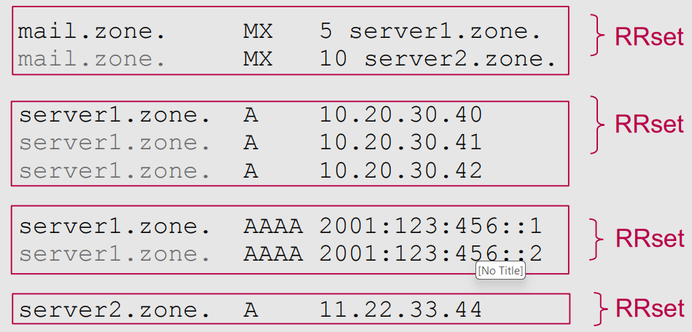
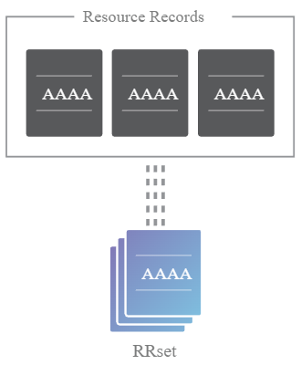
Resource Record Sets (RRSETs)
Recall: A DNS resource record has a fixed format
RR format: (name, [TTL], class, type, value)
E.g.,: edu. 172800 IN NS a.edu-servers.net
In DNSSEC: A group of DNS records with the same name and type form a Resource Record Set (RRset)
Example: All the type AAAA records for a given domain
Example: All the DNSKEY records
RRSETs will be useful for simplifying signatures
Instead of signing every record separately, name server can sign an entire RRset at once

Slide 199
New DNSSEC Record Types
We need new record types to send cryptographic information in DNSSEC packets
DNSKEY:
Contains the name server’s own public keys
DS (delegated signer):
The parent signs the DS record to delegate trust to child
Contains the signer’s (owner’s) name
Contains the hash of child’s public keys
RRSIG (resource record signature):
Contain a Type Covered field that specifies which type of record it covers
RRSIG (covering DNSKEY): Contains a signature on DNSKEY records
RRSIG (covering DS): Contains a signature on DS records
RRSIG (covering A and AAAA): Contains a signature on resource records (sign an entire RRset )
Note: DNSSEC requires a significant amount of metadata; the above description is oversimplified!

Slide 200
DNSSEC Lookup Steps
Recall: We implicitly trust the top of the certificate hierarchy, which is the root name server
Recall: The root name server’s public key (self-signed) is hard-coded into resolvers

Slide 201
DNSSEC Lookup Steps
Recall: We implicitly trust the top of the certificate hierarchy, which is the root name server
Recall: The root name server’s public key (self-signed) is hard-coded into resolvers

Slide 202
DNSSEC Lookup Steps
Recall: We implicitly trust the top of the certificate hierarchy, which is the root name server
Recall: The root name server’s public key (self-signed) is hard-coded into resolvers

Slide 203
New DNSSEC Keys
Problem 1: What if a name server wants to change its key pair?
A key change is necessary if, for example, an attacker steals the private key of a name server.
Option 1: Notify its parent name server; the parent change the DS record
Synchronization and communication cost
Time consuming and easily go wrong

Slide 204
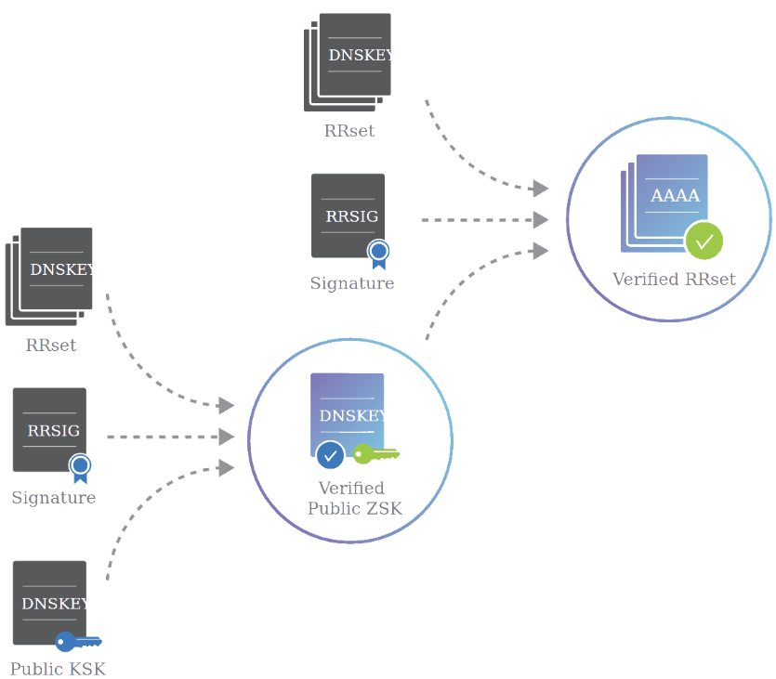
New DNSSEC Keys
Option 2: Each DNSSEC name server generates two public/private key pairs
Key signing key (KSK): sign the zone signing key
Zone signing key (ZSK): sign everything else (e.g., RRset)
Name server sends:
The public KSK (endorsed by the parent)
The public ZSK
A signature on the public ZSK (signed by KSK)
The DNS resolver:
Uses the public KSK to verify the signature
Accepts the public ZSK
Uses ZSK to verify RRSIG and accepts RRSET

Slide 205
DNSSEC: Trust Delegation
KSK is the “parent” and the ZSK is the “child”; both within one name server
KSK endorses the ZSK by signing the public ZSK
Each color (blue, green, orange) represents a name server
The lighter shade represents records signed with the KSK
The darker shade represents records signed with the ZSK
DS (delegated signer):
Contains the signer’s (owner’s) name
Contains the hash of child’s public keys

Slide 206
DNSSEC: Trust Delegation
Verification process:
Trust anchor:
Root KSK is hard-coded in resolvers
Root KSK signs DNSKEY RRset, so we can verify root’s ZSK
Dark blue:
We trust the root’s ZSK. The root’s ZSK signs the hash of .edu’s KSK, so now we can verify .edu’s KSK.
Note: the root’s ZSK also signs its own NS RRset at the zone
Steps 6-10: Similar as steps 1-5.

Slide 207
DNSSEC: Trust Delegation
Verification process:
msoe.edu name server:
Light orange: We verify the msoe.edu’s KSK; msoe.edu’s KSK signs msoe.edu’s ZSK; So now we trust msoe.edu’s ZSK (12-13).
Dark orange: We trust msoe.edu’s ZSK. msoe.edu’s ZSK signs the type A answer records, so we trust the final answer.

Slide 208
DNSSEC: Offline Signature Generation
Problem 2: DNS is designed to be fast and lightweight.
However, public-key cryptography is slow!
Solution: Offline signatures ➔ The name server computes signatures (for RRSET, DNSKEY) in advance; serves the signatures when they are needed
Benefit: Efficiency
Generating a signature each time a user requests it is slow (and can lead to DoS attacks)
Benefit: Availability and Security
Redundancy: One secure signature generation system, and many mirrored name servers providing the same records and signatures
If the signature generation system is separate from the name server, compromising the name server is not enough!

Slide 209
DNSSEC: Signing Non-Existent Domains
Problem 3: What if the user queries for a domain that doesn’t exist?
Option 1: Don’t authenticate nonexistent domain (NXDOMAIN) responses
Issue: If NXDOMAIN responses don’t have to be signed, the attacker can still spoof NXDOMAIN responses and cause denial-of-service (DoS)
Option 2: Keep the private key in the name server, ask it signs NXDOMAIN responses
Issue: Signing in real time is slow
Issue: Name servers stores the private key, which is an issue if they are malicious or hacked
We need a way that can prove that a domain doesn’t exist ahead of time

Slide 210
New DNSSEC Record Types: NSEC
NSEC (and NSEC3, and NSEC5): Prove nonexistence of a DNS record
NSEC record: Next Secure Record
Provide two adjacent domains alphabetically, so that the resolver knows that no domain in the middle exists
For example, suppose a website has 3 subdomains (hostnames):
b.example.com g.example.com q.example.com
Query for “c.example.com”, name server returns a signed NSEC record: “No domains exist between b.example.com and g.example.com”
Query for “x.example.com”, name server returns a signed NSEC record: “No domains exist between q.example.com and b.example.com” (wrapping around from z to a)

Slide 211
Roadmap
Review
DNS over TLS
DNSSEC: Design Ideas
DNSSEC: Implementation
DNS Security: Summary

Slide 212
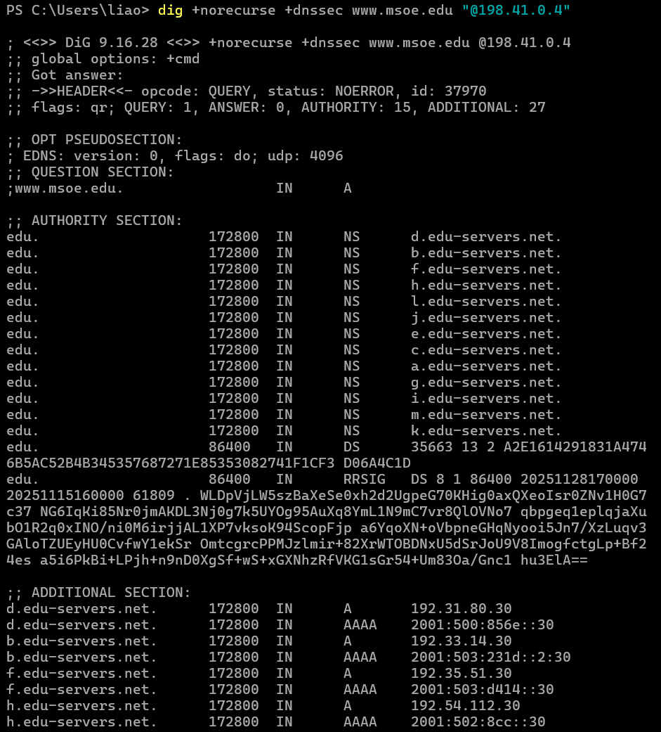
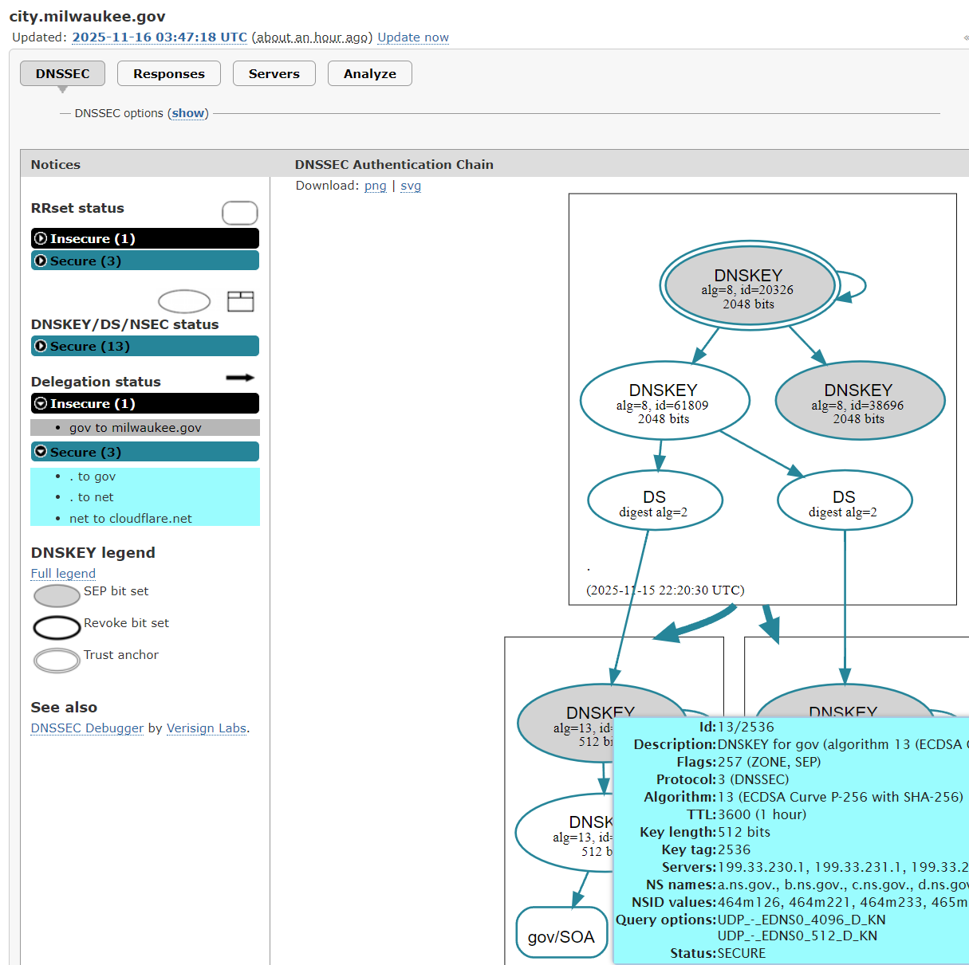
DNSSEC in Practice
DNSSEC lookup walkthrough (PowerShell):
$ dig +norecurse +dnssec www.msoe.edu “@198.41.0.4”
DNSSEC Visualization tool:
DNSViz | A DNS visualization tool

Slide 213
DNSSEC: Summary
DNSSEC: An extension of the DNS protocol that ensures integrity on the results
Provides object security (unlike DNS over TLS, which provides channel security)
Uses a hierarchical public key infrastructure to delegate trust from the trust anchor (root name server)
Uses signatures to cryptographically verify records
DNSSEC Implementation:
Each name server replies with its public key (DNSKEY type record)
When delegating trust, each name server signs the public key of the next name server (DS and RRSIG type records)
When providing a final answer, the name server signs the final answer (RRSIG type)
Zones are split into key-signing keys and zone-signing keys
NSEC signs a message saying no domains exist alphabetically between two records

Slide 214
DNS Security Solutions: Comparison
DoT (DNS over TLS):
✓ Provides confidentiality (privacy)
✓ Protects against on-path eavesdropping
✗ Requires trust in recursive resolver
✗ No authentication of DNS data
DNSSEC:
✓ Provides integrity and authenticity
✓ Cryptographically verifies DNS data
✓ Works with any name server
✗ No confidentiality
✗ Complex key management
DoT + DNSSEC: Best of both worlds!

Slide 215
CSC 3511 Security and Networking
Week 13, Lecture 1: Anonymity and Tor

Slide 216
Roadmap
Anonymity
Proxies and VPNs
Tor
Tor Onion Services

Slide 217
Anonymity
Anonymity: Concealing your identity
Wikipedia: “Anonymity describes situations in which the acting person's identity is unknown”
Anonymous communication on the Internet: The identity of the source and/or destination are concealed
Anonymity is not confidentiality
Confidentiality hides the contents of the communication
Anonymity hides the identities of who is communicating with whom
Anonymity on the Internet is hard
Packets contain the source IP address and destination IP address
Main strategy for anonymity: Ask someone else to send messages for you

Slide 218
Roadmap
Anonymity
Proxies and VPNs
Tor
Tor Onion Services

Slide 219
Proxies
Alice wants to send a message to Bob
Bob shouldn’t know the message is from Alice
An eavesdropper (Eve) cannot deduce that Alice is talking to Bob
Proxy: A third party that relays our Internet traffic, e.g., HTTP, DNS, …
Alice sends the message to the proxy, and the proxy forwards the message to Bob
The recipient’s name (and optionally the message) is encrypted (optional, not mandatory), so an eavesdropper does not see a packet with both Alice and Bob’s identities in plaintext
Bob receives the message from the proxy, with no indication it came from Alice
Mask the original IP address

Slide 220
Virtual Private Networks (VPNs)
VPNs: A virtual, encrypted, point-to-point tunnel
Creates an encrypted tunnel between your device and a remote VPN server, which acts as an intermediary for your internet traffic
Creates an alternative use case:
Appear as though you are coming from the virtually connected network instead of your real network!
E.g., a remote worker using a corporate VPN to securely access company resources
Proxies operate at the application layer, while VPNs operate at the network layer

Slide 221
Proxies and VPNs: Issues
Performance
Sending a packet requires additional hops across the network
Cost
VPNs can cost $80 to $200 per year
Trusting the proxy
The proxy can see the sender and recipient’s identities
Attackers might convince the proxy to tell them about your identity

Slide 222
Roadmap
Anonymity
Proxies and VPNs
Tor
Tor Onion Services

Slide 223
The Onion Router (Tor)
Idea: Send the packet through multiple proxies instead of just one proxy
Tor: A network that uses multiple proxies (relays) to enable anonymous communications

Slide 224
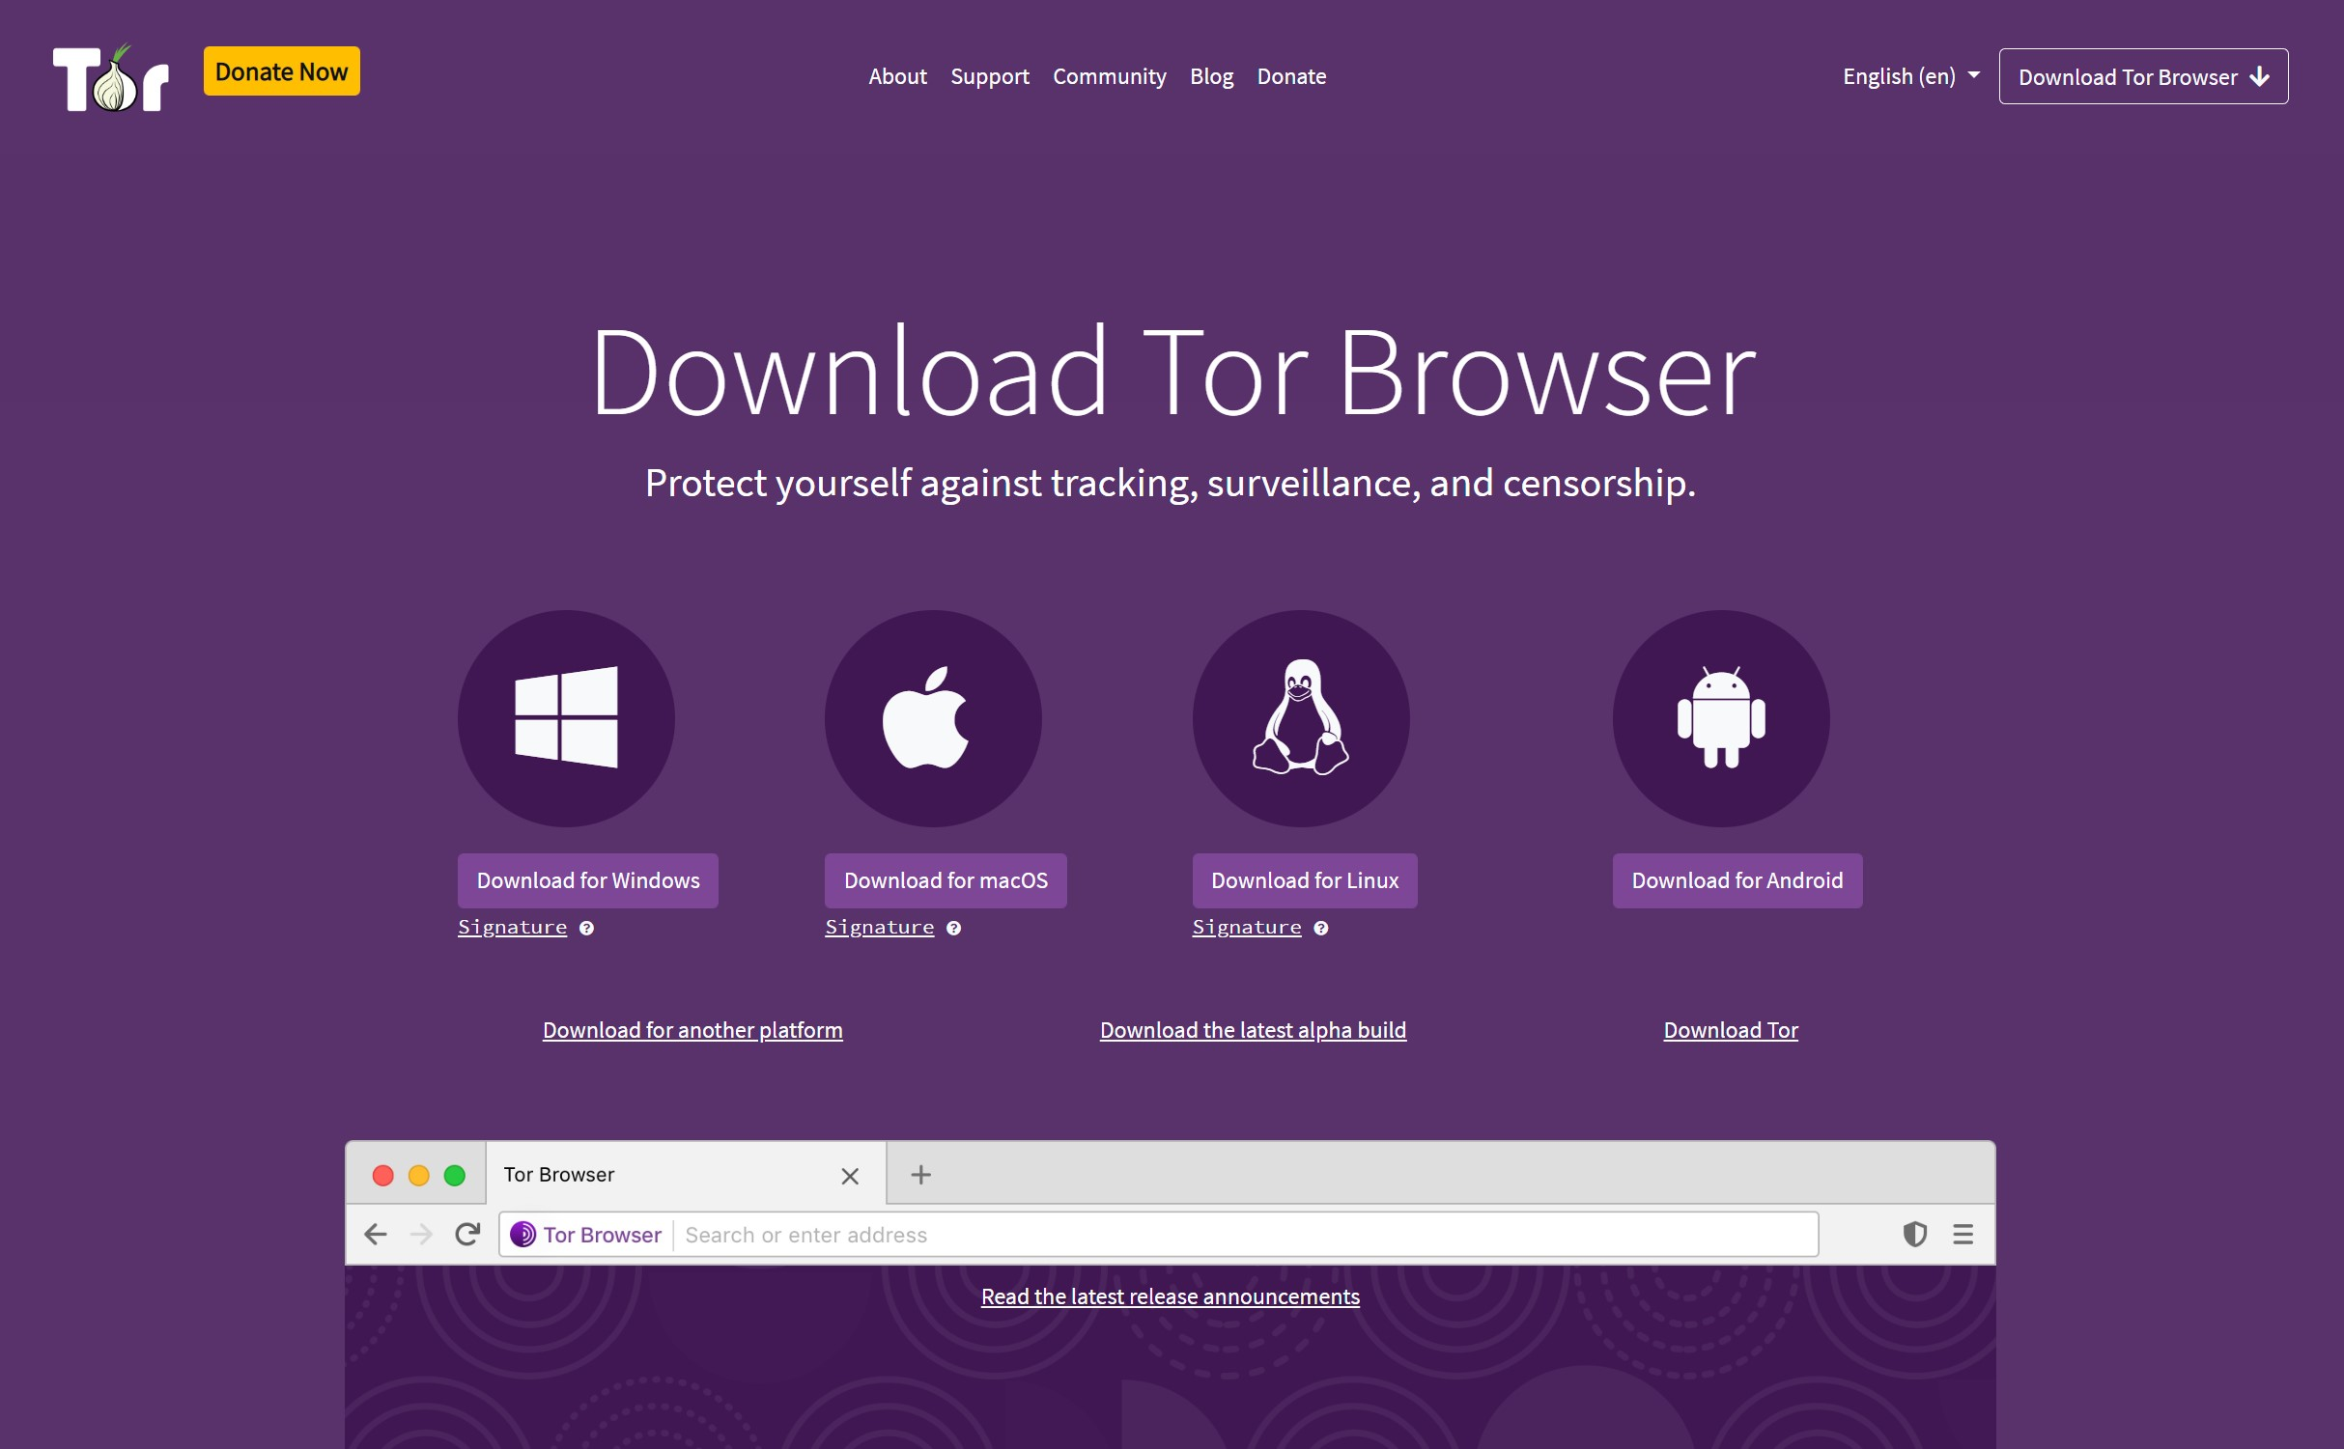
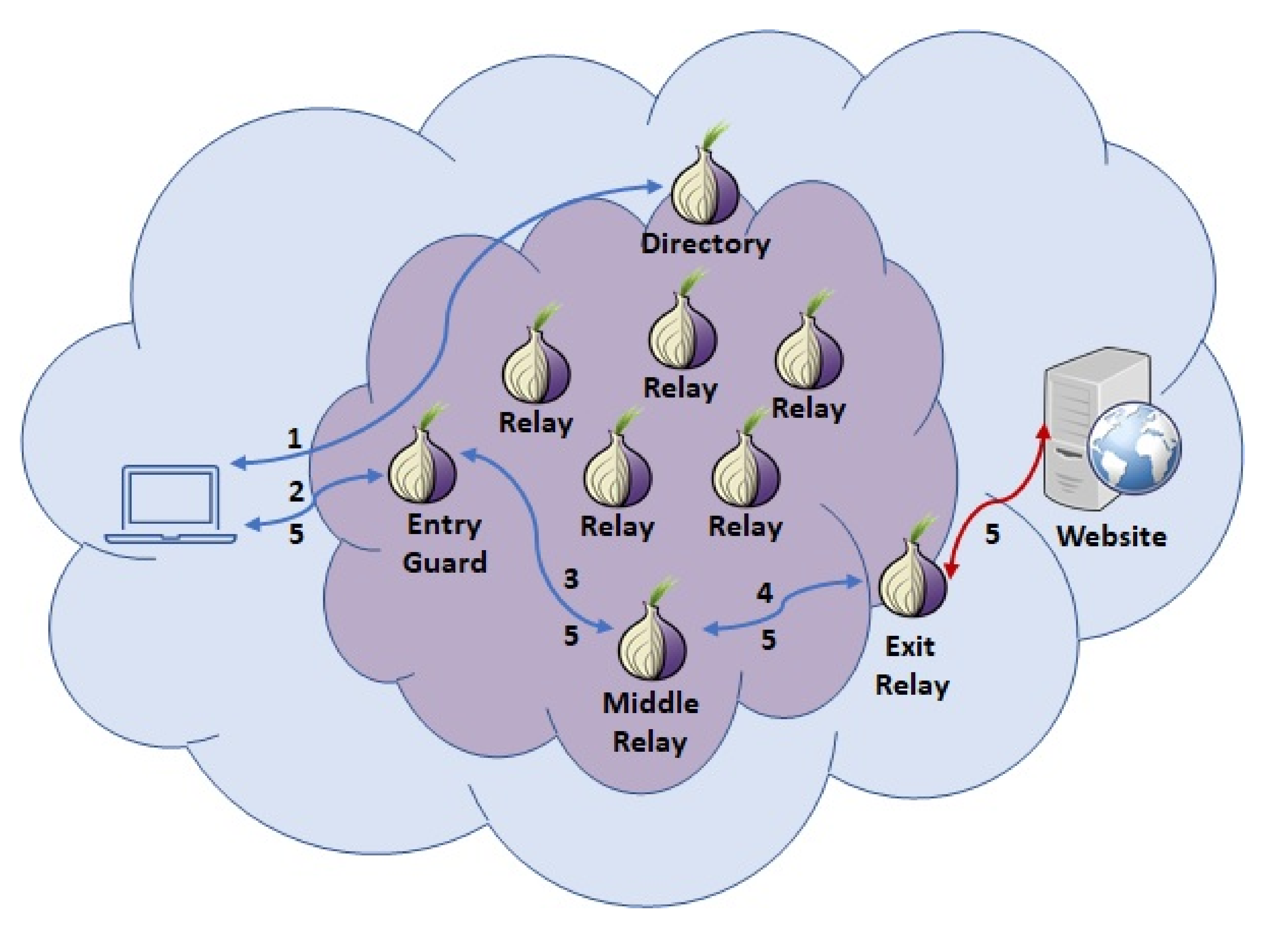
The Onion Router (Tor)
Components of Tor
Tor Browser: A web browser configured to connect to the Tor network (based on Firefox)
Tor network: A network of many Tor relays (proxies) for forwarding packets
Directory server: A server that holds and distributes a list of all active Tor relays (and their public keys ➔ why? MITM attacks!); also known as Directory Authorities
Tor onion services: Servers that can only be reached through the Tor network
Tor bridges: Tor relays that try to hide the fact that a user is connecting to the Tor network

Slide 225
The Goals of Tor
Security: Client anonymity and censorship resistance
Optional: Server anonymity with onion services
Performance: Low latency; communication should be fast.
Tor preserves anonymity against local adversaries
Example: An on-path attacker sees Alice send a message to a Tor relay, but not the final destination of the message
Example: The server should not know the identity of the client

Slide 226
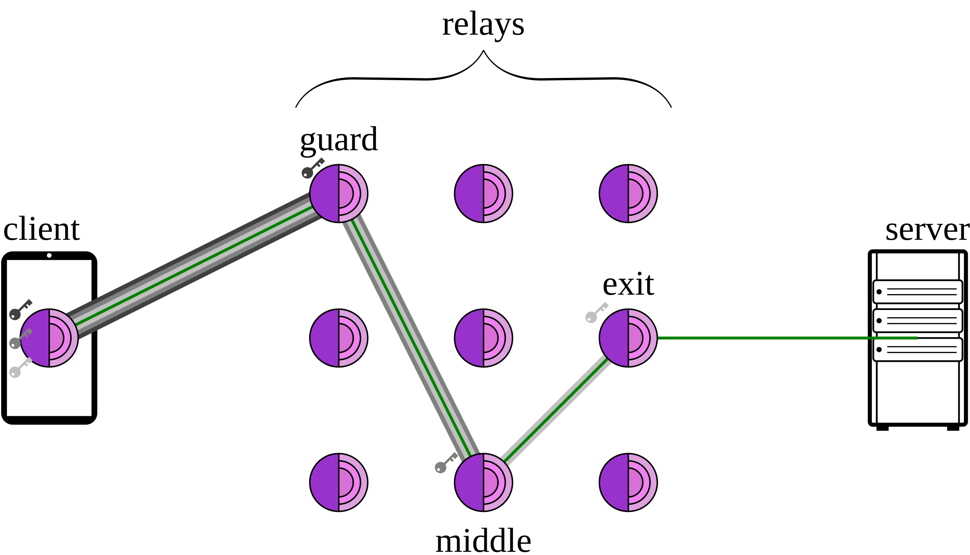
Tor Circuits
To communicate anonymously with a server, the Tor client forms a circuit consisting of 3 relays (by default)
Query the directory server for a list of relays
Directory server: Lists all Tor relays and their public keys
Choose 3 relays to form a Tor circuit
Connect to the first relay, forming an end-to-end TLS connection
Connect to the second relay through the first relay, forming an end-to-end TLS connection
Connect to the third relay through the second relay, forming an end-to-end TLS connection
Connect to the web server
If the web server is using HTTPS, then an end-to-end TLS connection will be formed through the third relay

Slide 227
Tor Circuits
Alice
Bob
Suppose Alice wants to talk to Bob anonymously.
Alice queries the directory server and chooses 3 relays

Slide 228
Tor Circuits
Relay
Relay
Relay
Relay
Relay
Alice
Relay
Bob
Relay
Relay
Then she forms a TLS connection with the second node (Tor EXTEND protocol), through the first node
Relay
Then she forms a TLS connection with the exit node (3rd relay), through the second node
Alice forms a TLS connection with the entry node
Notice: Relay 1 is only relaying TLS packets. It doesn’t know the contents of the packets!
Finally, she connects to Bob (optionally forming a TLS connection with Bob)

Slide 229
What a Relay Does
Function of the relays:
Listen for someone to initiate a TLS connection
When receiving a packet, decrypt using the key obtained through TLS
If the destination of the packet is another relay, forward the packet to the next relay
If the destination of the packet is an external server, forward the packet to that server

Slide 230
Tor Packet Construction
Wrap the packets via encryption
For example, the packet sent to Bob is encrypted under K3 since Relay 3 is the one to forward that information to Bob
Ensures that no one can read or tamper with the messages, since these are all sent over TLS connections
To: Relay 1
To: Relay 2
To: Relay 3
To: Bob
Hello world

Slide 231
Tor Circuits
Relay
Relay
Relay
Relay
Relay
Relay
Alice
K1, K2, K3
Relay
K2
Bob
Relay
K1
Relay
K3
To: Relay 1
To: Relay 2
To: Relay 3
To: Bob
Hello world

Slide 232
Tor Circuits
Relay
Relay
Relay
Relay
Relay
Relay
Alice
K1, K2, K3
Relay
K2
Bob
Relay
K1
Relay
K3
To: Relay 1
To: Relay 2
Relay 1 peels off the first layer;
Can’t read what the contents for Relay 2 is for, since it’s encrypted!
To: Relay 3
To: Bob
Hello world

Slide 233
Tor Packet Construction
What does Relay 1 see?
To: Relay 1, From: Alice
To: Relay 2, From: R1
???
All Relay 1 knows is the message came from Alice and is going to Relay 2. They don’t know Alice is talking to Bob!

Slide 234
Tor Circuits
Relay
Relay
Relay
Relay
Relay
Relay
Alice
K1, K2, K3
Relay
K2
Bob
Relay
K1
Relay
K3
To: Relay 2
To: Relay 3
To: Bob
Hello world

Slide 235
Tor Packet Construction
What does Relay 2 see?
To: Relay 2, From: R1
To: Relay 3, From: R2
??????
All Relay 2 knows is the message came from Relay 1 and is going to Relay 3. They know nothing about Alice and Bob!

Slide 236
Tor Circuits
Relay
Relay
Relay
Relay
Relay
Relay
Alice
K1, K2, K3
Relay
K2
Bob
Relay
K1
Relay
K3
To: Relay 3
To: Bob
Hello world

Slide 237
Tor Packet Construction
What does Relay 3 see?
To: Relay 3, From: R2
To: Bob
Hello world
All Relay 3 knows is the message came from Relay 2 and is going to Bob. They don’t know Alice sent the message!

Slide 238
Tor Circuits
Relay
Relay
Relay
Relay
Relay
Relay
Alice
K1, K2, K3
Relay
K2
Bob
Relay
K1
Relay
K3
To: Bob
Hello world

Slide 239
Tor Circuits
Relay
Relay
Relay
Relay
Relay
Relay
Alice
K1, K2, K3
Relay
K2
Bob
Relay
K1
Relay
K3

Slide 240
Tor Exit Nodes
Notice: The exit node (e.g., Relay 3) can see the message and the recipient
Without collusion, the exit node doesn’t know the sender
The exit node is a man-in-the-middle attacker
If the user is not using TLS to connect to the end host (using HTTP), the exit node can see and modify the traffic
If the user is using TLS (using HTTPS), the exit node cannot see or tamper with the traffic

Slide 241
Tor Weaknesses: Collusion
Collusion: Multiple nodes working together and sharing information
Collusion is adversarial (dishonest) behavior
If all nodes in the circuit collude, anonymity is broken
If at least one nodes in the circuit is honest, anonymity is preserved
It is easy to form some amount of colluding nodes
An adversary can create/control hundreds nodes in the Tor network to increase the chance that your circuit consists entirely of the attacker’s nodes!
The more nodes we use, the more confident we are that they are not all colluding

Slide 242
Tor Weaknesses: Distinguishable Traffic
Tor does not hide the fact that you are using Tor!
Packet Size Pattern:
HTTPS: Variable sizes reflecting the actual content length
Tor: Always fixed 514-byte cells
Connection Pattern:
HTTPS: Direct connection to destination
Tor: Always connects to Tor relay first
Anonymity only works in a crowd
Example: A Harvard student sends an anonymous threatening message using Tor. The administrators notice that only one student on the Harvard network is using Tor!

Slide 243
Tor Weaknesses: Timing Attacks
A network adversary who has a full (global) view of the network can learn that Alice and Bob are talking
Exploit a timing attack: Observe when Alice sends a message, when Bob receives a message, and link the two together
Global adversaries are outside of Tor’s threat model and are not defended against
Tor only defends against local adversaries with partial views of the network
Timing attacks could be defended against by delaying the timing of packets, but this violates Tor’s performance goal
German law enforcement has been identified as having a capability to deanonymize Tor users

Slide 244
Summary: Anonymity and Tor
Anonymity conceals an individual’s identity, but it’s difficult to achieve on the web
Proxies and VPNs relay traffic through a single machine
Issue: The single relay knows who you are and what you are doing!
Tor routes your traffic through multiple relays
No one machine knows both who you are and what you are doing
Circuits are established by performing TLS handshakes with (at least) three nodes, nesting encrypted channels
Weakness:
Collusion between relay nodes can deanonymize users by working together
Tor traffic is distinguishable from normal traffic
Timing attacks

Slide 245
Roadmap
Anonymity
Proxies and VPNs
Tor
Tor Onion Services

Slide 246
Tor Onion Services
Sometimes, the server wants to be anonymous, so no one knows where the server is located
Tor onion services: Websites that are only accessible through the Tor network
Gives the server anonymity protection
Sometimes called the dark web
Big idea: Route the server’s traffic through the Tor network so that no one knows who the server is

Slide 247
Tor Onion Services
Recall: Standard domain names translate to IP addresses, which would break server anonymity
Instead, identify servers using the hash of the service’s public key encoded as “abcxyz .onion” address
Example: http://pwoah7foa6au2pul.onion
Example: https://facebookcorewwwi.onion (Facebook brute-forced key pairs until they found one with a human-readable hash)
Any .onion address can only be accessed through the Tor browser (or other software specifically configured to use the Tor network)
Only the Tor network knows how to route traffic to .onion services through its encrypted relay system

Slide 248
Tor Onion Services
Regular Domain names vs .onion:
Regular domains must resolve to IP addresses, which reveal the server's network location
.onion addresses are hashes of public keys, which don't contain any location information
Where the anonymity comes from:
The .onion address being a hash of the public key means it's just a cryptographic identifier, not a network location
When clients connect to an onion service, they establish an encrypted connection through multiple Tor relays (detailed in the following slides)
The service's actual IP address is hidden behind these relay layers (hence "onion")
No single relay knows both the client and the server's real location
Why use the hash of the public key
The server proves it owns the address by proving it has the private key that matches the public key hash

Slide 249
Tor Onion Services
The server chooses nodes to be the introduction points
Relay
Relay
Relay
Relay
Relay I1
Client
Server
Relay
Relay
Relay I2
Relay
The server publishes its public key and the introduction points

Slide 250
Tor Onion Services
Now, the client connects to the server
The client queries the directory using the hash of the public key to get the server’s full public key and the introduction points
The client chooses an introduction point and forms a Tor circuit to it
The client chooses a rendezvous point (relay) and secret used to communicate to the server, encrypts them with the server’s public key, and sends them to the introduction point, which relays them to the server
The client and server both form Tor circuits to the rendezvous point and perform an end-to-end TLS handshake, and the server sends the decrypted secret to the client to authenticate itself

Slide 251
Tor Onion Services
Relay
Relay
Relay
Relay
Relay I1
Client
Server
Relay
Relay
Relay I2
Relay R
The client queries the directory and connects to an introduction point

Slide 252
Tor Onion Services
Relay
Relay
Relay
Relay
Relay I1
Client
Server
Relay
{“Rendezvous at R. The secret is K.”}PK
Relay
Relay I2
Relay R
The client chooses a rendezvous point and secret, encrypts using the public key, and sends them to the server through the introduction point

Slide 253
Tor Onion Services
Relay
Relay
{“Rendezvous at R. The secret is K.”}PK
Relay
Relay
Relay I1
Client
Server
Relay
Relay
Relay I2
Relay R
The client chooses a rendezvous point and secret, encrypts using the public key, and sends them to the server through the introduction point

Slide 254
Tor Onion Services
Relay
Relay
Relay
Relay
Relay I1
Client
Server
Relay
Relay
{“Rendezvous at R. The secret is K.”}PK
Relay I2
Relay R
The client chooses a rendezvous point and secret, encrypts using the public key, and sends them to the server through the introduction point

Slide 255
Tor Onion Services
Relay
Relay
Relay
Relay
Relay I1
Client
Server
Relay
Relay
{“Rendezvous at R. The secret is K.”}PK
Relay I2
Relay R
The client connects to the rendezvous point and waits
The server connects to the rendezvous point

Slide 256
Tor Onion Services
The secret that was encrypted is K
The client and server perform a handshake, and the server sends the decrypted secret

Slide 257
Tor Onion Services
The secret that was encrypted is K
The client and server perform a handshake, and the server sends the decrypted secret

Slide 258
Tor Onion Services
The secret that was encrypted is K
The client and server perform a handshake, and the server sends the decrypted secret

Slide 259
Tor Onion Services
Notice: The client and server never directly communicate, and the introduction and rendezvous points don’t know the client or the server

Slide 260
Hosting Illegal Services on Tor
Tor onion services are often used for services widely considered illegal around the world
Legitimate hosting services like Cloudflare will refuse to host these services
Most countries will take legal action against these services if hosted on the regular web
Dark markets: Marketplaces for buying and selling illegal goods
Transactions processed with a censorship-resistant currency like Bitcoin
Services like PayPal will refuse to process illegal transactions
Ratings system with mandatory feedback
Escrow service to handle disputes between sellers and buyers
Can only be accessed as a Tor onion service
Cybercrime forums: Websites for discussing illegal activity

Slide 261
CSC 3511 Security and Networking
Week 14, Lecture 1: Firewalls

Slide 262
Roadmap
Motivation and Security Policies
Firewalls: Packet Filters
Firewall Limitations and Evasion

Slide 263
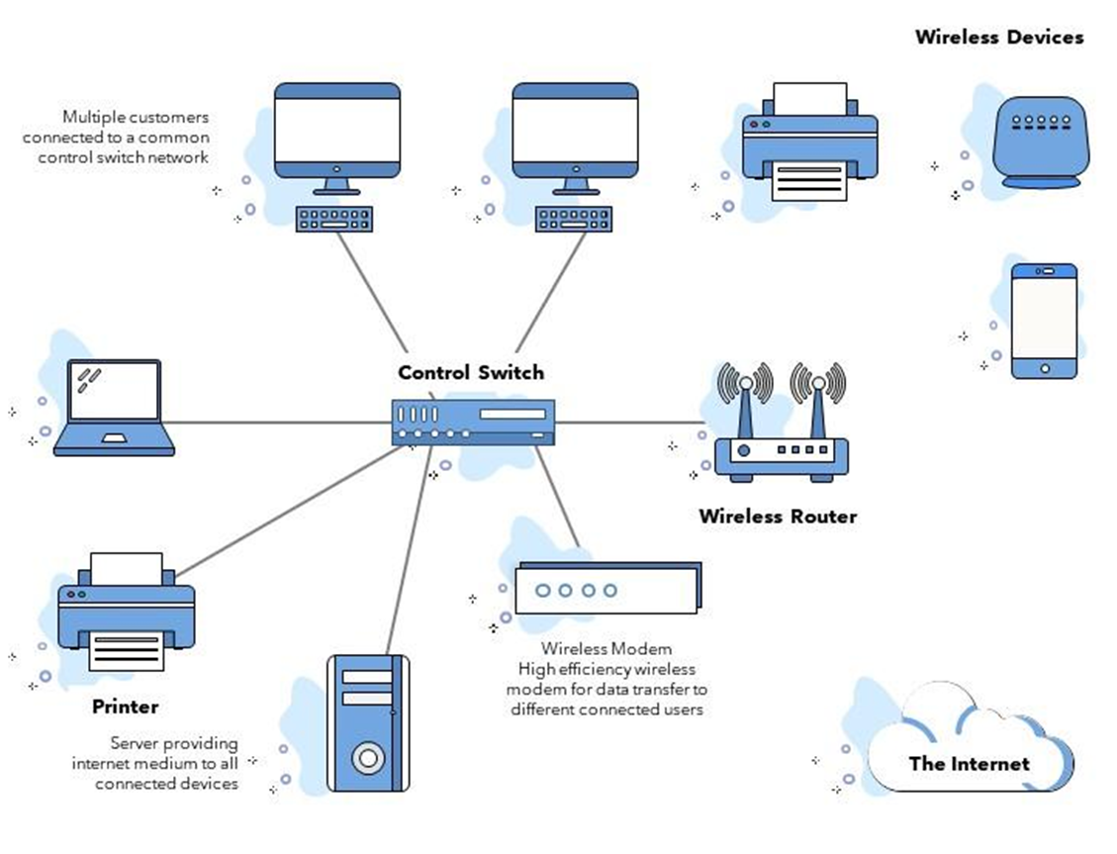
Motivation: Scalable Defenses
How do you protect a set of systems against external attack?
Example: A company network with many servers and employee computers
Observation: More network services = more risk
Each network connection creates more opportunities for attacks (greater attack surface)
Various connections/protocols
Observation: More networked machines = more risk
What if you have to secure hundreds of systems with different hardware, operating systems, and users?
What if there are some devices (e.g., guest’s computer) in the network that you aren't aware of?
Instead of securing individual machines, we want to secure the entire network!

Slide 264
Firewalls and Security Policies
Idea: Add a single point of access in and out of the network, with a monitor
Any traffic that could affect vulnerable systems must pass through the firewall
Ensure “complete mediation”
Network access is controlled by a policy
A security policy is a set of rules that defines what traffic is allowed or denied
Defines what traffic is allowed to exit the network (outbound policy)
Defines what traffic is allowed to enter the network (inbound policy)
Policy model based on our threat model: We usually assume users “inside” the network are trusted, and those outside are not

Slide 265
Firewalls and Security Policies
For example, what’s the policy of a standard home network?
Outbound policy: Allow outbound traffic
Users inside the network can connect to any service
Inbound policy: Only some traffic is able to enter the network
Allow inbound traffic in response an outbound connection (e.g., FTP)
Allow inbound traffic to certain, trusted services (e.g. SSH)
Deny all other inbound traffic (e.g., IP forwarding)

Slide 266
Default Security Policies?
How should we handle traffic that isn’t explicitly allowed or denied?
For example, an employee clicks a phishing link, and ransomware tries to connect to an AWS EC2 instance on port 8443
Default-allow policy: Allow all traffic, but deny those on a specified denylist
For the above example: Connection succeeds ➔ Ransomware communicates with attacker, encrypts files, exfiltrates data.
As problems arise, add them to the denylist
Default-deny policy: Deny all traffic, but allow those on a specified allowlist
For the above example: Connection blocked ➔ Attack is contained, ransomware can't receive instructions or send data out.
As needs arise, add them to the allowlist

Slide 267
Default Security Policies?
Default-allow policy vs. Default-deny policy, which default policy is better?
Default-allow is more flexible, but flaws are vulnerabilities and can be catastrophic
Default-deny is more conservative, but flaws are less painful
Default-deny is generally accepted to be the best default policy
Never trust, always verify

Slide 268
Roadmap
Motivation and Security Policies
Firewalls: Packet Filters
Firewall Limitations and Evasion

Slide 269
Packet Filters
Firewalls are often packet filters
Filtering with incoming and outgoing interfaces
Inspect network packets and chooses a handling method: forward or drop
Works at network layer and transport layer;
Filter based on packet header fields:
Source & destination IP addresses
Protocols (TCP, UDP, ICMP):
Source & destination port number
Control flags (TCP SYN, ACK, FIN, etc.)
Fast and efficient: Minimal processing overhead

Slide 270
Packet Filters
Stateless packet filters
Packet filters that have no history
All decisions must be made using only the information in the packet itself
Can have trouble implementing complex policies that require knowledge of history
Stateful packet filters
Maintain a state table that tracks all active connections and sessions passing through it

Slide 271
Stateless Packet Filters
Consider implementing the typical home network policy:
Allow outbound traffic
Allow inbound traffic in response to an outbound connection
Deny all other inbound traffic
Issue: How do we know what inbound traffic is in response to an outbound connection?
TCP: Can be implemented with a hack
Deny inbound traffic without an ACK flag set
Allow inbound traffic with the ACK flag set
If the internal computer sees an ACK packet without having formed a connection (through the OS), it will ignore it or send a RST packet
UDP (e.g., DNS responses): Impossible to implement
UDP “connections” are typically implemented at the application layer, so we can’t inspect much
Stateless packet filters are not good enough!

Slide 272
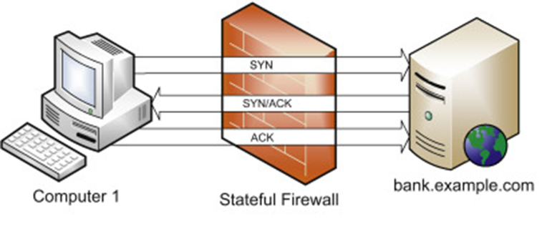

Stateful Packet Filters
A better idea: Keep “state” in the implementation of the packet filter
The filter keeps track of inbound/outbound connections and sessions passing through it, rather than individual packets
Phase 1: Session handling
The firewall tracks and remembers active connections by maintaining a connection state table
Remembers details about active connections
Source/destination IP addresses and ports
Connection states (NEW, ESTABLISHED, RELATED, etc.)
Protocol-specific parameters (e.g., TCP SEQ and ACK #, TCP flags seen, ICMP Seq #)
Timestamps (created, last activity)

Slide 273
Stateful Packet Filters
A better idea: Keep “state” in the implementation of the packet filter
Phase 2: Decision making
Makes decisions based on both static rules and connection context
For ESTABLISHED connections: Automatically allowed (already in state table)
For NEW connections: Must pass all firewall rules
For INVALID packets: Rejected (don't match any known connection)
Example rules:
allow tcp connection 4.5.5.4:* -> 3.1.1.2:80
Allow connections from 4.5.5.4 to 3.1.1.2 with destination port 80
allow tcp connection *:*/int -> *:80/ext
Allow outbound connections with destination port 80
allow icmp connection *:*/int -> *:*/ext
Allow outbound ICMP connections from any internal host to any external host
allow udp connection *:*/int -> *:53/ext
Allow outbound UDP connections from any internal host to any external DNS servers
Stateful firewall automatically allows UDP responses back

Slide 274

Stateful Packet Filters
A better idea: Keep “state” in the implementation of the packet filter
Phase 2: Decision making
Makes decisions based on both static rules and connection context
Outbound ICMP Echo Request to bank.example.com
Firewall creates state table entry, containing Session ID, connection type, des IP, ICMP ID & Seq, State (NEW ➔ ESTABLISHED), and expected reply
Inbound ICMP Echo Reply from bank.example.com
Validates session ID, ICMP ID and Seq match expected values
Unsolicited ICMP Echo Reply from evil.example.com
Checks state table: No matching ICMP request to evil.example.com
Marks as INVALID && Drops the packet
Computer 1 never receives this malicious ICMP reply

Slide 275
Stateless vs. Stateful Packet Filters
Consider implementing the typical home network policy:
Allow inbound traffic in response to an outbound connection
Issue: How do we know what inbound TCP traffic is in response to an outbound connection?
Attempted solutions with stateless filters:
Rule 1: Allow outbound TCP (all ports)
Rule 2: Deny inbound TCP WITHOUT ACK flag ← Attempts to block new connection initiations
Rule 3: Allow inbound TCP WITH ACK flag
Rule 4: Deny all other inbound
Problem:
Attacker can set ACK flag on malicious packets!
SRC addr && Port ➔ evil.com:80
DST addr && Port ➔ your_ip_addr:12345 [ACK = 1] && [RST = 1]
Some legitimate packets might be blocked: Server → Client: [FIN = 1] (ACK flag might be 0)

Slide 276
Stateless vs. Stateful Packet Filters
Consider implementing the typical home network policy:
Allow inbound traffic in response to an outbound connection
Issue: How do we know what inbound traffic is in response to an outbound connection?
Attempted solutions with stateful filters and state sable:
Rule 1: Check if packet matches existing session ➔ Allow
Rule 2: If not, check if it's starting a new valid session ➔ Check rules
Rule 3: Otherwise ➔ Deny
Legitimate responses: Matched to sessions ➔ allow
Spoofed packets: Don't match any session ➔ block
Unsolicited inbound: No matching session ➔ block
In networking context, unsolicited traffic means packets arriving at your network that you did not initiate or ask for

Slide 277
Stateless vs. Stateful Packet Filters

Slide 278
Stateless vs. Stateful Packet Filters: Example 1
Web Browsing

Slide 279
Stateless vs. Stateful Packet Filters: Example 2
ICMP Ping
ICMP has no ports, seq #, or connection states like TCP. How stateful firewalls track ICMP “connection”?
Solution: Firewall creates pseudo-connection by tracking ICMP-specific fields

Slide 280
Stateless vs. Stateful Packet Filters: Example 2
Step 1: User pings google.com
192.168.1.100 → 8.8.8.8
Step 2: Firewall creates state table entry
Step 3: Google replies
8.8.8.8 → 192.168.1.100
Step 4: Firewall checks incoming packet
Protocol: ICMP
Type: 0 (Echo Reply)
ICMP Identifier: 1234
ICMP Sequence: 1
Source IP: 8.8.8.8
Destination IP: 192.168.1.100
Attacker sends unsolicited ICMP reply?
No entry matches this ICMP message

Slide 281
Sample Question
Packet to Evaluate:
Source IP: 203.0.113.5
Destination IP: 192.168.1.10
Destination Port: 443
Protocol: TCP
Flags: SYN
Question a: Will this packet be allowed or denied by the policy? Justify your answer with reference to the rules and flags.
Question b: Modify the given policy (if needed) to ensure the packet is handled according to the scenario requirements.

Slide 282
Sample Question
Question a:
The packet will be denied.
Justification: The packet violates Rule 1, which only allows HTTP traffic (port 80) to the web server (192.168.1.10) from any source.
Question b:
Add a new rule as follows

Slide 283
Roadmap
Motivation and Security Policies
Firewalls: Packet Filters
Firewall Limitations and Evasion

Slide 284
New Challenge: Deep Packet Inspection
What We've Learned So Far:
Packet filters inspect headers (IP addresses, ports, protocols, flags)
They don't examine payload
Problem: What if malicious content is hidden inside the payload?
Example scenario:
Firewall Rule: Deny all packets containing the word root
Goal: Block exploitation attempts that use 'root' command
Question: How does the firewall detect "root" in the payload?
Must perform Deep Packet Inspection (DPI)
Must reconstruct TCP streams to see complete messages

Slide 285
Evading Packet Filters
Question: How does the firewall detect "root" in the payload?
Recall: TCP
Messages are split into packets before being sent
Packets can arrive out of order: The application will use sequence numbers to reorder packets
Attack 1: Payload Fragmentation
Split the word root across multiple packets
No single packet contains root, so the firewall won’t stop any of these packets
Destination host reassembles TCP stream ➔ sees complete malicious content

Slide 286
Evading Packet Filters
Question: How does the firewall detect "root" in the payload?
Recall: IP packets have a time-to-live (TTL)
The number of hops a packet may take before the packet is dropped
The attacker can easily find how many hops away a given server is ➔Send ping packets with increasing TTLs until the server responds
Attack 2: TTL Evasion Attack
Confuse firewall by sending duplicate packets with different TTLs
What the firewall sees: 'nroiocet'
What the server sees: 'root'

Slide 287
Evading Packet Filters
Defense strategies
Reconstruct TCP streams
Inspect reassembled payload, not individual packets
Apply content filters to complete messages
Example: next-generation firewall (NGFW)

Slide 288
Other Types of Firewalls
Proxy firewall: Instead of forwarding packets, form two TCP connections: One with the source, and one with the destination
Avoids problems with packets, since the firewall has direct access to the TCP byte streams
Application proxy firewall: Certain protocols allow for proxying at the application layer
Example: HTTP proxies will make an HTTP request on behalf of the user then return the HTTP response to the client

Slide 289
Summary: Firewalls
Firewalls: Defend many devices by defending the network
Security policies dictate how traffic on the network is handled
Packet filters: Choose to either forward or drop packets
Stateless packet filters: Choose depending on the packet only
Stateful packet filters: Choose depending on the packet and the history of the connection
Attackers can subvert packet filters by splitting key payloads or exploiting the TTL
Proxy firewalls: Create a connection with both sides instead of forwarding packets
ML-Powered NGFW: https://www.paloaltonetworks.com/cyberpedia/what-is-an-ml-powered-ngfw

Slide 290
CSC 3511 Security and Networking
Week 2, Lecture 1: Network Structure

Slide 291
Roadmap
Review: What is the Internet? What is a protocol?
Network structure: how to build a “network of networks”
Layers and encapsulation/decapsulation

Slide 292
What’s the “Internet”?
Internet

Slide 293
What’s a protocol – A Human Analogy
Protocols define the format, order of messages sent and received among network
entities, and actions taken on message transmission, receipt
Human protocols:
“what’s the time?”
“I have a question”
introductions
Network protocols:
computers (devices) rather than humans
all communication activity in Internet governed by protocols

Slide 294
Roadmap
Review: What is the Internet? What is a protocol?
Network structure: how to build a “network of networks”
Layers and encapsulation/decapsulation

Slide 295
A closer look at Internet structure
Network edge (endpoint):
Personal computers (PCs), adapters, modems, and devices that connect to them

Slide 296









A closer look at Internet structure
mobile network
Network core:
interconnected routers
network of networks
national or global ISP
local or regional ISP
home network
content
provider
network
datacenter
network
enterprise
network

Slide 297
Two key network-core functions
Routing:
Find paths through the network
Global action: determine source-destination paths taken by packets
routing algorithms
Forwarding:
aka “switching”
Local action: move arriving packets from router’s input link to appropriate router output link

Slide 298
Postal Analogy
Imagine you‘re mailing a package from San Jose, CA to Northampton, MA
Routing is like GPS planning your entire trip before you start:
Packages from California to Massachusetts should go through major sorting facilities in Denver, then Chicago, then finally to Massachusetts
This is the path determination - done once, updated occasionally
Need routing algorithm
traceroute command:
PowerShell command:
tracert google.com
tracert 8.8.8.8
Linux command: traceroute google.com
Web-based tool: https://tools.keycdn.com/traceroute

Slide 299
Postal Analogy
Imagine you‘re mailing a package from San Jose, CA to Northampton, MA
Forwarding is what you do at each highway intersection:
When you reach Sacramento, you see the intersection signs. You check your next-hop instruction: “Destination: Northampton... take I-80 East”
You don't recalculate the entire route ➔ you just follow the sign for your next highway
A simple look up ➔ This happens at every stop: a quick, local decisions based on a simple lookup table

Slide 300
Internet structure: a “network of networks”
Hosts connect to Internet via access Internet Service Providers (ISPs):
Residential: AT&T, Spectrum, Verizon
Mobile: T-Mobile, Verizon Wireless, AT&T Mobility
What is an ISP?
What they do: Provide the physical connection + IP address assignment
What you pay for: Bandwidth (50 Mbps, 1 Gbps), often with data caps
Access ISPs in turn must be interconnected
So that any two hosts (anywhere!) can send packets to each other
Resulting network of networks is very complex
Let’s take a stepwise approach to describe current Internet structure

Slide 301
Internet structure: a “network of networks”
Question: given millions of access Internet Service Providers (ISPs), how to connect them together?

Slide 302
Internet structure: a “network of networks”
Question: given millions of access ISPs, how to connect them together?
connecting each access ISP to each other directly doesn’t scale: O(N2) connections.

Slide 303
Internet structure: a “network of networks”
Option: connect each access ISP to one global transit ISP?
Customer and provider ISPs have economic agreement.

Slide 304
Internet structure: a “network of networks”
But if one global ISP is viable business, there will be competitors ….
ISP A
ISP B
ISP C

Slide 305
Internet structure: a “network of networks”
But if one global ISP is viable business, there will be competitors …. who will want to be connected
ISP A
ISP B
ISP C

Slide 306
Internet structure: a “network of networks”
… and content provider networks (e.g., Google, Microsoft, Akamai) may run their own network, to bring services, content close to end users
…
…
ISP A
…
…
ISP B
ISP C
…
…

Slide 307
Internet structure: a “network of networks”
At “center”: small # of well-connected large networks
“tier-1” commercial ISPs (e.g., Sprint, AT&T, Verizon), national & international coverage
content provider networks (e.g., Google, Facebook): private network that connects its data centers to Internet, often bypassing tier-1, regional ISPs
It's messier than a pure hierarchy - economics and politics shape it

Slide 308


Tier-1 ISP Network map: Sprint (2019)

Slide 309
Roadmap
Review: What is the Internet? What is a protocol?
Network structure: how to build a “network of networks”
Layers and encapsulation/decapsulation

Slide 310
Internet layering: OSI vs. TCP/IP model
Transmission Control Protocol/Internet Protocol (TCP/IP) model:
Practical model used on today’s Internet ➔ Layers 5 (Session) + 6 (Presentation) are usually bundled into Application in TCP/IP
Different models, same idea ➔ networking is layered abstraction, where each layer provides services to the one above
We follow the TCP/IP model (aka the Internet protocol suite model)to organize course content

Slide 311
Layer of the Network – Postal Analogy
CEO Alice wants to send a message to CEO Bob
Alice writes a letter
CEO
"Your days are numbered."
CEO
Secretary
Secretary
Mail Room
Mail Room

Slide 312
Layer of the Network – Postal Analogy
Alice passes the letter down to her secretary
Her secretary puts the letter in an envelope
CEO
CEO
From: Alice, To: Bob
Secretary
"Your days are numbered."
Secretary
Mail Room
Mail Room

Slide 313
Layer of the Network – Postal Analogy
Her secretary passes the letter down to the mailman
The mailman puts the envelope in a box
CEO
CEO
Secretary
Secretary
From: 123 Alice St
To: 456 Bob St
Mail Room
From: Alice, To: Bob
Mail Room
"Your days are numbered."

Slide 314
Layer of the Network – Postal Analogy
The packet travels through the postal system, to Bob's building
CEO
CEO
Secretary
Secretary
From: 123 Alice St
To: 456 Bob St
Mail Room
From: Alice, To: Bob
Mail Room
"Your days are numbered."

Slide 315
Layer of the Network – Postal Analogy
The mailman unwraps the box, revealing the envelope inside
The mailman passes the envelope up to the secretary
CEO
CEO
From: Alice, To: Bob
Secretary
"Your days are numbered."
Secretary
Mail Room
Mail Room

Slide 316
Layer of the Network – Postal Analogy
The secretary unwraps the envelope, revealing the letter inside.
The secretary passes the letter up to Bob.
CEO
"Your days are numbered."
CEO
Secretary
Secretary
Mail Room
Mail Room

Slide 317
Layer of the Network – Postal Analogy
As we move to lower layers, we wrap additional headers (and sometimes a trailer) around the packet ➔ Encapsulation
As we move to higher layers, we peel off headers (decapsulation), revealing the inner headers
CEO
CEO
Secretary
Secretary
Mail Room
Mail Room
From: 123 Alice St
To: 456 Bob St
From: Alice, To: Bob
From: Alice, To: Bob
"Your days are numbered."
"Your days are numbered."
"Your days are numbered."

Slide 318
Layer of the Network – Postal Analogy
Each person only cares about the headers at their layer
Mailman reads the green header, ignores all the payload inside
Each person communicates with its peers at the same layer
Alice's secretary writes the blue header, for Bob's secretary to read
A protocol at a specific layer only makes sense to people at that layer
CEO
CEO
From: 123 Alice St
To: 456 Bob St
Mailman only cares about this.
Secretary
Secretary
From: Alice, To: Bob
Secretary only cares about this.
"Your days are numbered."
CEO only cares about this.
Mail Room
Mail Room

Slide 319
Layer of the Network – Postal Analogy
Notice: Different layers use different addressing schemes
Inside a building: “329 Diercks Hall."
In the postal system: “1025 N Milwaukee St, Milwaukee, WI 53202”
From: 123 Alice St
To: 456 Bob St
These addresses make sense to the mailman
From: Alice, To: Bob
These names make sense to the secretary
"Your days are numbered."

Slide 320
Internet Headers and Encapsulation
As we move to lower layers, we wrap additional headers around the packet
Layer 5:
Application
Application
Converted to bits and transmitted
Layer 2 Header
Layer 4:
Transport
Transport
Layer 3 Header
Layer 4 Header
Layer 3:
Network
"Your days are numbered."
Network
Layer 2:
Link
Link
Layer 1:
Physical
Physical

Slide 321
Internet Headers and Decapsulation
As we move to higher layers, we peel off headers, revealing the inner headers
Layer 5:
Application
Application
Bits received over wire
Layer 2 Header
Layer 4:
Transport
Transport
Layer 3 Header
Layer 4 Header
Layer 3:
Network
"Your days are numbered."
Network
Layer 2:
Link
Link
Layer 1:
Physical
Physical

Slide 322
Layers and Protocols
Peers at the same layer communicate with each other using the header at that layer
Application
HTTP, DNS
Application
Layer 5:
Transport
TCP, UDP
Transport
Layer 4:
Network
IP
Network
Layer 3:
Link
Ethernet
Link
Layer 2:
Physical
Physical wire
Physical
Layer 1:

Slide 323
Application Layer: Next Lecture
Application layer builds services (e.g. websites, video streaming) on top of transport layer
This design lets us build different services, all on the same infrastructure.

Slide 324
Summary
We’ve covered a “ton” of material!
Internet overview
what’s a protocol?
network edge, access network, core
Routing versus packet forwarding
Internet structure
layering, service , encapsulation
networks under attack
You now have:
context, overview, vocabulary, “feel” of networking
more depth, detail, and fun to follow!

Slide 325
CSC 3511 Security and Networking
Week 2, Lecture 2: Application Layer and HTTP

Slide 326
Roadmap
Principles of network applications
Web and HTTP

Slide 327
Application Layer: Overview
Our goals:
Conceptual & implementation aspects of application-layer protocols
Learn about protocols by examining popular application-layer protocols and infrastructure
HTTP
SMTP, IMAP
DNS
Build network applications
socket API
5. Application
HTTP, FTP, SMTP, DNS
SSL/TLS, JPEG, MPEG
RPC, NetBIOS
4. Transport
TCP, UDP
3. Network
IP, ICMP
2. Data Link
Ethernet, Wi-Fi
1. Physical
Copper, Fiber, Radio

Slide 328
Application Layer: Overview
Application layer builds services (e.g. websites, video streaming) on top of transport layer
This design lets us build different services, all on the same infrastructure.

Slide 329
Some Network Apps
Social networking
Web
Text messaging
E-mail
Multi-user network games
Streaming stored video (YouTube, Hulu, Netflix)
P2P file sharing
Voice over IP (e.g., Skype)
Real-time video conferencing (e.g., Zoom)
Internet search
Remote login
…
Q: How do apps communicate?
A: Processes & Protocols

Slide 330

Creating a Network App
Write programs that:
Run on (different) end systems
Communicate over network
E.g., web server software communicates with browser software
No need to write software for network-core devices
Network-core devices do not run user applications
Applications on end systems allows for rapid app development, propagation
mobile network
national or global ISP
local or regional ISP
home network
content
provider
network
datacenter
network
enterprise
network

Slide 331
Processes communicating
Process: program running within a host
Within same host, two processes communicate using inter-process communication (defined by OS)
Processes in different hosts communicate by exchanging messages

Slide 332
Sockets
Process sends/receives messages to/from its (network) socket
Socket analogous to door
Sending process shoves message out the door
Sending process relies on transport infrastructure on other side of door to deliver message to socket at receiving process
Two sockets involved: one on each side

Slide 333
Sockets
# Client side
sock = socket.socket()
sock.connect(("www.google.com", 80))
sock.send("GET / HTTP/1.1\r\n...")
# Server side
server = socket.socket()
server.bind(("", 80))
server.listen()
Let's See Real Sockets
Try this command on your Windows PowerShell: $ netstat -an | findstr :443
It displays all network connections specifically related to port 443 (HTTPS)
Transport layer protocols: week 3

Slide 334
Client-server paradigm
Server:
Always-on host
Permanent (static) IP address
Often in data centers, for scaling
Clients:
Contact, communicate with server
May be intermittently connected
May have dynamic IP addresses
Do not communicate directly with each other
Examples: HTTP, IMAP, FTP
mobile network
national or global ISP
local or regional ISP
home network
content
provider
network
datacenter
network
enterprise
network

Slide 335
Peer-peer architecture
No always-on server
Arbitrary end systems directly communicate
Peers request service from other peers, provide service in return to other peers
Self scalability – new peers bring new service capacity, as well as new service demands
Peers are intermittently connected and change IP addresses
Complex management
Example: P2P file sharing [BitTorrent]
mobile network
national or global ISP
local or regional ISP
home network
content
provider
network
datacenter
network
Note: applications with P2P architectures have client processes & server processes
enterprise
network

Slide 336
Addressing Processes
To receive messages, process must have identifier
Host device has unique 32-bit IP address (IPv4)
Q: Does IP address of host on which process runs suffice for identifying the process?
A: No, many processes can be running on same host
Identifier includes both IP address and port numbers associated with process on host.
Example port numbers:
HTTP server: 80
mail server: 25
To send HTTP message to www.msoe.edu web server:
IP address: 69.20.113.171
port number: 80
Try $ nslookup www.msoe.edu
More shortly…

Slide 337
An Application-layer Protocol Defines:
Types of messages exchanged:
E.g., request, response
Message syntax:
What fields in messages & how fields are delineated
Message semantics
Meaning of information in fields
Rules for when and how processes send & respond to messages
Open protocols:
Defined in RFCs, everyone has access to protocol definition
Allows for interoperability
E.g., HTTP, SMTP
Proprietary protocols:
E.g., Skype, Zoom

Slide 338
Roadmap
Principles of network applications
Web and HTTP

Slide 339


From Theory to Practice: HTTP
Let's dive into a real-world example - the World Wide Web and HTTP
Web page consists of objects, each of which can be stored on different Web servers
Object can be HTML file, JPEG image, Java applet, audio file,…
Web page consists of base HTML-file which includes several referenced objects, each addressable by a URL, e.g.,
Base HTML file: https://www.msoe.edu/academics/undergraduate-degrees/engineering/computer-science/
Q: What protocol standardizes how browsers request the HTML file and referenced objects from different servers?
A: HTTP
https://msoe.s3.amazonaws.com/files/callouts/square_xsml_android-app-class-thumbnail-2.jpg

Slide 340
Brief History of HTTP
Development initiated by Tim Berners-Lee at European Organization for Nuclear Research (CERN) in 1989
1991: Initial specification, HTTP/0.9, drafted
1996: Standardized as HTTP/1.0
1997: Updated to HTTP/1.1 (persistent HTTP)
2015: HTTP/2.0 was introduced
2022: HTTP/3.0 was introduced
Driven by a need to share information between scientists
Needed a mechanism to transfer hypertext pages, with links to other pages
Resulting protocol: HyperText Transfer Protocol (HTTP)
You can still view the first website ever made

Slide 341
HTTP Basics
HTTP is a client-server protocol
One user is the client (e.g. your web browser, your PowerShell terminal)
One user is the server (e.g. the Google data center, Rosie)
HTTP is a request-response protocol
Client sends one request, and receives exactly one response
HTTP is “stateless”
Server maintains no information about past client requests
HTTP runs over TCP
Client and server run a TCP handshake and send data over the bytestream
No need to worry about packets being reordered, dropped, etc.
Server listens for HTTP on well-known port 80 (A later secure version uses 443)
Client (random port)
TCP bytestream
Server (port 80)

Slide 342
HTTP Requests
The request syntax is in human-readable plaintext (can be typed by a human).
Version: What HTTP version we're using
URL (Uniform Resource Locator): The resource we want to interact with
Intuition: The filepath of a file on some remote server
Method: What we want to do with that resource.
GET: Send me this resource. Originally, this was the only method
POST: Send data to the server (e.g. user submits a form)
Other methods for manipulating content on the server, not just retrieving it:
PUT, CONNECT, DELETE, OPTIONS, PATCH, TRACE, etc.
GET /projects/project1.html HTTP/1.1 \r\n
Method
URL
version
ends with a newline

Slide 343

HTTP Responses
Version: What HTTP version we're using.
Status code: A number, telling us what happened with the request
Description: A description of the status code
Content: The resource the user requested!
Status codes are classified into various categories, according to numeric value:
100s: Informational responses
200s: Successful responses
300s: Redirection messages
400s: Client error
500s: Server error
Try on your browser: http://neverssl.com/

Slide 344
Speeding Up HTTP
Loading a single website can require multiple HTTP requests
One request for the HTML (text/formatting) of the page
Separate requests for every picture
Separate requests for scripts to make the page interactive
Naive approach: Separate TCP connection with remote server for each request
Server is far away ➔ delay/RTT is high
We have to do a 3-way handshake for every request ➔ Time and resource consuming

Slide 345

Web caches
Goal: satisfy client requests without involving origin server
User configures browser to point to a (local) Web cache
Browser sends all HTTP requests to cache
If object in cache: cache returns object to client
Else cache requests object from origin server, caches received object, then returns object to client
client
origin
server
client

Slide 346
Web caches (aka proxy servers)
Web cache acts as both client and server
Server for original requesting client
Client to origin server
Why Web caching?
Reduce response time for client request (why?)
Cache is closer to client
Reduce traffic on an institution’s access link

Slide 347
Network Performance: Delay, Loss, Throughput
How do packet delay and loss occur?
Packets queue in router buffers, waiting for turn for transmission
Queue length grows when arrival rate to link (temporarily) exceeds output link capacity
Packet loss occurs when memory to hold queued packets fills up

Slide 348
Network Performance: Caravan analogy
100 km
toll booth
toll booth
Queueing Delay:
Time cars wait in line when toll booth is busy with other traffic
E.g., our caravan arrives, but 5 cars from another route are already waiting. The queueing time is: 5 x 12 = 60 sec for the first car of our caravan
In network: Packets waiting in router buffers when link is busy
Processing Delay:
Time for toll booth operator to check each car's documents
In network: Router examining packet headers, making forwarding decisions

Slide 349
Network Performance: Caravan analogy
100 km
toll booth
toll booth
Transmission Delay:
Time to "push" entire caravan through toll booth. E.g., 10 cars × 12 sec = 120 seconds
In network: Time to push all packet bits onto the link (packet length/ link transmission rate)
Propagation Delay:
Time for a car to travel from 1st to 2nd toll booth
E.g., 100 km ÷ 100 km/hr = 60 minutes
In network: Time for signal to travel through physical medium (length of physical link/propagation speed )

Slide 350
Network Performance: Delay
dqueue: queueing delay
Time waiting at output link for transmission
Depends on congestion level of router
dproc: processing delay
Nodal processing: check bit errors, determine output link, etc.
Typically, < microsecs
dtrans: transmission delay:
L: packet length (bits)
R: link transmission rate (bps)
dtrans = L/R
dprop: propagation delay:
d: length of physical link
s: propagation speed (~2x108 m/sec)
dprop = d/s

Slide 351
Network Performance: Packet Loss
Router buffers have limited capacity (finite queue space)
Buffer overflow: When packets arrive faster than they can be transmitted)
Drop policy: New packets dropped when buffer is full ➔ Packet Loss
What Happens to Lost Packets?
Depends on protocol: TCP retransmits, UDP does not (we will see later on)
Retransmission location: Previous router, or source end system
Application impact: Delay (TCP) or missing data (UDP)
Real-world impact: Web browsing slows down, file downloads pause, video stutters, gaming lag spikes
buffer
(waiting area)
A
packet being transmitted
B

Slide 352
Network Performance: Throughput
Throughput: rate (bits/time unit) at which bits are being sent from sender to receiver
Instantaneous: rate at given point in time
Average: rate over longer period of time
link capacity
Rs bits/sec
link capacity
Rc bits/sec
server, with
file of F bits
to send to client

Slide 353
Network Performance: Throughput
Rs < Rc What is average end-end throughput?
Rs bits/sec
Rs > Rc What is average end-end throughput?

Slide 354
Throughput: network scenario
Per-connection end-end throughput: min(Rc,Rs,R/10)
In practice: Rc or Rs is often bottleneck

Slide 355

Caching example
Scenario:
Access link rate: 1.54 Mbps (Megabits per second)
RTT from institutional router to server: 2 sec
Round-trip time (RTT): time for a small packet to travel from client to server and back
Web object size: 100K bits
Average request rate from browsers to origin servers: 15/sec
Avg data rate to browsers: 1.50 Mbps
Performance:
Access link utilization = 1.5/1.54 = .97
LAN utilization: 0.0015
End-end delay = RTT +
access link delay + LAN delay
= 2 sec + minutes + microseconds
Problem: large queueing delays at high utilization!

Slide 356
Option 1: buy a faster access link
Scenario:
access link rate: 1.54 Mbps
RTT from institutional router to server: 2 sec
web object size: 100K bits
average request rate from browsers to origin servers: 15/sec
avg data rate to browsers: 1.50 Mbps
origin
servers
public
Internet
1.54 Mbps
access link
Performance:
access link utilization = .97
LAN utilization: .0015
end-end delay = Internet delay +
access link delay + LAN delay
= 2 sec + minutes + microseconds
institutional
network
1 Gbps LAN
Cost: faster access link (expensive!)

Slide 357
Option 2: install a web cache
Solution:
Installed a Local Web Cache: Added a local web cache within the institutional network to store frequently accessed web content closer to the users.
Why it works:
Store frequently accessed data locally, reducing the need to fetch it repeatedly from a remote server
Reduce Load on Access Link: The institutional network is a bottleneck when multiple users request data simultaneously.
Improve Data Access Speed & Lower Latency: Fetching data from the local web cache is much faster
Benefits:
Reduce Internet Latency
Faster Response Time & Improved Performance
origin
servers
public
Internet
1.54 Mbps
access link
institutional
network
1 Gbps LAN
local web cache

Slide 358
Maintaining user/server state: cookies
Recall: HTTP GET/response interaction is stateless
No notion of multi-step exchanges of HTTP messages to complete a Web “transaction”
No need for client/server to track “state” of multi-step exchange
All HTTP requests are independent of each other
No need for client/server to “recover” from a partially-completed-but-never-completely-completed transaction
A stateful protocol: client makes two changes to X, or none at all
X
t’
time
time
Q: what happens if network connection or client crashes at t’ ?

Slide 359
Maintaining user/server state: cookies
Web sites and client browser use cookies to maintain some state between transactions
four components:
1) cookie header line of HTTP response message
2) cookie header line in next HTTP request message
3) cookie file kept on user’s host (client), managed by user’s browser
4) cookie also kept on back-end database at Website
Example:
Susan uses browser on laptop, visits specific e-commerce site for first time
when initial HTTP requests arrives at site, site creates:
Unique ID (aka “cookie”)
Entry in backend database for ID
Subsequent HTTP requests from Susan to this site will contain cookie ID value, allowing site to “identify” Susan

Slide 360
Maintaining user/server state: cookies
client
Amazon server
cookie file
backend
database
one week later:
time
time

Slide 361
HTTP Cookies: Tracking a User’s Browsing Behavior
What cookies can be used for:
User session state (Web, e-mail)
Authorization
Shopping carts
Recommendations
aside
cookies and privacy:
Cookies permit sites to learn a lot about you on their site
Third party persistent cookies (tracking cookies) allow common identity (cookie value) to be tracked across multiple web sites
Third party tracking via cookies:
Disabled by default in Firefox, Safari browsers
Disabled in Chrome browser since 2023

Slide 362



Example: displaying a NY Times web page
nytimes.com
NY times page with embedded ad displayed
AdX.com

Slide 363
Cookies: tracking a user’s browsing behavior
1634: sports, 2/15/25
nytimes.com (sports)
7493: NY Times sports, 2/15/25
NY Times: 1634
AdX.com
AdX: 7493

Slide 364

Cookies: tracking a user’s browsing behavior
On 2/16/25, I visit socks.com
1634: sports, 2/15/25
nytimes.com
AdX:
tracks my web browsing over sites with AdX ads
can return targeted ads based on browsing history
socks.com
7493: NY Times sports, 2/15/25
7493: socks.com, 2/16/25
NY Times: 1634
AdX.com
AdX: 7493

Slide 365

Cookies: tracking a user’s browsing behavior (one day later)
1634: sports, 2/15/25
1634: arts, 2/17/25
nytimes.com (arts)
socks.com
7493: NY Times sports, 2/15/25
7493: socks.com, 2/16/25
7493: NY Times arts, 2/17/25
NY Times: 1634
AdX.com
AdX: 7493
Returned ad for socks!

Slide 366
CSC 3511 Security and Networking
Week 3, Lecture 1: Domain Name System

Slide 367
Roadmap
What is DNS for?
Design and implementation

Slide 368
DNS: Domain Name System
Domain Name System (DNS):
Application-layer protocol: hosts, DNS servers communicate to resolve names (address/name translation)
A distributed database implemented in hierarchy of many name servers
People: many identifiers:
SSN, name, passport #
Internet hosts, routers:
Human-readable names (host name), e.g., www.msoe.edu - contains no relevant routing information
IP address (8.8.8.8) - used for machines to route datagrams but Hard to remember
Q: how to map between name and IP address, and vice versa ?

Slide 369
DNS: Definition
DNS (Domain Name System): An application layer protocol for translating human-readable domain names to IP addresses
Usage:
You want to send a packet to a certain domain (e.g. you type a www.google.com into your browser)
Your computer performs a DNS lookup to translate the domain name to an IP address
Your computer sends the packet to the corresponding IP address

Slide 370
Goals of DNS
DNS must be scalable
Many hosts/names; Many lookups; Many updates
DNS must be highly available
No single point of failure ➔ replication?
DNS must be lightweight and fast
Connections often start with a name lookup (e.g. user typing domain in browser)
If DNS is slow, every connection is slow

Slide 371
Roadmap
What is DNS for?
Design and implementation

Slide 372
The First Trial: A Single DNS Name Server
DNS is a client-server, request-response protocol.
To perform a DNS lookup, you (the client) send a DNS query: "What is the IP address of www.google.com?"
The name server sends a DNS response with the answer: "The IP address of www.google.com is 74.125.25.99."
Name server: A server on the Internet responsible for answering DNS requests
Name servers have domain names and IP addresses too
Example: There's a name server with name a.edu-servers.net and IP 192.5.6.30.
Issues:
Too many requests: one name server can't handle every DNS request from the entire Internet
Single point of failure
If there are many name servers, how do you know which one to contact?

Slide 373
DNS Name Server Hierarchy
Idea #1: If one name server doesn't know the answer to your query, the name server can direct you to another name server
Analogy: If I don't know the answer to your question, I will direct you to a friend who can help.
Idea #2: Arrange the name servers in a tree hierarchy
Intuition: Name servers will direct you down the tree until you receive the answer to your query

Slide 374
DNS Name Server Hierarchy
Each box is a name server. The label represents which queries the name server is responsible for answering
This name server is responsible for .edu queries like www.msoe.edu, but not a query like mail.google.com.
Root
Top Level Domain
Authoritative

Slide 375

DNS: root name servers
Official, contact-of-last-resort by name servers that can not resolve name
Incredibly important Internet function
Internet couldn’t function without it!
DNSSEC – provides security (authentication, message integrity)
ICANN (Internet Corporation for Assigned Names and Numbers) manages root DNS domain
13 logical root name “servers” worldwide each “server” replicated many times (~200 servers in US)

Slide 376

Top-Level Domain, and authoritative servers
Top-Level Domain (TLD) servers:
Responsible for managing the top-level domains such as .com, .org, .net, .edu, .aero, .jobs, .museums, and all top-level country domains, e.g.: .cn, .uk, .fr, .ca, .jp
Maintain a directory of which DNS servers are authoritative for each domain under their TLD
Network Solutions: authoritative registry for .com, .net TLD
Educause: .edu TLD
Authoritative DNS servers:
Organization’s own DNS server(s), providing authoritative hostname to IP mappings for organization’s named hosts
Can be maintained by organization or service provider

Slide 377
Local DNS name servers
When host makes DNS query, it is sent to its local DNS server
Local DNS server returns reply:
From its local cache of recent name-to-address translation pairs (possibly out of date!)
Forwarding request into DNS hierarchy for resolution. Once resolved, the local DNS server caches the response for future queries to speed up access for you and other users on the network.
Each ISP has local DNS name server; to find yours:
MacOS: % scutil --dns
Windows: >ipconfig /all
Local DNS server (aka Recursive Resolver) doesn’t strictly belong to hierarchy

Slide 378
DNS Name Resolution: Iterated Query
root DNS server
Example: host at engineering.mit.edu wants IP address for dsac.msoe.edu
2
3
TLD DNS server
Iterated query:
Contacted server replies with name of server to contact
“I don’t know this name, but ask this server”
1
4
8
5
requesting host at
engineering.mit.edu
dsac.msoe.edu
7
6
authoritative DNS server
dsac.msoe.edu

Slide 379
Caching DNS Information
Once (any) name server learns mapping, it caches mapping, and immediately returns a cached mapping in response to a query
Caching improves response time
Cache entries timeout (disappear) after some time (time to live -TTL)
Top-Level Domain (TLD) servers typically cached in local name servers
Cached entries may be out-of-date
If named host changes IP address, may not be known Internet-wide until all TTLs expire!

Slide 380
DNS Records
;; AUTHORITY SECTION:
edu. 172800 IN NS d.edu-servers.net.
type=A ("Address" Record)
name is hostname
value is IP address
type=NS ("Name Server" Record)
name is domain (e.g., foo.com)
value is hostname of authoritative name server for this domain
class: DNS was designed to support different types of networks
CH = Chaos (used for some diagnostic queries)
HS = Hesiod (used by some Unix systems)
NONE = Used in dynamic updates
99.9% of DNS records use "IN" (Internet class)

Slide 381
DNS Lookup Walkthrough
$ dig +norecurse www.msoe.edu @198.41.0.4

Slide 382
DNS Lookup Walkthrough
; <<>> DiG 9.16.28 <<>> +norecurse www.msoe.edu @198.41.0.4
;; global options: +cmd
;; Got answer:
;; ->>HEADER<<- opcode: QUERY, status: NOERROR, id: 7193
;; flags: qr; QUERY: 1, ANSWER: 0, AUTHORITY: 13, ADDITIONAL: 27
;; QUESTION SECTION:
;www.msoe.edu. IN A
;; AUTHORITY SECTION:
edu. 172800 IN NS d.edu-servers.net.
edu. 172800 IN NS b.edu-servers.net.
edu. 172800 IN NS f.edu-servers.net.
……
;; ADDITIONAL SECTION:
d.edu-servers.net. 172800 IN A 192.31.80.30
d.edu-servers.net. 172800 IN AAAA 2001:500:856e::30
b.edu-servers.net. 172800 IN A 192.33.14.30
……
;; Query time: 20 msec
;; SERVER: 198.41.0.4#53(198.41.0.4)
;; WHEN: Mon Sep 16 16:44:43 Central Daylight Time 2024
;; MSG SIZE rcvd: 836
id: 7193 ➔ 16-bit ID number
flags: qr ➔ This is a query record
QUERY, ANSWER, AUTHORITY, ADDITIONAL ➔ record counts

Slide 383
DNS Lookup Walkthrough
; <<>> DiG 9.16.28 <<>> +norecurse www.msoe.edu @198.41.0.4
;; global options: +cmd
;; Got answer:
;; ->>HEADER<<- opcode: QUERY, status: NOERROR, id: 7193
;; flags: qr; QUERY: 1, ANSWER: 0, AUTHORITY: 13, ADDITIONAL: 27
;; QUESTION SECTION:
;www.msoe.edu. IN A
;; AUTHORITY SECTION:
edu. 172800 IN NS d.edu-servers.net.
edu. 172800 IN NS b.edu-servers.net.
edu. 172800 IN NS f.edu-servers.net.
……
;; ADDITIONAL SECTION:
d.edu-servers.net. 172800 IN A 192.31.80.30
d.edu-servers.net. 172800 IN AAAA 2001:500:856e::30
b.edu-servers.net. 172800 IN A 192.33.14.30
……
;; Query time: 20 msec
;; SERVER: 198.41.0.4#53(198.41.0.4)
;; WHEN: Mon Sep 16 16:44:43 Central Daylight Time 2024
;; MSG SIZE rcvd: 836

Slide 384
DNS Lookup Walkthrough
; <<>> DiG 9.16.28 <<>> +norecurse www.msoe.edu @198.41.0.4
;; global options: +cmd
;; Got answer:
;; ->>HEADER<<- opcode: QUERY, status: NOERROR, id: 7193
;; flags: qr; QUERY: 1, ANSWER: 0, AUTHORITY: 13, ADDITIONAL: 27
;; QUESTION SECTION:
;www.msoe.edu. IN A
;; AUTHORITY SECTION:
edu. 172800 IN NS d.edu-servers.net.
edu. 172800 IN NS b.edu-servers.net.
edu. 172800 IN NS f.edu-servers.net.
……
;; ADDITIONAL SECTION:
d.edu-servers.net. 172800 IN A 192.31.80.30
d.edu-servers.net. 172800 IN AAAA 2001:500:856e::30
b.edu-servers.net. 172800 IN A 192.33.14.30
……
;; Query time: 20 msec
;; SERVER: 198.41.0.4#53(198.41.0.4)
;; WHEN: Mon Sep 16 16:44:43 Central Daylight Time 2024
;; MSG SIZE rcvd: 836
type=A ("Address" Record)
name is hostname
value is IP address

Slide 385
DNS Lookup Walkthrough
; <<>> DiG 9.16.28 <<>> +norecurse www.msoe.edu @198.41.0.4
;; global options: +cmd
;; Got answer:
;; ->>HEADER<<- opcode: QUERY, status: NOERROR, id: 7193
;; flags: qr; QUERY: 1, ANSWER: 0, AUTHORITY: 13, ADDITIONAL: 27
;; QUESTION SECTION:
;www.msoe.edu. IN A
;; AUTHORITY SECTION:
edu. 172800 IN NS d.edu-servers.net.
edu. 172800 IN NS b.edu-servers.net.
edu. 172800 IN NS f.edu-servers.net.
……
;; ADDITIONAL SECTION:
d.edu-servers.net. 172800 IN A 192.31.80.30
d.edu-servers.net. 172800 IN AAAA 2001:500:856e::30
b.edu-servers.net. 172800 IN A 192.33.14.30
……
;; Query time: 20 msec
;; SERVER: 198.41.0.4#53(198.41.0.4)
;; WHEN: Mon Sep 16 16:44:43 Central Daylight Time 2024
;; MSG SIZE rcvd: 836

Slide 386
DNS Lookup Walkthrough
; <<>> DiG 9.16.28 <<>> +norecurse www.msoe.edu @198.41.0.4
;; global options: +cmd
;; Got answer:
;; ->>HEADER<<- opcode: QUERY, status: NOERROR, id: 7193
;; flags: qr; QUERY: 1, ANSWER: 0, AUTHORITY: 13, ADDITIONAL: 27
;; QUESTION SECTION:
;www.msoe.edu. IN A
;; AUTHORITY SECTION:
edu. 172800 IN NS d.edu-servers.net.
edu. 172800 IN NS b.edu-servers.net.
edu. 172800 IN NS f.edu-servers.net.
……
;; ADDITIONAL SECTION:
d.edu-servers.net. 172800 IN A 192.31.80.30
d.edu-servers.net. 172800 IN AAAA 2001:500:856e::30
b.edu-servers.net. 172800 IN A 192.33.14.30
……
;; Query time: 20 msec
;; SERVER: 198.41.0.4#53(198.41.0.4)
;; WHEN: Mon Sep 16 16:44:43 Central Daylight Time 2024
;; MSG SIZE rcvd: 836

Slide 387
DNS sample query (using dig utility)
$ dig +norecurse www.msoe.edu @198.41.0.4
; <<>> DiG 9.16.28 <<>> +norecurse www.msoe.edu @198.41.0.4
;; global options: +cmd
;; Got answer:
;; ->>HEADER<<- opcode: QUERY, status: NOERROR, id: 7193
;; flags: qr; QUERY: 1, ANSWER: 0, AUTHORITY: 13, ADDITIONAL: 27
;; QUESTION SECTION:
;www.msoe.edu. IN A
;; AUTHORITY SECTION:
edu. 172800 IN NS d.edu-servers.net.
edu. 172800 IN NS b.edu-servers.net.
edu. 172800 IN NS f.edu-servers.net.
……
;; ADDITIONAL SECTION:
d.edu-servers.net. 172800 IN A 192.31.80.30
d.edu-servers.net. 172800 IN AAAA 2001:500:856e::30
b.edu-servers.net. 172800 IN A 192.33.14.30
……
;; Query time: 20 msec
;; SERVER: 198.41.0.4#53(198.41.0.4)
;; WHEN: Mon Sep 16 16:44:43 Central Daylight Time 2024
;; MSG SIZE rcvd: 836

Slide 388
DNS Protocol Messages
DNS query and reply messages, both have same format:
Identification (ID number):
16-bit number for query, reply to query uses same number
Flags:
QR bit: 0 in queries, 1 in responses
RD bit: 1 if we want the recursive resolver to do the lookup for us, and 0 otherwise
Counts:
The number of records of each type in the DNS payload
DNS Header
DNS Payload

Slide 389

DNS Protocol Messages
DNS Header
Name, type fields for a query
RRs in response to query
DNS Payload
Records for authoritative servers
Additional “ helpful” info that may be used

Slide 390
DNS Security
DDoS attacks
Bombard root servers with traffic
Not successful to date
Traffic filtering
Local DNS servers cache IPs of TLD servers, allowing root server bypass
Bombard TLD servers
Potentially more dangerous
Spoofing attacks
intercept DNS queries, returning bogus replies
DNS cache poisoning
RFC 4033: DNSSEC authentication services
We will discuss this topic in Week 9

Slide 391
Application Layer Summary
Our study of network application layer is now complete!
Application architectures
Client-server
P2P
Network performance:
Delay, packet loss, throughput
Cache
Cookie
Specific protocols:
HTTP
DNS
Next:
Transport layer service
Connection-oriented, reliable: TCP
Unreliable, datagrams: UDP
Socket programming:
TCP, UDP sockets

Slide 392
CSC 3511 Security and Networking
Week 3, Lecture 2: Transport Layer and UDP

Slide 393
Roadmap
Transport-layer services overview
Connectionless transport: UDP

Slide 394
Internet Layer: Review
Layer 3 (Network) gave us the ability to send packets anywhere on the Internet.
Abstraction level: Packets individually sent through the network.
Problem: IP offers best-effort delivery
Packets can be lost, corrupted, reordered, delayed, or duplicated
Problem: Applications don't want to think about packets and best-effort
Programmers want to think in terms of a more convenient abstraction

Slide 395
Transport Layer: Overview
Layer 4 (Transport) builds extra features on top of Layer 3
TCP (Transmission Control Protocol): Adds de-multiplexing and reliability
UDP (User Datagram Protocol): Adds de-multiplexing only
Both protocols provide a more useful abstraction to programmers
Let's check out each of these features

Slide 396
Transport Layer Actions
Transport protocols actions in end systems:
Sender: breaks application messages into segments, passes to network layer
Receiver: reassembles segments into messages, passes to application layer
Sender:
is passed an application-layer message
transport
determines segment header fields values
transport
creates segment
passes segment to Layer 3

Slide 397
Transport Layer Actions
Transport protocols actions in end systems:
Sender: breaks application messages into segments, passes to network layer
Receiver: reassembles segments into messages, passes to application layer
Receiver:
receives segment from IP
checks header values
transport
extracts application-layer message
transport
demultiplexes message up to application via socket

Slide 398
Two principal Internet transport protocols
TCP: Transmission Control Protocol
Reliable, in-order delivery
Congestion control
Flow control
Connection setup
UDP: User Datagram Protocol
Unreliable, unordered delivery
No-frills extension of “best-effort” IP
Services not available:
Delay guarantees
Bandwidth guarantees
mobile network
national or global ISP
logical end-end transport
local or regional ISP
home network
content
provider
network
datacenter
network
enterprise
network

Slide 399
Roadmap
Transport-layer services overview
Connectionless transport: UDP

Slide 400
UDP: User Datagram Protocol
“no frills,” “bare bones” Internet transport protocol
“best effort” service, UDP segments may be:
Lost
Delivered out-of-order to app
Connectionless:
No handshaking between UDP sender, receiver
Each UDP segment handled independently of others

Slide 401
UDP: User Datagram Protocol
UDP use:
streaming multimedia apps (loss tolerant, rate sensitive)
DNS
SNMP
HTTP/3
If reliable transfer needed over UDP (e.g., HTTP/3):
Add needed reliability at application layer
Add congestion control at application layer

Slide 402
UDP: Transport Layer Actions
DNS server
DNS client

Slide 403
UDP: Transport Layer Actions
DNS server
DNS client
UDP sender actions:
is passed an application-layer message
determines UDP segment header fields values
creates UDP segment
passes segment to IP

Slide 404
UDP: Transport Layer Actions
DNS server
DNS client
UDP receiver actions:
receives segment from IP
checks UDP checksum header value
extracts application-layer message
demultiplexes message up to application via socket

Slide 405
UDP segment header
32 bits
source port #
dest port #
length
checksum
application
data
(payload)
length, in bytes of UDP segment, including header
data to/from application layer
UDP segment format

Slide 406
UDP checksum
Goal: detect errors (i.e., flipped bits) in transmitted segment
Transmitted: 5 6 11
Received: 4 6 11

Slide 407
Internet checksum
Goal: detect errors (i.e., flipped bits) in transmitted segment
sender:
Treat contents of UDP segment (including UDP header fields and IP addresses) as sequence of 16-bit integers
Checksum: addition (one’s complement sum) of segment content
Checksum value put into UDP checksum field
receiver:
Compute checksum of received segment
Check if computed checksum equals checksum field value:
not equal - error detected
equal - no error detected. But maybe errors nonetheless? More later ….

Slide 408
Internet checksum: an example
example: add two 16-bit integers
1 1 1 0 0 1 1 0 0 1 1 0 0 1 1 0
1 1 0 1 0 1 0 1 0 1 0 1 0 1 0 1
The carryout bit is added back into the LSB of the result
wraparound
(carryout bit)
1 1 0 1 1 1 0 1 1 1 0 1 1 1 0 1 1
sum
1 0 1 1 1 0 1 1 1 0 1 1 1 1 0 0
0 1 0 0 0 1 0 0 0 1 0 0 0 0 1 1
checksum
(one’s complement of the sum)
Note: when adding numbers, a carryout from the most significant bit needs to be added to the result
* Check out the online interactive exercises for more examples: http://gaia.cs.umass.edu/kurose_ross/interactive/internet_checksum.php

Slide 409
UDP Checksum Calculation at the Sender
Prepare the UDP packet:
Header fields: source port, destination port, checksum (initialized as 0)
Data: The actual payload being sent (e.g., DNS query).
Create the pseudo-header:
Source IP, destination IP, protocol number (17 for UDP), total length (header & data)
Compute & insert checksum:
Concatenate pseudo-header, UDP header, and data as a unified structure
Interpret the above structure as 16-bit integers to compute the checksum
Insert the checksum into the UDP header
A special case: if the computed checksum is zero; it’s transmitted as 0xFFFF

Slide 410
UDP Checksum Verification at the Receiver
Receive the UDP packet:
Extract source port, destination port, length, checksum, and payload data
Rebuild the pseudo-header:
Source IP, destination IP, protocol number (17), total length (header & data)
Verify checksum:
Re-create the same structure as the sender for checksum verification
Verify checksum: all 16-bit words, including the received checksum
Apply wraparound to carry out bits (same as sender)
Verify if the result is all 1s (1111 1111 1111 1111)

Slide 411
Internet checksum: weak protection!
example: add two 16-bit integers
1 1 1 0 0 1 1 0 0 1 1 0 0 1 1 0
1 1 0 1 0 1 0 1 0 1 0 1 0 1 0 1
1 1 0 1 1 1 0 1 1 1 0 1 1 1 0 1 1
sum
checksum
0 1 0 0 0 1 0 0 0 1 0 0 0 0 1 1

Slide 412
Summary: UDP
“no frills” protocol:
Segments may be lost, delivered out of order
Best effort service: “send and hope for the best”
UDP has its plusses:
No setup/handshaking needed (no RTT incurred)
Can function when network service is compromised
Helps with reliability (checksum)
Build additional functionality on top of UDP in application layer (e.g., HTTP/3)

Slide 413
Challenge question 1: Where is the IP Address in a UDP Segment?
32 bits
source port #
dest port #
length
checksum
application
data
(payload)
length, in bytes of UDP segment, including header
data to/from application layer
UDP segment format

Slide 414



Challenge question 2: How does the computer know which incoming data packets belong to Netflix vs Skype vs Apache?

Slide 415
Multiplexing/demultiplexing
application
application
P1
P2
application
socket
P3
transport
P4
process
transport
network
transport
network
link
network
link
physical
link
physical
physical

Slide 416
Multiplexing/demultiplexing
multiplexing

Slide 418

Q: how did transport layer know to deliver message to Firefox browser process rather than Netflix process or Skype process?
HTTP msg

Slide 419
How demultiplexing works
Receiving host receives IP datagrams:
Each datagram has source IP address, destination IP address
Each datagram carries one transport-layer segment
Each segment has source, destination port number
Receiving host uses IP addresses & port numbers to direct segment to appropriate socket

Slide 420
Connectionless demultiplexing
Recall:
When creating socket, must specify host-local port #:
serverSocket = socket(AF_INET, SOCK_DGRAM)
serverSocket.bind(('', serverPort))
When receiving host receives UDP segment:
Checks destination port # in segment
Directs UDP segment to socket with that port #
When creating datagram to send into UDP socket, must specify
Destination IP address
Destination port #
clientSocket.sendto(message.encode(), (serverName, serverPort))
IP/UDP datagrams with same dest. port #, but different source IP addresses and/or source port numbers will be directed to same socket at receiving host

Slide 421
Connectionless demultiplexing: an example
mySocket = socket(AF_INET,SOCK_DGRAM)
mySocket.bind(myaddr,6428);
mySocket = socket(AF_INET,SOCK_DGRAM)
mySocket.bind(myaddr,9157);
mySocket = socket(AF_INET,SOCK_DGRAM)
mySocket.bind(myaddr,5775);
application
application
P1
application
P3
P4
UDP demultiplexing uses only the destination port to route packets to the correct socket, regardless of source IP/port
transport
transport
network
transport
network
link
network
link
physical
link
physical
physical
B
D
A
C

Slide 422
CSC 3511 Security and Networking
Week 4, Lecture 1: Transport Layer and TCP

Slide 423
Roadmap
Reliable data transmission
TCP implementation: TCP connection setup
TCP implementation: RTT estimation
TCP implementation: Byte notation, segments, sequence numbers & ACK number

Slide 424
Transport Layer Protocols
Layer 3 (Network/IP) gave us the ability to send packets anywhere on the Internet
Abstraction level: Packets individually sent through the network
Problem: IP offers best-effort delivery
Packets can be lost, corrupted, reordered, delayed, or duplicated
Problem: Applications don't want to think about packets and best-effort
Programmers want to think in terms of a more convenient abstraction
Layer 4 (Transport) builds extra features on top of Layer 3
UDP (User Datagram Protocol): Adds de-multiplexing only
TCP (Transmission Control Protocol): Adds de-multiplexing and reliability
Both protocols provide a more useful abstraction to programmers
Let's check out each of these features

Slide 425
Defining Reliability
3 different levels of reliability:
Best-effort delivery
At-least-once delivery: Every packet arrives, but some might arrive more than once (duplicates)
Exactly-once delivery: Every packet arrives exactly once
Our plan for bridging the abstraction gap:
At transport layer: Use IP (best-effort delivery) to build at-least-once delivery
Then, get rid of duplicates and pass the result to the application This gives the application exactly-once delivery
We have to deal with 5 problems from the best-effort service model:
Packets can be dropped
Packets can be corrupted
Packets can be delayed
Packets can be duplicated
Packets can be reordered

Slide 426
Designing Reliability for a Single Packet
Problem 1 - Packets can be dropped:
The packet is sent. How does the sender know if it was received successfully?
Solution: The recipient replies with an acknowledgment (ack)
Set a timer when we send the packet
If the timer expires and we don’t get the ack, resend the packet
When we get the ack, cancel the timer

Slide 427
Designing Reliability for a Single Packet
Problem 1 - Packets can be dropped:
What if the ack gets dropped
The timer expires, and the packet gets resent. Repeat until the ack arrives.
The destination received the packet twice, but that's okay (at-least-once delivery).

Slide 428
Designing Reliability for a Single Packet
Problem 2 - Packets can be corrupted:
The packet is sent. How does the sender know if it was received successfully?
Solution: The recipient calculates the checksum
When you get a corrupt packet, ignore it (don't send the ack)
Sender times out and resends
Alternative solution: When you get a corrupt packet, send a negative acknowledgement (nack)

Slide 429
Designing Reliability for a Single Packet
Problem 3 - Packets can be delayed:
Minor delay: No problem. The ack still arrives before the timeout.

Slide 430
Designing Reliability for a Single Packet
Problem 3 - Packets can be delayed:
Longer delay: Sender times out and resends
Aka, premature timeout
The sender receives two acks. That's fine ➔ The recipient will handle duplicate packets
Timeout!
Sender
Recipient

Slide 431
Designing Reliability for a Single Packet
Problem 4 - Packets can be duplicated:
The recipient gets the packet twice, and the sender receives two acks
Why would the network even duplicate a packet? Usually, because of link-level reliability gone wrong (very rare)
The recipient will handle duplicate packets

Slide 432
Designing Reliability for Multiple Packets
Problem 5 - Packets can be reordered (not relevant in single-packet case):
For problem 1 to 4: We can use the single-packet solution repeatedly to support sending multiple packets
One extra design component: sequence numbers
Label each packet with a unique, increasing number
Label each ack with which numbered packet is being acked
Solve reordering – use numbers to reorder packets
Solve duplication – use numbers to identify duplicate packets

Slide 433
Roadmap
Reliable data transmission
TCP implementation: TCP connection setup
TCP implementation: RTT estimation
TCP implementation: Byte notation, segments, sequence numbers & ACK number

Slide 434
TCP State
Reliability requires maintaining state at the end hosts
Sender has to remember:
Which packets have been sent and not acked?
How much longer on the timer before I resend a packet?
Receiver has to buffer the out-of-order packets
State is maintained at the end hosts (sender and receiver), not in the network
In each separate connection, both end hosts need to maintain state
How to build a connection?
TCP 3-way handshake

Slide 435
TCP Connection Setup: Three-Way Handshake
Before exchanging data, sender/receiver “handshake”:
Agree to establish connection (each knowing the other willing to establish connection)
Agree on connection parameters (e.g., initial sequence number (ISN))
application
application
connection state: ESTAB
connection variables:
seq # client-to-server
server-to-client
rcvBuffer size
at server,client
connection state: ESTAB
connection Variables:
seq # client-to-server
server-to-client
rcvBuffer size
at server,client
network
network
Socket clientSocket =
newSocket("hostname","port number");
Socket connectionSocket = welcomeSocket.accept();

Slide 436
TCP Connection Setup: Three-Way Handshake
Goal: Each host tells its ISN to the other host
SYN. Client says: "My ISN is x."
SYN-ACK. Server says: “I received x (expecting x+1 next). Also, my ISN is y.”
Connections in TCP are full-duplex:
Both hosts can send data, and both hosts can receive data
A can send to B, and B can send to A, simultaneously, in the same connection
ACK. Client says: "I received y (expecting y+1 next)."
After the three-way handshake, both sides can start sending data

Slide 437
TCP Connection Setup: Three-Way Handshake
The final ACK (3rd) acts as a confirmation mechanism to ensure that:
Both client and server are synchronized and aware of the connection state
No data is transmitted before the connection is fully established, avoiding the acceptance of duplicate data
The server only considers the connection fully established once the client sends the final ACK
Out-of-sync states are avoided because both sides explicitly confirm that the connection setup is complete

Slide 438
TCP Connection Teardown
Normal termination:
Each side sends a FIN packet to say: "I'm done sending, but will keep receiving."
FIN packets must be acked, just like any other data.
When only one side has sent FIN, the connection is half-closed.
When both sides have sent FIN (both done sending), the connection is closed.
Just for fun: Abrupt termination can be used instead (e.g. in case of error):
Send a RST (reset) to say: “I will no longer send or receive data.”
RST packets do not need to be acked
Any data in flight is lost
If the RST sender receives more data later, send another RST

Slide 439
Roadmap
Reliable data transmission
TCP implementation: TCP connection setup
TCP implementation: RTT estimation
TCP implementation: Byte notation, segments, sequence numbers & ACK number

Slide 440
TCP timeout and round trip time (RTT)
Problem 1 - Packets can be dropped:
Solution: Sender sets a timer; The recipient replies with an ack
How to set TCP timeout value?
Solution: Use RTT (round trip time) to estimate
Q: how to estimate RTT?
Too short: premature timeout, unnecessary retransmissions
Too long: slow reaction to segment loss
Timeout:
Waiting time for an ACK
Detect lost segments: the sender relies on the timeout to notice the absence of an ACK
Ensure timely retransmission

Slide 441
TCP timeout and round trip time (RTT)
Q: how to estimate RTT?
SampleRTT: measured time from segment transmission until ACK receipt
Ignore retransmissions
SampleRTT will vary, want estimated RTT “smoother”
Average several recent measurements, not just current SampleRTT
EstimatedRTT = (1- )*EstimatedRTT + *SampleRTT
Exponential weighted moving average (EWMA)
Influence of past sample decreases exponentially fast
Typical value:  = 0.125

Slide 442
TCP timeout and round trip time (RTT)
Timeout interval: EstimatedRTT plus “safety margin”
Large variation in EstimatedRTT: want a larger safety margin
(RTT deviation)
DevRTT: EWMA of SampleRTT deviation from EstimatedRTT:
* Check out the online interactive exercises for more examples: http://gaia.cs.umass.edu/kurose_ross/interactive/TCP_RTT.php

Slide 443
Roadmap
Reliable data transmission
TCP implementation: TCP connection setup
TCP implementation: RTT estimation
TCP implementation: Byte notation, segments, sequence numbers & ACK number

Slide 444
Notation Change: Bytes vs. Packets
So far, we've used packets as the primary unit of data:
Each packet has a number
Acks reference packet numbers
TCP is implemented with bytes as the primary unit of data
Each byte has a number ➔ Packets (number) are defined by the number of the first byte inside
ACKs reference byte numbers
You should be prepared to reason in terms of either.

Slide 445
TCP Segments
TCP provides a reliable, in-order bytestream
We have to split this bytestream into packets

Slide 446
TCP Segments
A segment is sent when the segment is full (max segment size),
or when the segment is not full, but times out waiting for more data

Slide 447
TCP Segments
TCP/IP packet: IP packet with TCP header and TCP data inside
Size limits (RFC 879 standard):
IP packet: Maximum transmission unit (MTU, e.g., 1500 bytes)
TCP segment: Maximum segment size (MSS)
MSS = MTU – (IP header) – (TCP header)

Slide 448
TCP Sequence Numbers
Numbering starts at a randomly-generated Initial Sequence Number (ISN)
First byte is ISN+1, then ISN+2, etc.
Starting at a randomly-chosen ISN is very important for security!

Slide 449
TCP Sequence Numbers
The sequence number of a segment is the number of the first byte in the segment
Example: In the segment below, the sequence number is ISN + 140

Slide 450
TCP ACK Numbers
The ack number indicates the next expected byte (i.e. the first unreceived byte)
Example: All bytes up to (and including) ISN + 219 have been received, so the next unreceived byte is ISN + 220

Slide 451
TCP Sequence and ACK Numbers
The sequence number of a segment is the number of the first byte in the segment
Sender sends a packet with sequence number j
The packet contains B bytes
Bytes in the packet are numbered: j, j+1, j+2, j+3, ..., , j+B–1
Recipient sends a cumulative ack (number of highest byte received, plus one)
If all prior data is received, ack number is j+B.
Think of this as the next expected byte, or the first unreceived byte.
If earlier data before this packet is missing, the ack number will be lower (Retransmit)

Slide 452
TCP Sequence and ACK Numbers
Assuming only one packet in flight, all packets length B, and no loss:
The last ack number is equal to the next sequence number.
"I expect j + B next." → "I'm sending j + B."
Q: What if the packet loss happens?
Sender’s packet is lost
ACK is lost

Slide 453
TCP: Retransmission Scenarios
Host A
Host B
Host A
Host B
send cumulative
ACK for 120
SendBase=120
lost ACK scenario
premature timeout

Slide 454
TCP: Retransmission Scenarios
Host A
Host B
Seq=92, 8 bytes of data
cumulative ACK covers for earlier lost ACK

Slide 455
TCP Fast Retransmit
Host A
Host B

Slide 456
CSC 3511 Security and Networking
Week 4, Lecture 2: Flow Control and Congestion Control

Slide 457
Roadmap
TCP implementation: sliding window
Flow control
Congestion control
TCP header

Slide 458
Reliably Delivering Multiple Packets
Problem: How to reliably deliver multiple packets (by using ACKs)
Naive approach: Wait for packet i to be acked before sending packet i+1.
This is correct, but really slow
Throughput: One packet per RTT

Slide 459
Reliably Delivering Multiple Packets
A better approach: Send more packets while waiting for acks
Have multiple packets in-flight (sent, but has not acked) simultaneously
Problem: What is them maximum number of packets can be in-flight at any time?
Answer: Use window-based algorithm to limit the number of in-flight packets
W is the size of the window
To stay inside the window limit:
Start: Send W packets
Each time a packet gets acked, send the next packet in line

Slide 460
Window-Based Algorithms
Start: Send W = 4 packets In-flight packets: {1, 2, 3, 4}
When ack(1) arrives: Send 5 In-flight packets: {2, 3, 4, 5}
When ack(2) arrives: Send 6 In-flight packets: {3, 4, 5, 6}
W is the size of the window. To stay inside the window limit:
Start: Send W packets
Each time a packet gets acked, send the next packet in line
Problem: How big should the window be?
Pick window size W to balance three goals:
Take advantage of network capacity ("fill the pipe")...
...but don't overload the recipient (flow control)...
...and don't overload links (congestion control)

Slide 461
Setting Window Size (1/3): Filling the Pipe
First goal: Take advantage of network capacity ("fill the pipe").
The sender should never be sitting idle
Set W large enough to keep the sender constantly busy
How to compute this W?
Suppose RTT = 6 seconds, and bandwidth = 1 packets per second; (Bandwidth means how fast packets can be sent without clogging the network)
Let's focus on the very first RTT: For the first 6 seconds, no acks arrive; We want the sender to be constantly busy
How many packets can be sent in 5 seconds?
(6 seconds) × (1 packets per second) = 6 packets
Thus, W = 6 packets keeps the sender busy
More generally: W = RTT × bandwidth
6

Slide 462
Setting Window Size (1/3): Filling the Pipe
W = RTT × bandwidth
The sender is busy the entire RTT sending W = 6 packets; ack(1) arrives just as the last of the 6 packets leaves
What exactly is the bandwidth?
The minimum ("bottleneck") link bandwidth along the path
How fast packets can be sent without clogging the network
Rewrite the above formula this in terms of bytes:
W × (packet size) = RTT × bandwidth
W = window size, in packets
Bandwidth now measured in bits/second
This gives us an upper bound on the desired size of W
The other two conditions (don't overload recipient and network) might impose stricter limits and decrease W.

Slide 463
TCP Sliding Window with Sequence Number
When we measured in packets, W was the maximum number of packets in flight
When we measure in bytes, W is the maximum number of contiguous bytes in flight
The window is a range of W contiguous bytes, starting at the first unacked byte
Only these W bytes are allowed to be in flight.
The window slides right if and only if its leftmost bytes are acked
Example: When 15–18 arrive, we can add 27–30

Slide 464
TCP Sliding Window with Sequence Number
When we measured in packets, W was the maximum number of packets in flight
When we measure in bytes, W is the maximum number of contiguous bytes in flight
The window is a range of W contiguous bytes, starting at the first unacked byte
Only these W bytes are allowed to be in flight.
The window slides right if and only if its leftmost bytes are acked
Example: When 15–18 arrive, we can add 27–30

Slide 465
TCP Sliding Window and ACK
When we measured in packets, W was the maximum number of packets in flight
When we measure in bytes, W is the maximum number of contiguous bytes in flight
The window is a range of W contiguous bytes, starting at the first unacked byte
Only these W bytes are allowed to be in flight.
The window slides right if and only if its leftmost bytes are acked
Acking non-leftmost bytes in the window (e.g. 19–22) does not slide the window
The window is determined by the first unacked byte (e.g. still 15)
What is ACK number?

Slide 466
TCP Sliding Window and Loss Detection
Two ways to detect loss and resend. We resend if either condition is true.
In both cases, we always resend the first unacked packet (leftmost part of window)
Ack-based: If 3 duplicate acks are received, resend.
Timer-based: Keep a single timer. If the timer expires, resend.
Set timer by estimating RTT

Slide 467
TCP Sliding Window with Additional Restrictions
TCP uses cumulative acks and a sliding window
Cumulative ack: "I have received everything up to (not including) 15."
Thus, first unacked byte is 15, and the sliding window is [15, 15 + W - 1].
In practice, W is set as the minimum of two values:
Advertised window (rwnd, recipient reports their remaining buffer space)
Congestion window (cwnd, sender magically finds value to avoid network overload)

Slide 468
Roadmap
TCP implementation: sliding window
Flow control
Congestion control
TCP header

Slide 469
Setting Window Size (2/3): Don’t Overload Recipient (Flow Control)
Consider the recipient:
TCP might receive packets out-of-order, but can only deliver packets to the application in order
The recipient must buffer incoming packets that are out of order
Packets stay in the buffer until all "missing" packets arrive
We have to make sure the recipient doesn't run out of buffer space
The application expects 3 next, but the sender gave me 4 and 5.
I'll hold on to 4 and 5 while waiting for 3 to arrive.

Slide 470
Setting Window Size (2/3): Don’t Overload Recipient (Flow Control)
Flow control ensures the recipient has enough buffer space for out-of-order packets
Recipient tells the sender how much space it has left
The size of remaining space is called the advertised window
This value is carried in ACK messages (rwnd field in TCP header)
Sender adjusts its window accordingly
Number of packets in flight must be less than the recipient's advertised window
The application expects 3 next, but the sender gave me 4 and 5.
I'll hold on to 4 and 5 while waiting for 3 to arrive.

Slide 471
Setting Window Size (2/3): Don’t Overload Recipient (Flow Control)
Recipient “advertises” free buffer space in rwnd field in TCP header
RcvBuffer size set via socket options (typical default is 4096 bytes)
Many operating systems auto-adjust RcvBuffer
Sender limits amount of unACKed (“in-flight”) data to received rwnd
Guarantees receive buffer will not overflow

Slide 472
Roadmap
TCP implementation: sliding window
Flow control
Congestion control
TCP header

Slide 473
Setting Window Size (3/3): Don’t Overload Network (Congestion Control)
Previously, we set W to fully consume the bottleneck link bandwidth.
Example: S–D would set W to send data at 1 Gbps
In practice, the bottleneck is shared with other flows
Example: With the red flow, S–D should only send at 0.5 Gbps
Each sender should only consume its share of the bandwidth ➔ Should reduce window size W
But, how do we update the window size?
Recall: W = RTT × bandwidth
So W and bandwidth are proportional (roughly speaking)

Slide 474
Setting Window Size (3/3): Don’t Overload Network (Congestion Control)
The sender's TCP code implements a congestion control algorithm that dynamically computes the sender's share of bandwidth
The algorithm balances a few goals (e.g. performance, avoid overload, fairness)
Dynamic adjustment: Learn the current congestion level, and adjust rate accordingly
The output of the algorithm is a congestion window (cwnd)
There are network-assisted congestion control algorithms (TCP ECN, ATM, DECbit, etc.):
Routers provide direct feedback to sender/receiver
I have magically decided that W = 7 avoids overloading the network
Recall: W = RTT × bandwidth
So W and bandwidth are proportional (roughly speaking)

Slide 475
Setting Window Size (3/3): Don’t Overload Network (Congestion Control)
Congestion Control Algorithm Sketch
Every host independently runs the same algorithm:
Pick an initial rate R (How do we pick the initial rate?)
Try sending at rate R for some period
Did I experience congestion in this time period? (How do we detect congestion: loss or delay?)
If no, increase R
If yes, reduce R (How much do we increase/decrease by?)
Repeat
Components of a solution:
Discovering an initial rate
Detecting congestion
Reacting to congestion (or lack thereof) by increasing/decreasing rate

Slide 476
Setting Window Size (3/3): Don’t Overload Network (Congestion Control)
Discovering an Initial Rate: Slow Start
Slow start is an algorithm for discovering the initial rate:
Start with a small rate (could be much less than actual bandwidth)
Increase exponentially (e.g. double rate each time) until we detect loss
A safe rate is the most recent rate before detecting loss:
0.5 × rate when loss occurred

Slide 477
Setting Window Size (3/3): Don’t Overload Network (Congestion Control)
Reacting to Congestion
Rate adjustment: How much do we increase/decrease by?
Critical part of congestion control design
Determines how quickly a host adapts to changes in available bandwidth
Goals for rate adjustment:
Efficiency: High utilization of link bandwidth.
Fairness: Each flow gets an equal share of bandwidth.

Slide 478
Setting Window Size (3/3): Don’t Overload Network (Congestion Control)
Reacting to Congestion
We can combine these rates in four ways:
AIAD: Additive Increase,
Additive Decrease
AIMD: Additive Increase,
Multiplicative Decrease
(TCP uses this)
MIAD: Multiplicative Increase,
Additive Decrease
MIMD: Multiplicative Increase,
Multiplicative Decrease
At a high level, we can either adjust quickly or slowly:
Fast: Multiplicative changes.
Increase by doubling: R → 2R
Decrease by halving: R → R/2
Slow: Additive changes.
Increase by adding: R → R + 1
Decrease by subtracting: R → R – 1

Slide 479
Setting Window Size (3/3): Don’t Overload Network (Congestion Control)
Reacting to Congestion
Why AIMD? Intuition: Sending too much is worse than sending too little
Sending too much: Congestion, packets dropped and retransmitted
Sending too little: Somewhat lower throughput
General approach:
Gentle increase when uncongested (exploration)
Rapid decrease when congestion detected

Slide 480
Setting Window Size (3/3): Don’t Overload Network (Congestion Control)
Pick an initial rate R (How do we pick the initial rate? ➔ Slow start)
Try sending at rate R for some period
Did I experience congestion in this time period? (How do we detect congestion: Packet loss)
If no, increase R (How much do we increase by? ➔ Additive increase)
If yes, reduce R (How much do we decrease by? ➔ Multiplicative decrease)
Repeat
Q1: How long? ➔ RTT? or event-driven
This algorithm creates a sawtooth-shaped graph as the rate is adjusted

Slide 481
Setting Window Size (3/3): Don’t Overload Network (Congestion Control)
Windows and Rates
Q1: How long is "some period of time"?
Ideally, each iteration lasts for one RTT ➔ RTT is hard to measure, changes dynamically
CWND updates are event-driven: Sender adjusts CWND each time something interesting happens in TCP
We get an ack for new data:
This means there was no congestion
Increase CWND (using slow-start, or additive increase in AIMD)
We get 3 duplicate acks and declare a packet lost:
Probably an isolated loss, since we're still getting subsequent acks
Decrease CWND (multiplicative decrease in AIMD)
The timer expires and we declare a packet lost:
We probably lost several packets – didn't get any duplicate acks. Bad news!
Abandon current rate and start over from slow-start

Slide 482
Setting Window Size (3/3): Don’t Overload Network (Congestion Control)
Q2: Event-Driven Slow Start – SSTHRESH (Slow Start Threshold)
When connection begins, increase rate/ cwnd exponentially until first loss event:
Initially cwnd = 1 MSS (Maximum Segment Size)
Double cwnd every RTT
Done by incrementing cwnd for every ACK received
After detecting the first loss, SSTHRESH "remembers" approximately where congestion occurred, preventing the sender from immediately growing too aggressively again
Event-Driven Slow Start

Slide 483
Setting Window Size (3/3): Don’t Overload Network (Congestion Control)
Q2: Event-Driven Slow Start – SSTHRESH (Slow Start Threshold)
When we encounter the packet loss:
Enter TCP recovery phase: TCP responds to detected packet loss and attempts to restore normal transmission rates while avoiding further congestion
SSTHRESH helps us remember the last safe rate
SSTHRESH serves 3 primary functions:
1. Phase Transition Control: Determines when to switch from Slow Start (exponential growth) to Congestion Avoidance (linear growth)
Set SSTHRESH = CWND/2

Slide 484
Setting Window Size (3/3): Don’t Overload Network (Congestion Control)
SSTHRESH and TCP Recovery Phases
SSTHRESH serves 3 primary functions:
2. Congestion Memory: Stores the approximate point where congestion was last detected
3. Recovery Guidance: Influences behavior during and after congestion recovery
Upon packet loss detection (3 dup ACKs):
Fast Recovery
SSTHRESH = cwnd / 2 ➔ Set new threshold
cwnd = SSTHRESH (Stay at threshold level), or cwnd = 1 (If dividing by 2 causes CWND to fall below 1, it's okay to round up to 1 packet)
Stay in the Congestion Avoidance Phase
Network is still working (receiving ACKs), so we assume selective packet loss
If sender receives duplicate ACKs but number is less than 3: The connection stays in its current state

Slide 485
Setting Window Size (3/3): Don’t Overload Network (Congestion Control)
SSTHRESH and TCP Recovery Phases
SSTHRESH serves 3 primary functions:
2. Congestion Memory: Stores the approximate point where congestion was last detected
3. Recovery Guidance: Influences behavior during and after congestion recovery
Upon packet loss detection (timeout):
SSTHRESH = cwnd / 2 ➔ Set new threshold
cwnd = 1 (Reset to minimum)
Switch to the Slow Start Phase
No ACKs received suggests severe congestion or failure; aggressive response needed

Slide 486
Setting Window Size (3/3): Don’t Overload Network (Congestion Control)
SSTHRESH and TCP Recovery Phases
SSTHRESH serves 3 primary functions:
2. Congestion Memory: Stores the approximate point where congestion was last detected
3. Recovery Guidance: Influences behavior during and after congestion recovery
During slow start: If CWND exceeds SSTHRESH, switch to additive increases
SSTHRESH = ∞ for first slow-start

Slide 487
Summary: TCP Congestion Control
Detecting congestion:
Loss-based
Discovering an initial rate:
Slow-start. Double rate until loss or safe rate (SSTHRESH) exceeded
Event-driven AIMD: Add 1 to CWND on each ack
Adapting rate to congestion:
AIMD (additive increase, multiplicative decrease) approaches fairness
Event-driven:
Add 1/CWND on each ack. After one RTT, CWND will have increased by 1
Divide CWND in half when there are 3 duplicate acks
When a packet is lost on timeout, restart from slow-start

Slide 488
Summary: TCP Congestion Control State Machine

Slide 489
Setting Window Size: Summary
How big should the window be?
Pick window size W to balance three goals:
Take advantage of network capacity ("fill the pipe")... (set W = RTT × bandwidth)
...but don't overload the recipient (flow control)... (set W = recipient's advertised window)
...and don't overload links (congestion control). (set W = sender's congestion window)
Ideally: W is set to the minimum of the 3 values
In practice: W is the minimum of advertised window (2) and congestion window (3)
It's hard for the sender to discover the bottleneck bandwidth and calculate (1)
Congestion window ≤ pipe-filling window Equal if we're the only connection, less than if sharing bandwidth with others

Slide 490
Roadmap
TCP implementation: sliding window
Flow control
Congestion control
TCP header

Slide 491
TCP Header
What functions does TCP implement?
Demultiplexing (ports)
Reliability (checksum, sequence and ack numbers)
Connection setup and teardown (flags)
Flow control (advertised window/receive window, rwnd)
TCP Header
TCP Payload

Slide 492
TCP Header
There are 8 flags that can be set in TCP. We care about 4 of them:
SYN: I'm sending my initial sequence number.
ACK: I'm acking data (please look at the ack number).
FIN: I'm done sending data, but will keep receiving data.
RST: I'm done sending and receiving data.
We won't look at the other four: CWR, ECE, URG, PSH.
TCP Header
TCP Payload

Slide 493
CSC 3511 Security and Networking
Week 5, Lecture 1: Network Layer and IP Protocol

Slide 494
Roadmap
Network Layer: Overview
Routers
IP: Internet Protocol
IP Address and DHCP
Network Address Translation (NAT)

Slide 495
Network-layer Services and Protocols
Layer 3 (Network/IP) gave us the ability to transport segment from sending to receiving host
Sender: encapsulates segments into datagrams, passes to link layer
Receiver: delivers segments to transport layer
Network layer protocols in every Internet device: hosts, routers
Internet “best effort” service model; No guarantees on:
Successful datagram delivery to destination
Timing or order of delivery
Bandwidth available to end-end flow
mobile network
national or global ISP
datacenter
network
The Internet Protocol (IP) is the dominant network layer protocol that provides this host-to-host delivery service
enterprise
network

Slide 496
Two Key Network Layer Functions
Network layer functions:
Forwarding: move packets from a router’s input link to appropriate router output link
Routing: determine route taken by packets from source to destination
Analogy: taking a trip
Forwarding: process of getting through single interchange
Routing: process of planning trip from source to destination
Core component: routers
Examines header fields in all IP datagrams passing through it
Moves datagrams from input ports to output ports to transfer datagrams along end-end path
IP provides both functions: IP forwarding (data plane) + IP routing (control plane)

Slide 497
Network Layer: Data Plane and Control Plane
Data plane:
Local, per-router function
Determines how datagram arriving on router input port is forwarded to router output port
Control plane
Network-wide logic
Determines how datagram is routed among routers along end-end path from source host to destination host
values in arriving
packet header
1
3
2

Slide 498
The Internet Protocol (IP)
What IP does (functions):
Addressing: Assigns logical IP address
Encapsulation: Wraps transport layer segments in IP datagrams
Forwarding: Moves packets hop-by-hop toward destination
Fragmentation: Breaks/reassembles packets for different link MTUs
What IP Contains/Related Protocols:
IPv4 / IPv6 addressing and packet format
Address Configuration: DHCP (automatic IP assignment)
Address Translation: NAT (private ↔ public addresses)
Support Protocols: ICMP (error reporting), ARP (address resolution)
Control plane: Separate routing algorithms (RIP, OSPF, BGP, etc.) populate IP forwarding tables
Data plane: Internet Protocol performs forwarding based on destination IP address

Slide 499
Roadmap
Network Layer: Overview
Routers
IP: Internet Protocol
IP Address and DHCP
Network Address Translation (NAT)

Slide 500





Routers
A router performs routing protocols to learn about routes
A router receives packets and forwards them according to the forwarding table
What do routers look like in real life?
A router is just a computer specialized for forwarding packets
Colocation facility (aka carrier hotel): A building where multiple ISPs install routers

Slide 501
Router Planes
The components of a router can be split into 3 planes:
The data plane handles forwarding packets
Used every time a packet arrives: Nanosecond time scale
Operates locally; No coordinating with other routers
The control plane performs routing protocols
Used every time the network topology changes; Second time scale
The management plane lets the operator interact with the router.
Operator uses network management system (NMS) to interact with router
Tell the router what to do, and monitor what the router is doing
Example: Assigning costs to links
Example: How much traffic is being sent on each link?
Each plane is optimized for its tasks and its time scale

Slide 502
What‘s Inside a Router: View of Components
A router is just a computer specialized for forwarding packets
Chassis: The metal box holding the hardware
Control processor: Runs routing protocols and puts forwarding tables on linecards
Also handles management plane
Removable linecards gives us flexibility in scaling the router
1–20 linecards per chassis
Each linecard has several ports A port can be used for both input/output
Each linecard has some hardware to control its functionality

Slide 503
What‘s Inside a Router: View of Port
switch
fabric

Slide 504
What's Inside a Router: View of Links
Controller card, aka network interface controller (NIC), connects to linecards, provides physical connection to a network, and manages routing operations
Linecard
Each linecard is connected to the fabric: A bunch of wires providing high-bandwidth interconnection between linecards
Controller Card

Slide 505
What's Inside a Router: View of a Linecard
Specialized hardware optimized to forward packets
Sends packets into the fabric, to other ports on the router
Fabric

Slide 506
What's Inside a Router: Data Plane
Data plane/Forwarding: Packet travels from port to port, via forwarding chips and fabric (chips)

Slide 507
What's Inside a Router: Data Plane
Control plane/Routing: Controller card talks with other routers, and programs linecards with routes

Slide 508
Roadmap
Network Layer: Overview
Routers
IP: Internet Protocol
IP Address and DHCP
Network Address Translation (NAT)

Slide 509
Hierarchical Network Addressing
Recall: The Internet is a network of networks
Leads naturally to a hierarchy of addresses
Each network gets a number; Then, each host gets a number inside the network
Hosts that are "close to each other" (in the same network) share part of their address
Analogy: All third-floor room numbers start with the digit 3

Slide 510
IP (v4) Addresses
An IP address is a 32-bit number that uniquely identifies a network interface. We could write an IP address as a 32-bit binary number:
11011100111010001001101001011101
What is an interface?
The physical connection point between a device and a network. E.g., Ethernet port, WiFi adapter, fiber connection, etc.
Each interface connects to one physical link and has one IP address
Routers have multiple interfaces → multiple IP addresses (one per connected network)
Hosts typically have 1-2 interfaces (e.g., Ethernet, WiFi)

Slide 511
IP (v4) Addresses
An IP address is a 32-bit number that uniquely identifies a network interface. We could write an IP address as a 32-bit binary number:
11011100111010001001101001011101 ➔ Nobody wants to read that
Dotted quad (dotted-decimal) notation:
Split into groups of 8 bits
Write each 8-bit number in decimal, separated by dots
Q1: How to represent a “network”? How do we know the hosts are “close to each other”

Slide 512
IP Addresses: Network and Host Portions
A1: IP addresses have hierarchical (two-part) structure
Network prefix (high-order bits): Identify the host belongs to which network
Host portion (low-order bits): Identify specific host/interface on that network
Why this matters:
Hosts with same network prefix are on the same subnet (local network)
They can communicate directly without going through a router
Routers use network prefix for forwarding decisions
Q2: How do we indicate where to split the network and host portions?
Network Prefix
Host Portion

Slide 513
IP (v4) Addresses
A2: Slash notation (CIDR notation) specifies the network prefix length:
CIDR: Classless Inter Domain Routing (pronounced “cider”), address format: a.b.c.d/x
Network prefix: Fixed bits identify the network. Write as dotted quad
Prefix length: After the slash (/), write how many bits are in the network prefix
Examples:
220.232.144.0/24 means first 24 bits = (sub)network, last 8 bits = hosts. Host range is 220.232.144.0 – 220.232.144.255 (256 addresses on this subnet)
192.168.1.0/29 means 29 bits are fixed. Host range is 192.168.1.0 – 192.168.1.7
0.0.0.0/0 means no bits are fixed. All addresses

Slide 514
Subnets
223.1.1.2
Where are the subnets?
What are the /24 subnet addresses?
223.1.1.1
223.1.1.4
223.1.1.3
223.1.9.2
223.1.7.0
223.1.9.1
223.1.7.1
223.1.8.1
223.1.8.0
223.1.2.6
223.1.3.27
223.1.2.1
223.1.2.2
223.1.3.1
223.1.3.2

Slide 515
IP (v4) Addresses
Netmask notation is an older alternative way to specify the network prefix:
Set network prefix bits to 1, and host bits to 0. Write as dotted quad
Useful in code: To extract network ID, bitwise AND the address and netmask
E.g., 220.232.144.93 AND 255.255.255.0 = 220.232.144.0
Slash notation is more convenient for humans; Netmask still used in some configurations (e.g., older routers, subnet calculators)
11011100 11101000 1001.... ........
Set all unfixed bits to 0
11111111 11111111 11110000 00000000
255
.
255
.
240
.
0
Slash notation: 220.232.144.0/20
Netmask notation: 220.232.144.0 (netmask 255.255.240.0)

Slide 516
Roadmap
Network Layer: Overview
Routers
IP: Internet Protocol
IP Address and DHCP
Network Address Translation (NAT)

Slide 517
IP addresses: how to get one?
That’s actually two questions:
Q1: How does a host get IP address within its network (host part of address)?
A1:
Hard-coded by sysadmin in config file (e.g., /etc/rc.config in UNIX)
DHCP: Dynamic Host Configuration Protocol: dynamically get address from a network server
Q2: How does network get subnet part of IP address?
A2: Gets allocated portion of its provider ISP’s address space

Slide 518
DHCP: Dynamic Host Configuration Protocol
Goal: host dynamically obtains IP address from network server when the host “joins” network
Support for mobile users who join/leave network
Can renew its lease on address in use
Allows reuse of addresses (only hold address while connected/on)
DHCP overview:
Host broadcasts DHCP discover msg [optional]
DHCP server responds with DHCP offer msg [optional]
Host requests IP address: DHCP request msg
DHCP server sends address: DHCP ack msg

Slide 519
DHCP client-server scenario
DHCP server:
IP: 223.1.2.5,
port 67
Arriving client,
port 68
The two steps above can be skipped “if a client remembers and wishes to reuse a previously allocated network address” [RFC 2131]
DHCP can return more than just allocated IP address on subnet:
Name and IP address of DNS sever
Network mask (indicating network versus host portion of address)
Address of first-hop router for client

Slide 520
DHCP: Workflow
DHCP is an application layer protocol, running on top of UDP/IP
Connecting laptop will use DHCP to get IP address, address of first-hop router, address of DNS server
DHCP REQUEST message encapsulated in UDP, encapsulated in IP, encapsulated in Ethernet
Ethernet frame broadcast (dest: FFFFFFFFFFFF) on LAN, received at router running DHCP server
168.1.1.1
router with DHCP
server built into
router
Ethernet de-mux’ed to IP de-mux’ed, UDP de-mux’ed to DHCP

Slide 521
DHCP: Workflow
DHCP is an application layer protocol, running on top of UDP/IP
DCP server formulates DHCP ACK containing client’s IP address, IP address of first-hop router for client, name & IP address of DNS server
Encapsulated DHCP server reply forwarded to client, de-muxing up to DHCP at client
Client now knows its IP address, name and IP address of DNS server, IP address of its first-hop router
router with DHCP
server built into
router

Slide 522
IP Addressing: Last Words ...
IPv4 addresses are 32 bits long. 232 ≈ 4 billion addresses. Is that enough?
ICANN: Internet Corporation for Assigned Names and Numbers http://www.icann.org/
Allocates IP addresses, through 5 regional registries (RRs) (who may then allocate to local registries)
Manages DNS root zone, including delegation of individual TLD (.com, .edu , …) management
ICANN allocated last chunk of IPv4 addresses to regional registries in 2011

Slide 523
Introducing IPv6
IPv6 was introduced in 1998 to deal with IPv4 address exhaustion
Main difference: Addresses are now 128 bits, instead of 32
Fundamentally, same addressing structure as IPv4
Some other minor changes (won't discuss here)
Is 128 bits enough?
2128 ≈ 3.4 × 1038 possible addresses
We won't run out again, really?
IPv5 was an experimental protocol from the 1990s. It was never widely implemented

Slide 524
Introducing IPv6
IPv6 uses hexadecimal instead of decimal
2001:0DB8:CAFE:BEEF:DEAD:1234:5678:9012
Colon between every 4 hex digits (16 bits)
Shorthand:
Omit leading zeros per block: 2001:0DB8:0000:0000:0000:0000:0000:0001 → 2001:DB8:0:0:0:0:0:1
Omit a long string of zeros, once per address: 2001:DB8:0:0:0:0:0:1 → 2001:DB8::1
Can still use slash notation for ranges.
2001:0DB8::/32 has 32 bits fixed, and 296 addresses.
IPv5 was an experimental protocol from the 1990s. It was never widely implemented

Slide 525
Roadmap
Network Layer: Overview
Routers
IP: Internet Protocol
IP Address and DHCP
Network Address Translation (NAT)

Slide 526
NAT: Network Address Translation
Problem: IPv4 address is not enough for every host on the Internet.
IPv4 and IPv6 are not compatible with each other
Requires software and hardware upgrades, from both hosts and routers ➔ IPv6 adoption is slow (and ongoing)
Solution: Use private IP addresses to conserve IP addresses
Private ranges allocated for networks that don't require Internet access
Weird fact:
Your home network uses private IP addresses to conserve addresses
However, you do need Internet access!

Slide 527
NAT: Network Address Translation
NAT (Network Address Translation): Use a single public IP address to represent many hosts in the local network.
Outgoing packets: Router changes private addresses to the public address.
Incoming packets: Router changes the public address back to private addresses.
local network (e.g., home network) 10.0.0/24
138.76.29.7
is the unique public addresses
10.0.0.1
10.0.0.4
10.0.0.1 – 10.0.0.4
are private addresses
10.0.0.2
10.0.0.3

Slide 528
NAT: Network Address Translation
Without NAT, if A sends a packet, replying to A is impossible
Because A's IP address is private
local network (e.g., home network) 10.0.0/24
From: S
To: A
From: A
To: S
10.0.0.1
Host A
S
10.0.0.4
10.0.0.2
Host B
T
Who the heck is A??
10.0.0.3
Host C

Slide 529
NAT: Network Address Translation
With NAT, if A sends an outgoing packet:
Router rewrites the header so it's coming from a public IP instead of a private IP
Router keeps a table, so it remembers where to send any replies
How to design this table?
local network (e.g., home network) 10.0.0/24
From: S
To: R?
From: A
To: S
10.0.0.1
Host A
S
10.0.0.4
10.0.0.2
Host B
T
10.0.0.3
Host C

Slide 530
NAT: Network Address Translation
NAT translation table
WAN side addr LAN side addr
138.76.29.7, 5001 10.0.0.1, 3345
…… ……
Advantages:
Can change addresses of host in local network without notifying outside world
Security: devices inside local net not directly addressable, visible by outside world
10.0.0.1
10.0.0.4
10.0.0.2
138.76.29.7
10.0.0.3
3: reply arrives, destination address: 138.76.29.7, 5001

Slide 531
NAT: Network Address Translation
Implementation: NAT router must (transparently):
Outgoing datagrams: replace (source IP address, port #) of every outgoing datagram to (NAT IP address, new port #)
Remote clients/servers will respond using (NAT IP address, new port #) as destination address
Remember (in NAT translation table) every (source IP address, port #) to (NAT IP address, new port #) translation pair
Incoming datagrams: replace (NAT IP address, new port #) in destination fields of every incoming datagram with corresponding (source IP address, port #) stored in NAT table

Slide 532
CSC 3511 Security and Networking
Week 5, Lecture 2: Forwarding and Routing

Slide 533
Roadmap
Packet Forwarding
Define the Routing Problem
Routing Protocol: Link State

Slide 534
Review: Router Architecture
Generic router architecture:
Routing, control plane (software): operates in millisecond time frame
Forwarding, data plane (hardware): operates in nanosecond
Input port
(e.g.,
Ethernet)
Output port
(e.g.,
Ethernet)
router input ports
router output ports
Input ports and output ports are connected via switching fabrics

Slide 535
Switching fabrics
Transfer packet from input link to appropriate output link
Switching rate: rate at which packets can be transfer from inputs to outputs
Often measured as multiple of input/output line rate
N inputs: switching rate N times line rate R
Three major types of switching fabrics:

Slide 536
Input Port Functions
lookup,
forwarding
queueing
line
termination
switch
fabric
Physical layer:
Decode the optical /electrical signal into 1s and 0s
Decentralized switching:
Using header field values, lookup output port using forwarding table in input port memory (“match plus action”)
Destination-based forwarding: forward based only on destination IP address (traditional)
Generalized forwarding: forward based on any set of header field values

Slide 537
Output Port Queuing
Buffering required when datagrams arrive from fabric faster than link transmission rate
Drop policy: drop datagrams if no free buffers
Scheduling discipline chooses among queued datagrams for transmission

Slide 538
Forwarding Pipeline
When a packet arrives, what does the input linecard need to do?
Input port: Receive signals and assemble data packets
Process the packet:
Parse the packet to understand its headers, e.g. IPv4 or IPv6
Look up the next hop in the forwarding table
Update the packet: Decrement TTL, update checksum, fragment packet if it's too big, etc.
Send the packet onwards:
Fabric interconnect chip sends packets to other linecards via inter-chassis links

Slide 539
Efficient Forwarding
The forwarding table is a map (key-value pairs)
How do we do fast lookups?
Challenges:
Entries can contain a range of addresses, not just one
Ranges might overlap; A destination can match multiple entries. E.g., output port 5 connects to hosts in 2.1.1.0/24
Naive solution: Write out the whole range:
Table gets really big
If a route changes, we have to update tons of entries. E.g., 2.1.1.0/24 connects to port 6?
We need something smarter

Slide 540

Destination-based Forwarding
Maps destination IP address ranges to specific output link interfaces in a router
Router checks the destination address of each incoming packet and uses the table to determine which link interface to forward the packet to
Q: What happens if ranges don’t divide up so nicely? E.g., packets with a destination address within a subset in this first range should go to interface 3?
A: Split the first address range into multiple pieces and add new entries. Or a more elegant way: longest prefix matching

Slide 541
Longest Prefix Matching
We want a fast implementation of longest prefix matching
Instead of using explicit ranges, use longest address prefix that matches destination address
If the address matches multiple prefixes, take the most specific (longest) match
If the address matches no prefixes, take the default route
If there's no default route, drop the packet.

Slide 542
Longest Prefix Matching
Instead of using explicit ranges, use longest address prefix that matches destination address
If the address matches multiple prefixes, take the most specific (longest) match
If the address matches no prefixes, take the default route
If there's no default route, drop the packet.
Destination Address Range
11001000 00010111 00010
11001000 00010111 00011000
11001000 00010111 00011
otherwise
Link interface
0
1
2
3
***
********
********
***
********
examples:
11001000 00010111 00010110 10100001
which interface?
11001000 00010111 00011000 10101010
which interface?

Slide 543
Longest Prefix Matching
Instead of using explicit ranges, use longest address prefix that matches destination address
If the address matches multiple prefixes, take the most specific (longest) match
If the address matches no prefixes, take the default route
If there's no default route, drop the packet.
Destination Address Range
11001000 00010111 00010
11001000 00010111 00011000
11001000 00010111 00011
otherwise
Link interface
0
1
2
3
***
********
********
***
********
examples:
11001000 00010111 00010110 10100001
which interface?
11001000 00010111 00011000 10101010
which interface?

Slide 544
Longest Prefix Matching
Instead of using explicit ranges, use longest address prefix that matches destination address
If the address matches multiple prefixes, take the most specific (longest) match
If the address matches no prefixes, take the default route
If there's no default route, drop the packet.
Destination Address Range
11001000 00010111 00010
11001000 00010111 00011000
11001000 00010111 00011
otherwise
Link interface
0
1
2
3
***
********
********
***
********
examples:
11001000 00010111 00010110 10100001
which interface?
11001000 00010111 00011000 10101010
which interface?

Slide 545
Efficient Longest Prefix Matching with Tries
Is there a map data structure that supports efficient longest prefix match?
We can use a more obscure data structure: Tries
Idea: Spell out each key, one letter/digit at a time
A node is marked blue if walking from root to that node forms a valid key
Longest prefix matching on a trie:
Start at the root, and spell out the word
Remember most recent (longest) key you see along the way
Stop when you're done, or fall off the tree. Return the longest key you saw
If you finish spelling or fall off the tree without seeing any other prefix, the default is returned

Slide 546
Roadmap
Packet Forwarding
Define the Routing Problem
Routing Protocol: Link State

Slide 547
Modeling the Network
Two types of machines on the network (simplified):
End hosts send and receive packets, to and from other end hosts.
Example: Your personal computer
End hosts don't forward intermediate packets.
Routers forward intermediate packets
Example: Your home router, heavy-duty router in a datacenter
For now, assume routers don't send and receive packets of their own
We'll draw the network as a graph:
Each node represents a machine
Each edge represents a link. For now, assume every link is undirected and connects exactly 2 machines
Assume each machine is identified by a unique label (e.g., IP addr)

Slide 548
Modeling the Network
Packets are the basic unit of data sent across the network.
Packets have a header with metadata
For now, we only care about the source address and destination address fields
Packets have a payload with the application data
Example: Website contents, image, etc.
Routing isn't concerned about the payload. It's just some sequence of 1s and 0s we have to forward
Source Address
Destination Address
Payload

Slide 549
Least-Cost Routing
What makes a routing solution good? Many different ways to define good, including:
Transmission delay
Price cost
Unreliability
Bandwidth constraints
Least-cost routing: Assign costs to every edge, and find paths with lowest cost
Cost depends on the metric the operator wants to minimize.
Costs can be arbitrary. Routing protocols don't care where the costs come from.

Slide 550
Least-Cost Routing
In least-cost routing, routers should forward packets such that they take the lowest-cost path to the destination
Example: If all costs are 1, the protocol finds paths with the fewest hops
Usually, if edges are unlabeled, assume they have cost 1

Slide 551
Least-Cost Routing
Where do costs come from?
Costs are local to a router. Each router knows the cost of its own links
In practice, generally configured by an operator
Properties of costs:
Costs are always positive integers
Consistent with almost any practical metric you'd use: bandwidth, delay, etc.
Usually, costs are symmetrical
A → B costs the same as B → A
Exceptions possible in theory (e.g. different upload/download bandwidth)
These two assumptions will simplify our routing protocols

Slide 552
Routing vs. Forwarding
Forwarding:
Look up packet's destination in table, and send packet to neighbor.
Inherently local. Depends only on arriving packet and local table.
Occurs every time a packet arrives (nanoseconds)
Routing:
Communicates with other routers to determine how to populate tables
Inherently global: Must know about all destinations, not just local ones
Occurs every time the network changes (e.g. a link fails)

Slide 553
Roadmap
Packet Forwarding
Define the Routing Problem
Routing Protocol: Link State

Slide 554
Routing Protocols: Roadmap
Routing protocols can be classified by:
Where they operate:
Intra-domain: routing packets within a local network
Inter-domain: routing packets across different networks
How they operate (Distance-vector, link-state, or path-vector)
Today, we'll look at link-state protocols
Major examples:
IS-IS (Intermediate System to Intermediate System)
OSPF (Open Shortest Path First)

Slide 555
Link-State Protocols: Definition
Link-state protocols:
Every router learns the full network graph.
Then, each router runs a shortest-path algorithm on the graph to populate the forwarding table.
Link-state:
Global data: Each node knows about the full network graph.
Local computation: Each node computes the full solution by itself.
Distance-vector:
Local data: Each node only knows about part of the network.
Global (distributed) computation: Each node computes part of the solution, working with other nodes.

Slide 556
Link-State Protocols: Definition
Suppose R3 has learned the full network graph
We know all the links, their status (up or down?), and their costs
We know about all the destinations
R3 can run a graph algorithm to compute paths
We can populate the forwarding table with the next-hop (in the computed path)

Slide 557
Link-State Algorithms
What graph algorithm do we run to compute paths?
Any single source shortest-path algorithm will work
Need to find shortest paths from a single source (the router) to every host
Some possible choices:
Bellman-Ford (the original serial version)
Dijkstra's algorithm
Breadth-first search
Parallel single-source shortest path
Dynamic shortest path
Approximate shortest path
etc.

Slide 558
Steps of Learning Network Graph
Link-state protocols:
Every router learns the full network graph
Step 1A: Discover my neighbors
Step 1B: Tell everybody about my neighbors
Then, each router runs a shortest-path algorithm on the graph to populate the forwarding table

Slide 559
Steps of Learning Network Graph (1/2): Learn Neighbors
How do we discover who is adjacent to us and their identity? Say hello!
Routers periodically send hello messages to their neighbors.
If they stop saying hello, assume that they disappeared.
This helps us learn about our direct neighbors, but not the whole network.
R1 does not know about the rest of the network (e.g. R3).

Slide 560
Steps of Learning Network Graph (2/2): Propagate Neighbor Information
How do we learn about the rest of the network, beyond our neighbors?
Solution: Flood information across the network.
When local information changes, send it to everyone.
When you receive information from your neighbor, send it to everyone.

Slide 561
Steps of Learning Network Graph
Link-state protocols:
Every router learns the full network graph
Step 1A: Discover my neighbors
Step 1B: Tell everybody about my neighbors
Then, each router runs a shortest-path algorithm on the graph to populate the forwarding table

Slide 562
Dijkstra’s Shortest Path Algorithm
Centralized: network topology, link costs known to all nodes
Accomplished via “link state broadcast”
All nodes have same info
Computes least cost paths from one node (“source”) to all other nodes
Gives forwarding table for that node
Iterative: after k iterations, know least cost path to k destinations

Slide 563
Dijkstra’s Shortest Path Algorithm
1 Initialization:
2 N' = {u} /* compute least cost path from u to all other nodes */
3 for all nodes v
4 if v adjacent to u /* u initially knows direct-path-cost only to direct neighbors */
5 then D(v) = cu,v /* but may not be minimum cost! */
6 else D(v) = ∞
7
8 Loop
9
10
11
12
13
14
15 until all nodes in N'
find a node w not in N' such that D(w) is a minimum
add w to N'
update D(v) for all v adjacent to w and not in N' :
D(v) = min ( D(v), D(w) + cw,v )
/* new least-path-cost to v is either old least-cost-path to v or known
least-cost-path to w plus direct-cost from w to v */

Slide 564
Dijkstra’s Algorithm: an Example
v
w
x
y
z
Step
0
1
2
3
4
5
N'
D(v),p(v)
D(w),p(w)
D(x),p(x)
D(y),p(y)
D(z),p(z)
u
Initialization (step 0):
For all a: if a adjacent to u then D(a) = cu,a

Slide 565
Dijkstra’s Algorithm: an Example
v
w
x
y
z
Step
0
1
2
3
4
5
N'
D(v),p(v)
D(w),p(w)
D(x),p(x)
D(y),p(y)
D(z),p(z)
u
ux
8 Loop
9
10
find a not in N' such that D(a) is a minimum
add a to N'

Slide 566
Dijkstra’s Algorithm: an Example
v
w
x
y
z
Step
0
1
2
3
4
5
N'
D(v),p(v)
D(w),p(w)
D(x),p(x)
D(y),p(y)
D(z),p(z)
u
ux
8 Loop
9
10
11
find a not in N' such that D(a) is a minimum
add a to N'
update D(b) for all b adjacent to a and not in N' :
D(b) = min ( D(b), D(a) + ca,b )

Slide 567
Dijkstra’s Algorithm: an Example
v
w
x
y
z
Step
0
1
2
3
4
5
N'
D(v),p(v)
D(w),p(w)
D(x),p(x)
D(y),p(y)
D(z),p(z)
u
ux
2,u
4,x
2,x
∞
uxy
8 Loop
9
10
find a not in N' such that D(a) is a minimum
add a to N'

Slide 568
Dijkstra’s Algorithm: an Example
v
w
x
y
z
Step
0
1
2
3
4
5
N'
D(v),p(v)
D(w),p(w)
D(x),p(x)
D(y),p(y)
D(z),p(z)
u
ux
uxy
8 Loop
9
10
11
find a not in N' such that D(a) is a minimum
add a to N'
update D(b) for all b adjacent to a and not in N' :
D(b) = min ( D(b), D(a) + ca,b )

Slide 569
Dijkstra’s Algorithm: an Example
v
w
x
y
z
Step
0
1
2
3
4
5
N'
D(v),p(v)
D(w),p(w)
D(x),p(x)
D(y),p(y)
D(z),p(z)
u
ux
uxy
uxyv
8 Loop
9
10
find a not in N' such that D(a) is a minimum
add a to N'

Slide 570
Dijkstra’s Algorithm: an Example
v
w
x
y
z
Step
0
1
2
3
4
5
N'
D(v),p(v)
D(w),p(w)
D(x),p(x)
D(y),p(y)
D(z),p(z)
u
ux
uxy
uxyv
8 Loop
9
10
11
find a not in N' such that D(a) is a minimum
add a to N'
update D(b) for all b adjacent to a and not in N' :
D(b) = min ( D(b), D(a) + ca,b )

Slide 571
Dijkstra’s Algorithm: an Example
v
w
x
y
z
Step
0
1
2
3
4
5
N'
D(v),p(v)
D(w),p(w)
D(x),p(x)
D(y),p(y)
D(z),p(z)
u
ux
uxy
uxyv
uxyvw
8 Loop
9
10
find a not in N' such that D(a) is a minimum
add a to N'

Slide 572
Dijkstra’s Algorithm: an Example
v
w
x
y
z
Step
0
1
2
3
4
5
N'
D(v),p(v)
D(w),p(w)
D(x),p(x)
D(y),p(y)
D(z),p(z)
u
ux
uxy
uxyv
uxyvw
4,y
8 Loop
9
10
11
find a not in N' such that D(a) is a minimum
add a to N'
update D(b) for all b adjacent to a and not in N' :
D(b) = min ( D(b), D(a) + ca,b )

Slide 573
Dijkstra’s Algorithm: an Example
v
w
x
y
z
Step
0
1
2
3
4
5
N'
D(v),p(v)
D(w),p(w)
D(x),p(x)
D(y),p(y)
D(z),p(z)
u
ux
uxy
uxyv
uxyvw
4,y
uxyvwz
8 Loop
9
10
find a not in N' such that D(a) is a minimum
add a to N'

Slide 574
Dijkstra’s Algorithm: an Example
v
w
x
y
z
Step
0
1
2
3
4
5
N'
D(v),p(v)
D(w),p(w)
D(x),p(x)
D(y),p(y)
D(z),p(z)
u
ux
uxy
uxyv
uxyvw
4,y
uxyvwz
8 Loop
9
10
11
find a not in N' such that D(a) is a minimum
add a to N'
update D(b) for all b adjacent to a and not in N' :
D(b) = min ( D(b), D(a) + ca,b )

Slide 575
Dijkstra’s Algorithm: an Example
resulting least-cost-path tree from u:

Slide 576
Dijkstra’s Algorithm: Discussion
Algorithm complexity: n nodes
Each of n iteration: need to check all nodes, w, not in N
n(n+1)/2 comparisons: O(n2) complexity
More efficient implementations possible: O(nlogn)
Message complexity:
Each router must broadcast its link state information to other n routers
Efficient (and interesting!) broadcast algorithms: O(n) link crossings to disseminate a broadcast message from one source
Each router’s message crosses O(n) links: overall message complexity: O(n2)

Slide 577
CSC 3511 Security and Networking
Week 6, Lecture 1: IP Header and IP Security

Slide 578
Roadmap
IP(v4) Header
IP Security

Slide 579
IP Header Design Goals
Think of the IP header as an interface:
Forwarding and routing: allows the source and intermediate routers to exchange information
Data exchange: allows the source and destination to exchange information
Design goals:
Small: A larger IP header makes every single IP packet (IP datagram) larger
Simple: Routers have to process packets quickly
What fields are in the IP header?
It depends on what tasks IP needs to perform

Slide 580
Introducing the IP Header
What IP does (functions):
Addressing: IP addr, addr configuration & translation
Encapsulation: Wraps segments in IP datagrams
Forwarding: Moves packets hop-by-hop
Fragmentation: Breaks/reassembles packets
Our goal:
Understand the fields in IP header
Understand the design choices in making this header
IP Header
IP Payload

Slide 581
IP Tasks
IP functionality can be classified into 6 tasks. Some tasks are done by only routers or the destination host; Others are done by both:
Parse the packet (both router and destination)
Forward packet to the next hop (router only)
Tell the destination what to do next (destination only)
Send responses back to the source (both router and destination)
Handle errors (both router and destination)
Specify any special packet handling (both router and destination)

Slide 582
Task 1: Parse the Packet
Version: What version of IP?
Header length (Internet Header Length (IHL)):
A 4-bit field called IHL that specifies the header length
Each value represents 4 bytes instead of 1 byte
Total length (measured in bytes):
Total Length = IP Header Length + IP Payload Length
Where does the packet end?
“Malformed Packet: IPv4”:
Wireshark detected something wrong
Packet capture error: Only part of the packet was captured
Network corruption: Packet was damaged in transit
Malicious packet: Deliberately crafted to be malformed, etc.
In a healthy IP packet, you'd see something like:
IHL: (0101) 20 bytes Total Length: 1500 bytes ➔ IP Payload: 1500 - 20 = 1480 bytes (TCP/UDP/ICMP data)

Slide 583
Task 2: Forward Packet to Next Hop
Destination IP address
IP Header
IP Payload

Slide 584

Task 3: Tell Destination What to Do Next
Protocol field:
Identify the Layer 4 (Transport Layer) protocol to pass the payload to
List of IP protocol numbers: https://en.wikipedia.org/wiki/List_of_IP_protocol_numbers
IP Header
IP Payload

Slide 585
Task 3: Tell Destination What to Do Next
We need to indicate which protocol should handle the packet next
De-multiplexing: Picking one of several possible Layer 4 protocols

Slide 586
Task 4: Send Response Back to Source
Source IP address
Note: We said both the router and destination might do this
The router might want to send a response back to the source too (e.g. Ping 10.9.0.7 in Lab 5, an error occurs)
IP Header
IP Payload

Slide 587
Task 5: Handle Errors - TTL
Problem: Forwarding errors (e.g., loops) cause packets to cycle indefinitely; Wastes bandwidth
Time-to-live (TTL):
Specifies maximum number of hops a packet can take
TTL is decremented at every hop by the router.
If router receives packet with TTL 1:
Router decrements TTL: 1 - 1 = 0
Router sees TTL = 0 after decrementing
Router drops the packet and sends ICMP “Time Exceeded” packet back to the source
IP Header
IP Payload

Slide 588
Task 5: Handle Errors - Checksum
Problem: The packet could get corrupted in transit
Checksum: Small number of bits used to verify that data hasn't been corrupted
The checksum is only computed on the IP header, not the payload (How does TCP/UDP calculate the checksum? ➔ including the pseudo-header, header, and payload data):
IP header can't detect the payload being corrupted
Why this design? End-to-end principle ➔ The payload should be checked by the end hosts, not intermediate routers
The checksum has to be updated at every router:
Why? Because the TTL changes

Slide 589
Task 5: Handle Errors - Fragmentation
Problem:
The packet might be too large for a link: IPv4 total length field is 16 bits ➔ Maximum IP packet has 65,535 bytes
Every link has a Maximum Transmission Unit (MTU): Largest number of bits the link can carry as one unit. E.g., Ethernet has an MTU of 1500 bytes, some wide area networks (WANs), such as X.25, have an MTU of 576 bytes
Sender doesn't know the path (and MTU). If a packet size exceeds a link's MTU, the router must split the packet into multiple fragments
Then, the receiver has to reassemble the fragments to recover the original packet

Slide 590
Task 5: Handle Errors - Fragmentation
ID: Each fragment of the same packet has the same ID. The destination needs to know which fragments belong together
Flags (3 bits, 1 bit unused):
DF: Don't Fragment. If this packet is too large, just drop it
MF: More Fragments. There's more data after this fragment
Offset:
Identifies which bytes of the original packet are in this fragment
Offset = (Position of fragment data in original packet) ÷ 8

Slide 591
Task 5: Handle Errors - Fragmentation
Source host assigns the ID, mandatory

Slide 592
Task 6: Specify Special Packet Handling
Type of Service: Treat packets differently depending on application / customer needs
Options: Request advanced functionality for this packet
IP Header
IP Payload

Slide 593
Task 6: Specify Special Packet Handling
Original idea:
Request different forms of delivery depending on these bits
Based on priority, delay, throughput, reliability, cost, etc.
These bits were frequently re-defined and never fully deployed
Only the notion of priorities remained
Modern usage:
Request advanced functionality for this packet. For example:
Record Route: Tell me the path that this packet took (useful for diagnostics)
Source Route: Send the packet along the route I provide
Timestamp: Record when each router processes this packet

Slide 594
IP Header: Summary
Parse the packet (both router and destination)
Forward packet to the next hop (router only)
Tell the destination what to do next (destination only)
Send responses back to the source (both router and destination)
Handle errors (both router and destination)
Specify any special packet handling (both router and destination)

Slide 595
Roadmap
IP(v4) Header
IP Security

Slide 596
Exploiting Source IP: Spoofing
Spoofing: Lie about the source address
Attacker pretends to be somebody else and sends the packet.
Using spoofing to attack the impersonated user (Lab 5):
Attacker pretends to be Bob and sends a virus
Now Bob is wrongly blamed for sending the virus
Return traffic (e.g. angry messages) goes to Bob instead
Using spoofing to attack a destination:
Denial-of-service (DoS) attack: Overwhelm a service by flooding it with packets
Without spoofing: The service can block your source address
Spoofing makes DoS more effective: Server doesn't know which packets to block

Slide 597
Exploiting Type of Service
Recall type of service (ToS): Bits indicating priority of the packet
Attack: Prioritize your own traffic
If anybody can set ToS bits, attackers can make their own packets high-priority ➔ Network prefers attacker traffic
Today, ToS bits are mostly set/used by operators, not end hosts
Attack: Use spoofing to make someone else pay for priority traffic
Suppose the network charges for high-priority traffic
Attacker sends a spoofed packet: "I am Bob and this packet is high-priority."
Network makes Bob pay for that packet

Slide 598
Exploiting Fragmentation and Options
Recall: Fragmentation and options are more work for the router
Denial-of-service (DoS) attack: Overwhelm routers by making them do more work. For example:
Fragmentation: Send large packets on purpose
Options: Send packets with complicated options on purpose
Defense: Routers often ignore options, or drop packets with options

Slide 599
Exploiting TTL: Traceroute
Traceroute: Exploiting the TTL to discover the path a packet travels along
You have done this in Lab 5
Key idea: When TTL expires, the router sends back a "TTL Exceeded" error. This allows you to learn the identity one of the routers on the path
Basic approach: Send packets with TTL=1, TTL=2, TTL=3, etc.
In practice, not all routers respond with the "TTL Exceeded" message

Slide 600
Exploiting TTL: Traceroute
Traceroute: Exploiting the TTL to discover the path a packet travels along
You have done this in Lab 5
Key idea: When TTL expires, the router sends back a "TTL Exceeded" error. This allows you to learn the identity one of the routers on the path
Basic approach: Send packets with TTL=1, TTL=2, TTL=3, etc.
In practice, not all routers respond with the "TTL Exceeded" message

Slide 601
Exploiting TTL: Traceroute
Traceroute: Exploiting the TTL to discover the path a packet travels along
You have done this in Lab 5
Key idea: When TTL expires, the router sends back a "TTL Exceeded" error. This allows you to learn the identity one of the routers on the path
Basic approach: Send packets with TTL=1, TTL=2, TTL=3, etc.
In practice, not all routers respond with the "TTL Exceeded" message

Slide 602
Exploiting Other Fields?
Exploiting protocol field?
If protocol is set incorrectly, the next layer will find the packet malformed.
Exploiting checksum?
A bad checksum causes the network to drop the packet.
These are not effective attacks.

Slide 603
Summary of IP Attacks
Source IP address: Spoofing
Type of service: Prioritize attacker traffic
Fragmentation, Options: Denial-of-service
TTL: Traceroute
Protocol, Checksum: No apparent problems

Slide 604
CSC 3511 Security and Networking
Week 6, Lecture 2: Link Layer

Slide 605
Roadmap
Link Layer and LAN
Multiple Access Protocol
Sending Ethernet Packets

Slide 606
Link Layer: Introduction
Link layer has responsibility of transferring data between adjacent nodes over a single link
Scope: One "hop" at a time (node-to-node, same local network)
Different from Network Layer: Link layer ➔ one hop, Network layer ➔ end-to-end path
Link Layer Terminology
Frame: Link layer packet (encapsulates network layer datagram)
Links: Physical communication channels connecting physically adjacent nodes. E.g., Wired (fiber optical cable, copper cable) or wireless (WiFi channel, cellular)
Nodes: Host, routers
Different links use different protocols:
WiFi on first hop → Ethernet on next hop → …
Same datagram, different link-layer protocols at each hop

Slide 607
Transportation analogy
Transportation analogy:
Travel agent = routing algorithm
Determines the overall path and which modes to use
Trip from San Jose, CA to Milwaukee, WI
Uber: San Jose to SFO
Plane: SFO to ORD
Train: ORD to Milwaukee
Passenger = frame
The "packet" being transported
Transport segment = communication link
The physical path/medium
Transportation mode = link-layer protocol
Different rules/methods for each segment
E.g., Uber – road protocol; Airline – air protocol; Amtrak – rail protocol

Slide 608
Link layer: Services
Framing, link access:
Encapsulate datagram into frame, adding header, trailer
“MAC” addresses in frame headers identify source, destination (different from IP address!)
Channel access if shared medium
Reliable delivery between adjacent nodes
Unnecessary, mostly used on high bit-error links (wireless) where data corruption or loss is more frequent
Correct errors locally
Q: why both link-level and end-end reliability?
Link layer errors do not propagate further, more efficient than end-to-end retransmission
An additional layer of error checking and correction

Slide 609
Link Layer: Services
Flow control:
Pacing between adjacent sending and receiving nodes
Error detection:
Errors caused by signal attenuation, noise.
Receiver detects errors, signals retransmission, or drops frame
Error correction:
Receiver identifies and corrects bit error(s) without retransmission
Half-duplex and full-duplex:
With half duplex, nodes at both ends of link can transmit (two-way transmission), but not at same time

Slide 610


Host Link Layer Implementation
In each-and-every host
Link layer implemented on-chip or in network interface card (NIC) (aka, network adapter)
Implements link and physical layer
Attaches into host’s system buses
Combination of hardware, software, firmware
cpu
memory
host bus
(e.g., PCI)
controller
physical
network interface

Slide 611
Interfaces Communicating
Sending side:
Encapsulates datagram in frame
Adds error checking bits, reliable data transfer, flow control, etc.
Receiving side:
Looks for errors, reliable data transfer, flow control, etc.
Extracts datagram, passes to upper layer at receiving side

Slide 612
Roadmap
Link Layer and LAN
Multiple Access Protocol
Sending Ethernet Packets

Slide 613
Connecting Local Hosts
Challenge: Building a Local Network
Multiple hosts need to communicate in the same local area (e.g., office, home, campus building)
Q: How do we physically connect them?
Option 2: Shared Medium (Boradcase link, bus Topology)
A single wire can connect multiple computers. From the wire‘s perspective, the router is just a machine like any other.
All hosts connect to a single shared wire:
Just one cable - easy to add new hosts
Each host needs only 1 interface
Introduces a new problem - shared media:
All hosts share the same communication channel
What if A and B transmit at the same time? → COLLISION!
Signals interfere, data corrupted
Option 1: Point-to-point links
Every pair of hosts has a dedicated link
Expensive cabling and ports, does not scale:
For N hosts, need N(N-1)/2 links
For every new host, we have to add new links to every other host
Need a lot of (physical) ports per host

Slide 614
Shared Media and Multiple Access Protocols
Shared media:
If multiple machines transmit at the same time, signals will interfere or collide
Analogy: People talking simultaneously on a group call
Note: Shared media is not necessarily a wire
Could be light signals on a shared optical fiber
Or radio waves on a shared wireless link
Q: How can multiple nodes share one channel without collisions?
A: Multiple Access Protocol ➔ allocates the shared media to everyone wanting to use it

Slide 615
Multiple Access Protocols (1/3) - Multiplexing
A multiple access protocol allocates the shared media to everyone wanting to use it
3 types of approaches
Several protocols of each type
Multiplexing( aka Channel partitioning):
Divide channel into smaller “pieces” (time slots, frequency, code)
Allocate piece to node to each node for exclusive use
Time-based multiplexing: Give each node some fixed time slots
Frequency-based multiplexing: Divide medium into frequency channels

Slide 616
Multiple Access Protocols (1/3) - Multiplexing
TDMA: time division multiple access
Access to channel in “rounds”
Each node gets fixed length slot (length = packet transmission time) in each round
Unused slots go idle
Example: 6-node LAN, 1,3,4 have packets to send, slots 2,5,6 idle

Slide 617
Multiple Access Protocols (1/3) - Multiplexing
FDMA: frequency division multiple access
Channel spectrum divided into frequency bands
Each node assigned fixed frequency band
Unused transmission time in frequency bands go idle
Example: 6-node LAN, 1,3,4 have packet to send, frequency bands 2,5,6 idle

Slide 618
Multiple Access Protocols (1/3) - Multiplexing
Idea: Allocate a fixed slice of resources to each node
Problem: Can be wasteful.
There's only so much frequency/time available to allocate
If a node has nothing to say, some frequency/time goes unused

Slide 619
Multiple Access Protocols (2/3) – Taking Turns
Taking turns:
Nodes take turns speaking
Polling protocols: A coordinator decides when each node can speak
Example: Bluetooth
Token passing: Pass a virtual token around. Only the node with the token can speak
Example: IBM Token Ring, FDDI

Slide 620
Multiple Access Protocols (2/3) – Taking Turns
Polling protocols: A coordinator decides when each node can speak

Slide 621
Multiple Access Protocols (2/3) – Taking Turns
Token passing: Pass a virtual token around. Only the node with the token can speak

Slide 622
Multiple Access Protocols (2/3) – Taking Turns
Idea: Nodes take turns speaking
Benefit: No more time wasted on idling
If someone has nothing to say, immediately move on
Problem: Complexity
Need to implement inter-node communication
How do we elect the central coordinator?
What if two nodes both think they have the token?

Slide 623
Multiple Access Protocols (3/3) – Random Access
ALOHA random access scheme: "rude" version
If you have a packet, just send it
Recipient replies with an ack
If two nodes send simultaneously, collision corrupts the packets.
No ack!
If you don't get an ack: Wait some random amount of time, then resend.
Randomness helps avoid another collision.

Slide 624

Multiple Access Protocols (3/3) – Random Access
spatial layout of nodes
CSMA (Carrier Sense Multiple Access): "polite" version
Listen before transmit:
If channel sensed idle: transmit entire frame
If channel sensed busy: defer transmission
Human analogy: don’t interrupt others!
Collision can still occur with carrier sensing:
Propagation delay means two nodes may not hear each other’s just-started transmission
Collision: entire packet transmission time wasted
Distance & propagation delay play role in in determining collision probability

Slide 625

Multiple Access Protocols (3/3) – Random Access
CSMA/CD (Carrier Sense Multiple Access with Collision Detection):
Listen before sending, but also while you're sending
If you hear someone else sending, stop! Collision detected!
CSMA/CD uses binary exponential backoff:
After every collision, wait up to twice as long before resending.
After first collision: Wait between 0–4 seconds.
If resend collides again: Wait between 0–8 seconds.
Resends fast when possible, slowing down when necessary (e.g. many senders)
spatial layout of nodes

Slide 626
Ethernet CSMA/CD Algorithm
Ethernet receives datagram from network layer, creates frame
If Ethernet senses channel:
if idle: start frame transmission.
if busy: wait until channel idle, then transmit
If entire frame transmitted without collision - done!
If another transmission detected while sending: abort, send jam signal
After aborting, enter binary (exponential) backoff:
after mth collision, chooses K at random from {0,1,2, …, 2m-1}. Ethernet waits K·512 bit times, returns to Step 2
more collisions: longer backoff interval

Slide 627
Roadmap
Link Layer and LAN
Multiple Access Protocol
Sending Ethernet Packets

Slide 628
Ethernet as LAN Network Protocol
Local Area Networks (LANs) are typically Ethernet
Machines in the same LAN can exchange messages directly at Layer 2!
No need for IPs, routers, forwarding, etc.
Use MAC addresses instead
Analogy: If we're in the same office building
Same floor (LAN): Walk directly to colleague's desk ➔ Layer 2 (Ethernet)
Different buildings (different networks): Need address & postal system ➔ Layer 3 (IP routing)

Slide 629
Ethernet Addressing
At layer 2, each machine has a MAC address (Media Access Control)
Function: used “locally” to get frame from one interface to another physically-connected interface (same subnet)
48 bits, written in hex, e.g. f8:ff:c2:2b:36:16
Stored permanently on the machine ("burned in")
Often can be overridden by software
Allocated according to organization, e.g. manufacturer of the machine
Globally unique. You might plug your computer in anywhere
Beware of endianness
Vendors Get OUIs (Organizationally Unique Identifier, the first 24 bits) with first bit = 0, e.g., 00:1A:2B:xx:xx:xx
Manufacturer fills in the last 24 bits (xx:xx:xx) for each device

Slide 630
Types of LAN Communication
Ethernet supports three types of communication:
Unicast: Send a packet to a single recipient
Broadcast: Send a packet to everyone on the local network
Multicast: Send a packet to everyone in a specific group
Machines in the local network can join groups
Broadcast: Send a packet to everyone on the local network
Packet already reaches everybody on the shared medium
We just need to make sure everyone knows it's meant for them
Destination = the broadcast address, FF:FF:FF:FF:FF:FF
Unicast: Send a packet to a single recipient
Destination = the recipient's MAC address
Recall: On a shared medium, everybody gets the signal
When you get a packet, check the destination to see if it's meant for you
If not, ignore the packet

Slide 631
Types of LAN Communication
Multicast: Send a packet to everyone in a specific group
How group addresses work:
These are used by software/protocols, not burned into hardware
First bit = 1 ➔ reserved for multicast/group address, e.g., 01:00:5E:xx:xx:xx = IPv4 multicast
When a device wants to join a multicast group, it configures its NIC to listen for that group address
A device can listen to multiple multicast addresses, but its burned-in address is always unicast
Broadcast is just a special case of multicast, where everyone is in a group
Example of using multicast: Bonjour/mDNS
Invented by Apple.
All Apple products join a multicast group.
Apple devices can multicast to the group.
iPhone says: "Hey, local Apple products, can anyone play music?“
Apple TV says: "Hey, local Apple products, I'm an Apple TV."

Slide 632
Ethernet Packet Structure
A data packet in Ethernet (IEEE 802.3) is often called a frame.
Many fields (destination, source, type, checksum) similar to IP header
Need additional fields to separate packets on the wire

Slide 633
CSC 3511 Security and Networking
Week 7, Lecture 1: Link Layer, Switches, and ARP

Slide 634
Roadmap
Layer 2 Networks
Switches and Self-learning
ARP

Slide 635
Layer 2 Networks
We could use more than one wire in a local network:
Previously: Layer 2 operating on a single shared link with multiple computers
Now: We introduce multiple links and build a network entirely using Layer 2
Switches interconnect these links:
Create a larger local network by connecting multiple links
Switches forward frames between different network segments
Packet forwarding and routing (e.g., Spanning Tree Protocol) in Layer 2:
Forwarding uses MAC addresses as destinations
Switches maintain MAC address tables to forward frames
Q1: If switches can forward packets like routers, why do we need routers?
Q2: Could we scale Layer 2 switching to the entire Internet?
Switches

Slide 636

Switches vs. Routers
A switch connects devices within a single network using MAC addresses; while a router connects multiple networks
Switches (Layer 2):
Connect devices within a local network (LAN)
Fast, simple forwarding based on MAC addresses
Transparent: hosts unaware of presence of switches
Random and unique MAC addresses means no scalability beyond local networks
Switches must remember every single device; Can't group addresses together (E.g., Can't say "all devices starting with XX go to output port 1")
Routers (Layer 3):
Designed to interconnect different networks
Intelligent path selection between networks using logical addresses (IP address)
Hierarchical IP addressing enables route aggregation and Internet-scale routing ➔ More complex, requires configuration, but scales globally
Modern convergence of switches and routers: Layer 3 switches blur the lines, but fundamental scalability differences remain

Slide 637
Why Layer 2 Cannot Scale to Internet
Layer 2 cannot scale to Internet-size networks ➔ Problem: MAC addresses have no structure
No route aggregation: Every MAC needs separate forwarding table entry; Internet: 5 billion devices
No hierarchy: Can't build efficient routing
Can't say “all US traffic → this way” ➔ Must know exact path to every MAC
Broadcast storms:
DHCP/ARP flood entire network ➔ millions of broadcast messages/second
Layer 3 (IP) solves these problems:
Hierarchical addressing: IPs assigned by geographic location
Route aggregation (Longest Prefix Matching): 10.0.0.0/8 = 16M addresses in ONE entry
Result: BGP handles 900K+ routes efficiently

Slide 638
Ethernet and Ethernet Physical Topology
“Dominant” wired LAN technology:
First widely used LAN technology (1980s)
Simpler, cheap
Kept up with speed race: 10 Mbps – 400 Gbps
Single chip, multiple speeds (e.g., Broadcom BCM5761)
Bus: popular through mid 90s
All nodes in same collision domain (can collide with each other)
Switched: prevails today
Active link-layer 2 switch in center
Each “spoke” runs a (separate) Ethernet protocol (nodes do not collide with each other)

Slide 639
Roadmap
Layer 2 Networks
Switches and Self-learning
ARP

Slide 640

Ethernet Switch
Switch is a link-layer device:
Hosts have dedicated, direct connection to switch
Store, buffer, and forward Ethernet frames
Switches vs. Routers:
Router forwarding tables: Must be manually configured
Network admin configures IP routing tables
Requires knowledge of network topology
Switch MAC Address Table (aka switch table or forwarding table for switches):
Plug-and-play: No configuration needed
Learns MAC addresses by observing traffic
Automatically builds forwarding table ➔ Self-learning
Dedicated wires for each connection ➔ Each link is point-to-point
No shared medium = impossible to collide!
Each port has its own buffer
Switching: A-to-A’ and B-to-B’ can transmit simultaneously, without collisions

Slide 641
Self-learning and Forwarding
Q: How to “learn” and build a forwarding table?
Key idea: When you receive a data packet, you get a clue about where the sender is
If a packet from host A comes from the west...
...then host A must be to my west!
Use this idea to add a table entry for the sender
As more packets get sent, more table entries get added
Note: The packet only helps you learn about the sender, not the receiver

Slide 642
Self-learning and Forwarding
Q: How to forward a frame?
Key idea: Use the destination to decide the next-hop
If the destination exists in the table: Forward to corresponding next-hop
If the destination is not in the table: Flood of all ports (except incoming port)

Slide 643
Self-learning and Forwarding
Let’s build the forwarding table using “self-learning”:
Host A wants to send a frame to host B
All tables start empty. Nobody has an entry for B, so the packet gets flooded
Along the way, everyone gets a clue about A's location, and adds a table entry for A
A forwards the packet to S1 (Port 1)
S1 learns A must be toward Port 1
S1 floods this packet out of all ports (except the incoming port)
S2 and S4: Both receive the “From A, to B” packet from S1; Add a mapping for A to their forwarding tables; Flood…
S3 and S5: Update forwarding tables; Flood the packet… (except…)
C: Receives packet; Check the header; Drop the packet
B: Receives this packet
S2
S3
B
From: A, To: B
From: A, To: B
From: A, To: B
A
S1
From: A, To: B
From: A, To: B
From: A, To: B
From: A, To: B
From: A, To: B
S4
S5
C

Slide 644
Self-learning and Forwarding
When host B wants to reply to host A:
This packet can get directly forwarded to A (no flooding) using the forwarding tables
Switches along the B-to-A path get a clue about B's location, and add a table entry for B
B forwards the packet to S3 (Port 2)
S3 learns B must be toward Port 2
S3 forwards the packet along the next-hop to A (instead of flooding the packet)
S2: Adds a mapping for B to its forwarding table; Forwards packet to S1
S1: Adds a mapping for B to its forwarding table; Forwards packet to A
S2
S3
B
From: B, To: A
From: B, To: A
From: B, To: A
A
S1
From: B, To: A
From: B, To: A
S4
S5
C

Slide 645
Self-Learning and Forwarding Algorithm
When frame received at switch:
Step 1: Learn (from source MAC)
Record incoming port and source MAC address in table
“MAC_source_addr is reachable via port X”
Step 2: Forward (using destination MAC)
Look up destination MAC address in table
Step 3: Forwarding decision
if entry found for destination:
forward frame out the port indicated in table entry
else (destination unknown):
flood ➔ forward on all ports except arriving port
Learning:
Uses source MAC to build table
Forwarding:
Uses destination MAC to make decisions
Plug-and-play:
No configuration needed, learns automatically

Slide 646
Roadmap
Layer 2 Networks
Switches and Self-learning
ARP

Slide 647
ARP: Connect Layer 2 and Layer 3
Recall: Packet gets passed down the stack, picking up more headers
Layer 3 fills in the IP addresses
Then, Layer 2 needs to fill in the MAC addresses
Q: How to fill in the destination MAC address?
If the destination IP is in our local network:
Find the destination's MAC address, and send to destination on Layer 2
If the destination IP is not in our local network:
Find the router's MAC address, and send to the router on Layer 2
Router can forward our packet toward the destination

Slide 648
ARP: Connect Layer 2 and Layer 3
Q: How do we send packets to the destination (local) or the router (non-local)?
A: We need some way to translate IP addresses to MAC addresses.
ARP translates Layer 3 IP addresses to Layer 2 MAC addresses
Example: Alice knows Bob's IP address is 1.2.3.4 She wants to know Bob's MAC address
Steps of the protocol:
Alice checks her cache (ARP table) to see if she already knows Bob's MAC address
If Bob's MAC address is not in the cache, Alice broadcasts: "What is the MAC address of 1.2.3.4?"
Bob responds by unicasting to Alice: "My IP is 1.2.3.4 and my MAC address is ca:fe:f0:0d:be:ef." Everyone else does nothing.
Alice caches the result

Slide 649
ARP: Address Resolution Protocol
Q: How to determine interface’s MAC address, knowing its IP address?
ARP table: each node (host, router) on LAN has table
< IP address; MAC address; TTL>
IP/MAC address mappings for some LAN nodes
TTL (Time To Live): time after which address mapping will be forgotten (typically 20 min)

Slide 650
ARP: Address Resolution Protocol
Example: A wants to send datagram to B
B’s MAC address not in A’s ARP table, so A uses ARP to find B’s MAC address
Ethernet frame (sent to FF-FF-FF-FF-FF-FF)
C
TTL
A
B
71-65-F7-2B-08-53
58-23-D7-FA-20-B0
137.196.7.23
137.196.7.14
D

Slide 651
ARP: Address Resolution Protocol
Example: A wants to send datagram to B
B’s MAC address not in A’s ARP table, so A uses ARP to find B’s MAC address
ARP message into Ethernet frame (sent to 71-65-F7-2B-08-53)
C
TTL
A
B
71-65-F7-2B-08-53
58-23-D7-FA-20-B0
137.196.7.23
137.196.7.14
D

Slide 652
ARP Protocol in Action
Example: A wants to send datagram to B
B’s MAC address not in A’s ARP table, so A uses ARP to find B’s MAC address
C
TTL
A
B
71-65-F7-2B-08-53
58-23-D7-FA-20-B0
137.196.7.23
137.196.7.14
D

Slide 653
Using ARP in Routers and Hosts
ARP runs directly on Layer 2 (not Layer 3)
Note: Any router/host can broadcast an unsolicited response ("Gratuitous ARP")
Device broadcasts its own IP-to-MAC mapping without being asked
Common when device boots up or changes IP/MAC
Purpose: Announce presence, detect IP conflicts, update neighbors' ARP caches
Example: "My IP is 1.2.3.4, and my MAC is ca:fe:f0:0d:be:ef"

Slide 654
Connecting ARP and Forwarding Tables
NO IP address
The router’s forwarding table contains a single entry, mapping the entire subnet’s range of IP addresses to be direct
If the router (R1) receives a packet whose destination (e.g., H1) is in this local range:
The router runs ARP (or look in our cached ARP table) to find the corresponding MAC address
H1 replies through S1 with its MAC address
Uses Layer 2 to send the unicast Ethernet frames to the correct host on the link
R1 sends packet in frame (dest MAC = H1's MAC) to S1
S1 looks up H1's MAC in its table && S1 forwards to H1
Router doesn't "skip" the switch ➔ the switch is transparent but still in the data path!

Slide 655
Using ARP in Hosts
How do hosts forward packets?
Determine if destination is local (same LAN) or non-local:
Uses subnet mask to check. (See note at bottom of slide for example)
Use ARP based on destination:
If destination IP is local:
Use ARP to find MAC of destination. Send packet to destination
If destination IP is non-local:
Use ARP to find MAC of router. Send packet to router
Q: How does host know router's IP and subnet mask?
A: DHCP provides all network configuration:
IP address for the host (e.g., 192.168.1.5)
Subnet mask (e.g., 255.255.255.0)
Default gateway (router's IP, e.g., 192.168.1.1)
DNS server(s) (e.g., 8.8.8.8)
Lease time (how long IP is valid)

Slide 656
Sending to Another Network: MAC = Next Hop, IP = Final Destination
A creates IP datagram with IP source A, destination B
A creates link-layer frame containing A-to-B IP datagram
R's MAC address is frame’s destination

Slide 657
Sending to Another Network: MAC = Next Hop, IP = Final Destination
Frame sent from A to R
Frame received at R, datagram removed, passed up to IP

Slide 658
Sending to Another Network: MAC = Next Hop, IP = Final Destination
R determines outgoing interface, passes datagram with IP source A, destination B to link layer
R creates link-layer frame containing A-to-B IP datagram. Frame destination address: B's MAC address
IP src: 111.111.111.111
IP dest: 222.222.222.222
A
R
B
111.111.111.111
74-29-9C-E8-FF-55
222.222.222.220
1A-23-F9-CD-06-9B
111.111.111.112
CC-49-DE-D0-AB-7D
222.222.222.221
88-B2-2F-54-1A-0F

Slide 659
Sending to Another Network: MAC = Next Hop, IP = Final Destination
R determines outgoing interface, passes datagram with IP source A, destination B to link layer
R creates link-layer frame containing A-to-B IP datagram. Frame destination address: B's MAC address
Transmits link-layer frame
A
R
B
111.111.111.111
74-29-9C-E8-FF-55
222.222.222.220
1A-23-F9-CD-06-9B
111.111.111.112
CC-49-DE-D0-AB-7D
222.222.222.221
88-B2-2F-54-1A-0F

Slide 660
Sending to Another Network: MAC = Next Hop, IP = Final Destination
B receives frame, extracts IP datagram destination B
B passes datagram up protocol stack to IP
A
R
B
111.111.111.111
74-29-9C-E8-FF-55
222.222.222.220
1A-23-F9-CD-06-9B
111.111.111.112
CC-49-DE-D0-AB-7D
222.222.222.221
88-B2-2F-54-1A-0F

Slide 661
CSC 3511 Security and Networking
Week 7, Lecture 2: Link Layer

Slide 662
Roadmap
Error Detection and CRC
Synthesis: A Day in the Life of a Web Request

Slide 663
Error Detection
EDC: error detection and correction bits (e.g., redundancy)
D: data protected by error checking, may include header fields
Error detection not 100% reliable!
Protocol may miss some errors, but rarely
Larger EDC field yields better detection and correction

Slide 664
Checksum (Review, see W3D2 UDP)
Goal: Detect errors (i.e., flipped bits) in transmitted datagrams/segments
Sender (UDP):
Prepare the UDP packet
Header: source & destination port, checksum (initialized as 0)
Data: The actual payload
Create the pseudo-header
Source IP, destination IP, protocol number (17 for UDP), total length (header & data)
Compute & insert checksum
A special case: if the computed checksum is zero; it’s transmitted as 0xFFFF
Receiver (UDP):
Receive the UDP packet
Rebuild the pseudo-header
Verify checksum of received segment:
Add everything together, verify if the result is all 1s (1111 1111 1111 1111)
Not all 1s ➔ Error detected
All 1s ➔ No error detected. But maybe errors nonetheless? More later ….

Slide 665
Parity Checking
Single bit parity:
Add one extra bit to make the total number of 1s either even or odd
Detect single bit errors
Two-dimensional parity:
Detect and correct single bit errors (without retransmission!)
See the even parity example below
Even parity:
Total number of 1s (including the parity bit) should be even
Odd parity:
Total number of 1s (including the parity bit) should be odd
0111000110101011
d (16) data bits, nine 1s
At receiver:
Compute parity of d received bits
Compare with received parity bit – if different than error detected
no errors:
1
0
1
0 0 1 0 1
0
* Check out the online interactive exercises for more examples: http://gaia.cs.umass.edu/kurose_ross/interactive/2d_parity.php

Slide 666
Cyclic Redundancy Check (CRC)
More powerful error-detection coding
Treat data as a polynomial, divide by a generator polynomial (G), use remainder as checksum
D: data bits (given, think of these as a binary number)
G: bit pattern (generator), of r+1 bits (given, specified in CRC standard)
Sender: compute r CRC bits, R, such that <D,R> exactly divisible by G (mod 2)
Receiver knows G, divides <D,R> by G. If non-zero remainder: error detected!
Can detect all burst errors less than r+1 bits
Widely used in practice (Ethernet, 802.11 WiFi)

Slide 667
Cyclic Redundancy Check (CRC): Example
Generator polynomial: x³ + 1 → Binary: 1001 (4 bits)
Data to send: 101110 (6 bits)
Step 1: Append 3 zeros to data (degree of generator = 3)
Sender wants to compute R, such that:
D . 2r XOR R = nG
1
0
1
0 1 1
... or equivalently (XOR R both sides):
D . 2r = nG XOR R
1 0 1 1 1 0
0 0 0
1 0 0 1
1 0 1
D
2r (here, r=3)
0 0 0
*
... which says:
if we divide D . 2r by G, we want remainder R to satisfy:
CRC uses
modulo-2 division (XOR)
1 0 1 0
1 0 0 1
algorithm for
computing R
Check out the online interactive exercises for more examples:
http://gaia.cs.umass.edu/kurose_ross/interactive/CRC.php
R

Slide 668
Roadmap
Error Detection and CRC
Synthesis: A Day in the Life of a Web Request

Slide 669
Synthesis: A Day in the Life of a Web Request
Our journey down the protocol stack is now complete!
Application, transport, network, link
Putting-it-all-together: synthesis!
Goal: identify, review, understand protocols (at all layers) involved in seemingly simple scenario: requesting www page
Scenario: student attaches laptop to campus network, requests/receives www.google.com

Slide 670
A Day in the Life: Scenario
scenario:
DNS server
Arriving mobile client attaches to network …
Comcast network
68.80.0.0/13
Requests web page: www.google.com
school network
68.80.2.0/24
web server
Google’s network
64.233.160.0/19
64.233.169.105

Slide 671
A Day in the Life: Connecting to the Internet
Connecting laptop needs to get its own IP address, addr of first-hop router, addr of DNS server: use DHCP
arriving mobile:
DHCP client
DHCP request encapsulated in UDP, encapsulated in IP, encapsulated in 802.3 Ethernet
Ethernet frame broadcast (dest: FFFFFFFFFFFF) on LAN, received at router running DHCP server
router has
DHCP server
Ethernet de-muxed to IP de-muxed, UDP de-muxed to DHCP

Slide 672
A Day in the Life: Connecting to the Internet
DHCP server formulates DHCP Offer containing client’s IP address, subnet mask, IP address of first-hop router (default gateway), name & IP address of DNS server
arriving mobile:
DHCP client
Encapsulation at DHCP server, DHCP Offer frame forwarded (switch learning) through LAN, demultiplexing at client
router has
DHCP server
DHCP client receives DHCP ACK reply
Client now has IP address, subnet mask, knows name & addr of DNS
server, IP address of its first-hop router

Slide 673
A Day in the Life… ARP (before DNS, before HTTP)
Before sending HTTP request, need IP address of www.google.com: DNS
arriving mobile:
ARP client
DNS query created, encapsulated in UDP, encapsulated in IP, encapsulated in Eth. To send frame to router, need MAC address of router interface: ARP
ARP query broadcast, received by router, which replies with ARP reply giving MAC address of router interface
router has
ARP server
Client now knows MAC address of first hop router, so can now send frame containing DNS query

Slide 674
A Day in the Life… Using DNS
de-muxed to DNS
DNS replies to client with IP address of www.google.com
DNS
server
Comcast network
68.80.0.0/13
IP datagram containing DNS query forwarded via LAN switch from client to 1st hop router
IP datagram forwarded from campus network into Comcast network, routed (tables created by RIP, OSPF, IS-IS and/or BGP routing protocols) to DNS server

Slide 675
A Day in the Life…TCP Connection Carrying HTTP
To send HTTP request, client first opens TCP socket to web server
Comcast network
68.80.0.0/13
TCP SYN segment (step 1 in TCP 3-way handshake) inter-domain routed to web server
Web server responds with TCP SYN-ACK (step 2 in TCP 3-way handshake)
Client responds with ACK; TCP connection established! (step 3)
Google web server
64.233.169.105

Slide 676

A Day in the Life… HTTP Request/Reply
HTTP request sent into TCP socket
web page finally (!!!) displayed
Comcast network
68.80.0.0/13
IP datagram containing HTTP request routed to www.google.com
Web server responds with HTTP reply (containing web page)
IP datagram containing HTTP reply routed back to client
Google web server
64.233.169.105

Slide 677
CSC 3511 Security and Networking
Week 9, Lecture 1: DNS Vulnerabilities and Attacks

Slide 678
Roadmap
DNS: Review
DNS Security and DNS Cache Poisoning Attacks
DNS Kaminsky Attack

Slide 679
Week 3 Lecture 1: DNS
DNS (Domain Name System):
An application layer protocol that maps between hostname and IP address, and vice versa (e.g., dig -x 8.8.8.8)
Name servers are arranged in a domain hierarchy tree
Lookups proceed down the domain tree: name servers will direct you down the tree until you receive an answer
The stub resolver (a software/library on the host machine) tells the recursive resolver (DNS server) to perform the lookup

Slide 680
Steps of a DNS Lookup
“What is the IP address of dsac.msoe.edu?”
Stub Resolver
.(root)
Recursive Resolver
.edu
.org
msoe.edu
mit.edu
cs101.org

Slide 681
Steps of a DNS Lookup
Stub Resolver
.(root)
$ dig +norecurse dsac.msoe.edu @198.41.0.4
;; Got answer:
;; ->>HEADER<<- opcode: QUERY, status: NOERROR, id: 26114
;; flags: qr; QUERY: 1, ANSWER: 0, AUTHORITY: 13, ADDITIONAL: 27
;; QUESTION SECTION:
;eecs.msoe.edu. IN A
;; AUTHORITY SECTION:
edu. 172800 IN NS a.edu-servers.net.
edu. 172800 IN NS b.edu-servers.net.
edu. 172800 IN NS c.edu-servers.net.
...
;; ADDITIONAL SECTION:
a.edu-servers.net. 172800 IN A 192.5.6.30
b.edu-servers.net. 172800 IN A 192.33.14.30
c.edu-servers.net. 172800 IN A 192.26.92.30
...
Recursive Resolver
.edu
.org
msoe.edu
mit.edu
cs101.org

Slide 682
Steps of a DNS Lookup
Stub Resolver
.(root)
$$ dig +norecurse dsac.msoe.edu @192.5.6.30
;; Got answer:
;; ->>HEADER<<- opcode: QUERY, status: NOERROR, id: 36257
;; flags: qr; QUERY: 1, ANSWER: 0, AUTHORITY: 3, ADDITIONAL: 5
;; QUESTION SECTION:
;eecs.msoe.edu. IN A
;; AUTHORITY SECTION:
msoe.edu. 172800 IN NS adns1.msoe.edu.
msoe.edu. 172800 IN NS adns2.msoe.edu.
...
;; ADDITIONAL SECTION:
adns1.msoe.edu. 172800 IN A 128.32.136.3
adns2.msoe.edu. 172800 IN A 128.32.136.14
...
Recursive Resolver
.edu
.org
msoe.edu
mit.edu
cs101.org

Slide 683
Steps of a DNS Lookup
$ dig +norecurse dsac.msoe.edu @128.32.136.3
;; Got answer:
;; ->>HEADER<<- opcode: QUERY, status: NOERROR, id: 52788
;; flags: qr aa; QUERY: 1, ANSWER: 1, AUTHORITY: 0, ADDITIONAL: 1
;; QUESTION SECTION:
;dsac.msoe.edu. IN A
;; ANSWER SECTION:
dsac.msoe.edu. 86400 IN A 24.175.3.1
Stub Resolver
.(root)
Recursive Resolver
.edu
.org
msoe.edu
mit.edu
cs101.org

Slide 684
Steps of a DNS Lookup
The recursive resolver returns the final answer to the stub resolver
Stub Resolver
.(root)
Recursive Resolver
.edu
.org
msoe.edu
mit.edu
cs101.org

Slide 685
What's in a DNS packet?
Source / Destination IP address
Source / Destination port numbers:
DNS servers listen on port 53/UDP
The source port varies considerably
Sometimes it's also port 53/UDP
Sometimes it's chosen at random by the operating system
Query ID:
A unique identifier
This is also sometimes called the Transaction ID (TXID)
Counts: The number of records of each type in the DNS payload
http://unixwiz.net/techtips/iguide-kaminsky-dns-vuln.html

Slide 686
DNS Caching
DNS responses are cached
Quick response for repeated translations
DNS negative queries are cached
Save time for nonexistent sites, e.g., misspelling
Cached data periodically times out
Lifetime (TTL) of data controlled by owner of data
TTL passed with every record

Slide 687
Roadmap
DNS: Review
DNS Security and DNS Cache Poisoning Attacks
DNS Kaminsky Attack

Slide 688
Why Should We Care About DNS Security?
Suppose you take over a lot of home routers… How do you make money from your attack?
Change the DNS server settings
Each router is programmed with the IP address of the recursive resolver
Replace the IP address of the recursive resolver with the attacker’s IP address
Cache poisoning attacks are now possible!
Redirect DNS requests for ads to an attacker-controlled domain and serve attacker-chosen ads to the victim
DNS: what’s the IP address of www.google.com? ➔ 6.6.6.6 (attacker’s website)
The attacker can now sell this advertising space!
Are attacks on DNS systems merely theoretical? No!

Slide 689

DNS Security: Know Your Threat Model
Threat Model:
Who your attacker is?
Malicious name server
External attacker
What capabilities do they have? ➔
What attacks can they launch?
Forge DNS data
Hijack DNS name server
DNS Flood
...

Slide 690
DNS Cache Poisoning Attacks
Cache poisoning attack:
Returning a false information into the DNS cache
The victim will cache the malicious records, “poisoning” it
Later, DNS queries return an incorrect response, and users are directed to the wrong websites
Example: Supply a malicious record mapping the attacker’s IP address to a legitimate domain
Now when the victim visits google.com, they’ll actually be sending packets to the attacker (6.6.6.6), who can launch the MITM attack!

Slide 691
Security Risk: Malicious Name Servers
Malicious name servers can lie and supply a malicious answer
Malicious records could also poison the cache with other records
DNS query results include Additional Records section:
Provide records for anticipated next resolution step
Early servers accepted and cached all additional records provided in query response

Slide 692
Defense: Bailiwick Checking
Idea: Limit the amount of damage a malicious name server can do
Bailiwick checking: the resolver only accepts records if they are in the name server’s zone
Bailiwick: “one’s sphere of operations or particular area of interest”
Example: The .edu name server can provide a record for msoe.edu and mit.edu, but not google.com
Example: The msoe.edu name server can provide a record for dsac.msoe.edu, but not cs.uchicago.edu
Exception: The root name server can provide a record for any domain (everything is in bailiwick for the root)

Slide 693
Security Risk: In-Path (MITM) Attackers
DNS is not secure against MITM attackers
MITM attackers can poison the cache by adding, removing, or changing any record in the DNS response

Slide 694
Security Risk: On-Path Attackers
DNS is not secure against on-path attackers
How does client authenticate response?
Port numbers must match
Query ID number must match
On-path attackers can poison the cache by sending a spoofed response
The on-path attacker can see every field in the unencrypted DNS request. Nothing to guess!
If the spoofed response arrives before the legitimate response, the victim will cache the attacker’s malicious records

Slide 695
Security Risk: Off-Path Attackers
The off-path attacker needs to guess the query ID field to spoof a response
If the ID in the response doesn’t match the ID in the request, the resolver won’t accept the response
If the ID number is randomly generated:
Recall: The Query ID number is 16 bits long
Probability of guessing correctly = 1/216
Requires approximately 65,000 tries to successfully send a spoofed packet
This is too small!

Slide 696
Security Risk: Off-Path Attackers
What if the Query ID field is incremented by 1 for every request?
Off-path attacker can spoof a packet as follows:
Trick the victim into visiting the attacker’s website
Include this HTML on the attacker’s website: <img src="http://www.attacker.com">
The victim’s browser will make a DNS query for www.attacker.com
If the attacker controls the attacker.com DNS name server, they can see the request and learn the ID field
Include this HTML on the attacker’s website: <img src="http://www.google.com">
The victim’s browser will make a DNS query for www.google.com
The attacker knows the ID is 1 more than the previous ID, so they can spoof a response!
Query ID numbers need to be random in DNS requests

Slide 697
Roadmap
DNS: Review
DNS Security and DNS Cache Poisoning Attacks
DNS Kaminsky Attack

Slide 698
Kaminsky Attack
Dan Kaminsky, security researcher, noticed that DNS clients would cache additional glue records as if they were authoritative answers, even though they aren’t
Previous attacks: poison the final answer, the type A record with the IP address
Kaminsky Attack: goes up one level and hijacks the authority records (NS record) instead
The attacker (Mallory) requests a random name (usually nonexistent) within the target domain, something unlikely to be in cache:
<img src="http://fake_photo1.google.com">
<img src="http://fake_photo2.google.com">
<img src="http://fake_photo3.google.com">
... and so on
Attacker’s browser continues to make DNS requests for each tag

Slide 699
Kaminsky Attack
What is the IP address of fake_photo1.google.com
2a
.(root)
Attacker’s client
1
Victim Recursive Resolver
3
4
.com
2b
5
Attacker’s name server
6
7
google.com
Flood of forged answers with randomly guessed Query IDs
IP for photos.google.com
What is the payload in these forged answers?

Slide 700
Kaminsky Attack: Example
Stub Resolver
Let's walk through the DNS query for the IP address of fake_photo1.google.com
.(root)
Recursive Resolver
We’ll use orange color to represent normal packets across Alice’s DNS query.
.com
We’ll use this color to represent attacker’s packets across Alice’s DNS query.
google.com

Slide 701
Kaminsky Attack: Example
Stub Resolver
“Can you figure out what the ip address of fake_photo1.google.com is?”
.(root)
Recursive Resolver
.com
google.com

Slide 702
Kaminsky Attack: Example
Stub Resolver
“What is the IP address of fake_photo1.google.com? This request has ID 161.”
2a
.(root)
Recursive Resolver
.com
google.com

Slide 703
Kaminsky Attack: Example
Stub Resolver
2a
.(root)
Recursive Resolver
3
“I don’t know, but I have delegated authority to the .com name server. This response has ID 161.
Authority: .com NS a.gtld-servers.net.
Additional: a.gtld-servers.net A 192.5.6.30”
.com
google.com
The .com name server a.gtld-servers.net. is cached with IP 192.5.6.30

Slide 704
Kaminsky Attack: Example
Stub Resolver
2a
.(root)
Recursive Resolver
3
4
.com
“What is the IP address of fake_photo1.google.com? This request has ID 972.”
google.com

Slide 705
Kaminsky Attack: Example
Stub Resolver
2a
.(root)
Recursive Resolver
3
4
.com
5
“I don’t know, but I have delegated authority to the google.com name server. This response has ID 972.
Authority: google.com NS ns1.google.com
Additional: ns1.google.com A 216.329.32.10”
google.com
The google.com name server ns1.google.com. is cached with IP 216.239.32.10

Slide 706
Kaminsky Attack: Example
Stub Resolver
2a
.(root)
Recursive Resolver
3
4
.com
5
6
google.com
“What is the IP address of fake_photo1.google.com? This request has ID 774.”

Slide 707
Kaminsky Attack: Example
Stub Resolver
Let’s see what happens when Mallory correctly guesses the ID number and wins the race condition
2a
.(root)
Recursive Resolver
3
4
.com
5
“fake1.google.com doesn’t exist! This response has ID 774.”
6
google.com
7
2b
Attacker

Slide 708
Kaminsky Attack: Example
Stub Resolver
2a
.(root)
Recursive Resolver
3
4
.com
5
“fake1.google.com doesn’t exist! This response has ID 774.”
6
google.com
7
2b
Attacker

Slide 709
Kaminsky Attack: Example
Stub Resolver
We don’t really care what next steps are involved in this request, as we have already poisoned the cache.
2a
.(root)
Recursive Resolver
3
4
.com
5
6
google.com
7
2b
Attacker

Slide 710
Kaminsky Attack: Example
Stub Resolver
What if the attacker didn’t guess the ID number correctly?
2a
.(root)
Recursive Resolver
3
4
.com
5
“fake1.google.com doesn’t exist! This response has ID 774.”
6
google.com
7
2b
Attacker

Slide 711
Kaminsky Attack: Example
Stub Resolver
What if the attacker didn’t guess the ID number correctly?
2a
.(root)
Recursive Resolver
3
4
.com
5
6
google.com
7
The recursive resolver discards the response packet from attacker, because the ID does not match the ID from the request.
2b
Attacker

Slide 712
Kaminsky Attack: Example
Attacker can use the DNS requests from his/her other image tags to try to guess the ID number
google.com
“fake3.google.com doesn’t exist! This response has ID 324.”
“fake7.google.com doesn’t exist! This response has ID 432.”
“fake27.google.com doesn’t exist! This response has ID 161.”
“fake6.google.com doesn’t exist! This response has ID 629.”
“fake4.google.com doesn’t exist! This response has ID 691.”
“fake6.google.com doesn’t exist! This response has ID 427.”
Recursive Resolver
Attacker

Slide 713
Kaminsky Attack: Example
If attacker wins the race condition and guesses the correct ID during any one of these DNS queries, attacker’s IP will be cached
Recursive Resolver
Attacker

Slide 714

Kaminsky Attack: Example
Stub Resolver
Now that the cache is poisoned, what happens when Alice wants to know the ip address of www.google.com?
www.google.com
Recursive Resolver
6.6.6.6
Attacker

Slide 715
Kaminsky Attack: Example
Stub Resolver
“My cache says the ip address of www.google.com is 6.6.6.6”
www.google.com
Recursive Resolver
The attacker can launch a man-in-the-middle attack!
6.6.6.6
Attacker
Attacker will receive all traffic Alice meant to send to www.google.com!

Slide 716
Defense: Source Port Randomization
Why does the attacker's reply work?
The Query ID matches the value in the sender’s request package
Randomize the source port of the DNS query
The attacker must guess the destination port of the response in addition to the query ID
This adds 16 bits of entropy, to total 232 possibilities
What is information entropy? ➔ The higher the uncertainty, the harder it is for an attacker to successfully launch an attack
Attack now takes several hours

Slide 717
Defense: Glue Validation
Don’t cache glue records (additional section) as part of DNS lookups
They are necessary, since NS records are given in terms of domain names, not IP addresses
If you want to cache, you can perform a separate recursive DNS lookup to validate the authority of glue records
Issue: This was not implemented by all DNS software
$ dig +norecurse .photos.google.com @128.42.156.7
;; Got answer:
;; ->>HEADER<<- opcode: QUERY, status: NOERROR, id: 26144
;; flags: qr; QUERY: 1, ANSWER: 0, AUTHORITY: 13, ADDITIONAL: 27
;; AUTHORITY SECTION:
.photos.google.com 172800 IN NS a.photos.google.com
...
;; ADDITIONAL SECTION:
a.photos.google.com 172800 IN A 192.5.6.30
...
It costs you one extra DNS request, but at least it makes Kaminsky attack impossible

Slide 718
DNS Related Attacks and Risks: Summary
Cache poisoning attack: Send a malicious record to the resolver, which caches the record
Causes packets to be sent to the wrong place (e.g. to the attacker, who becomes a MITM)
Risk: Malicious name servers
Defense: Bailiwick checking: Resolver only accepts records in the name server’s zone
Risk: Network attackers
MITM attackers can poison the cache without detection
On-path attackers can race the legitimate response to poison the cache
Off-path attackers must guess the ID field (Defense: Make the ID field random)
Kaminsky attack: Query (usually) non-existent domains and put the poisoned record in the additional section (which will still be cached). Lets the off-path attacker try repeatedly until succeeding
Defense: Source port randomization (more bits for the off-path attacker to guess)

Slide 719
Cache Poisoning Attack: Response Possibilities

Slide 720
Kaminsky Attack: Response Possibilities

Slide 721
CSC 3511 Security and Networking
Week 9, Lecture 2: Introduction to Cryptography

Slide 722
Roadmap
What is Cryptography?
Definitions and Cryptography Roadmap
Symmetric-Key Encryption
Caesar Cipher

Slide 723
What is cryptography
Older definition: The study of secure communication over insecure channels
Newer definition: Provide rigorous guarantees about the data and computation in the presence of an attacker
Not just confidentiality but also integrity and authenticity
Modern cryptography involves a lot of math:
Discrete Math
Probability Theory
Linear Algebra
Abstract Algebra
Number Theory, and more…
We will teach you the basic building blocks of cryptography without going into the details
It’s very easy to make a mistake that makes your code insecure
Lots of tricky edge cases that we won't cover
One small bug could compromise the security of your code (SONY PlayStation 3 Hack)
Never try to write your own cryptographic algorithms:
Use existing well-vetted cryptographic libraries
This portion of the class is mostly about making you a good consumer of cryptography

Slide 724
Roadmap
What is Cryptography?
Definitions and Cryptography Roadmap
Symmetric-Key Encryption
Caesar Cipher

Slide 725

Meet Alice, Bob, Eve, and Mallory
Alice and Bob: The main characters trying to send messages to each other over an insecure communication channel
Eve: A passive attacker (eavesdropper) who can observe and read data sent over the channel, but cannot modify it
Mallory: An active attacker (man-in-the-middle) who can intercept, read, modify, and even inject data sent over the channel

Slide 726
Meet Alice, Bob, Eve, and Mallory
We often describe cryptographic problems using a common cast of characters (Alice and Bob)
For example:
Alice wants to send a message to Bob.
However, Eve is going to eavesdrop on the communication channel.
How does Alice send the message to Bob without Eve learning about the message?
Another example:
Bob wants to send a message to Alice.
However, Mallory is going to tamper with the communication channel.
How does Bob send the message to Alice without Mallory changing the message?

Slide 727
Three Goals of Cryptography
In cryptography, there are three common properties that we want on our data
Confidentiality: An adversary cannot read our messages
Integrity: An adversary cannot change our messages without being detected
Authenticity: I can prove that this message came from the person who claims to have written it
Integrity and authenticity are closely related properties:
Before I can prove that a message came from a certain person, I have to prove that the message wasn’t changed!
But they’re not identical properties. Later we’ll see some edge cases

Slide 728


Keys
The most basic building block of any cryptographic scheme: The key
We can use the key in our algorithms to secure messages
Two models of keys:
Symmetric key model: Alice and Bob both know the value of the same secret key
Asymmetric key model: A user has two keys, a private key and a public key

Slide 729
Security Principle: Kerckhoff’s Principle
Kerckhoff’s principle says:
Cryptosystems should remain secure even when the attacker knows all internal details of the system
The key should be the only thing that must be kept secret
The system should be designed to make it easy to change keys that are leaked (or suspected to be leaked)
If your secrets are leaked, it is usually a lot easier to change the key than to replace every instance of the running software
Our assumption: The attacker knows all the algorithms we use. The only information the attacker is missing is the secret key(s).
This principle is closely related to Shannon’s Maxim:
"one ought to design systems under the assumption that the enemy will immediately gain full familiarity with them"

Slide 730
Confidentiality
Confidentiality: An adversary cannot read our messages
Schemes provide confidentiality by encrypting messages
Analogy: Locking and unlocking the message
Alice uses the key to lock (encrypt) the message (plaintext) in a box
Alice sends the locked message (ciphertext) over the insecure channel
Eve sees the locked box, but cannot access the message without the key
Bob receives the locked message and uses the key to unlock (decrypt) the message

Slide 731
Integrity (and Authenticity)
Integrity: An adversary cannot change our messages without being detected.
Schemes provide integrity by adding a tag or signature on messages
Analogy: Adding a seal on the message
Alice uses the key to add a special seal on the message (e.g. puts tape on the envelope)
Alice sends the message and the seal over the insecure channel
If Mallory tampers with the message, she’ll break the seal (e.g. break the tape on the envelope)
Without the key, Mallory cannot create her own seal
Bob receives the message and the seal and checks that the seal has not been broken

Slide 732
Integrity (and Authenticity)
Schemes provide integrity by adding a tag or signature on messages
Alice uses the key to generate a special tag for the message
Alice sends the message and the tag over the insecure channel
If Mallory tampers with the message, the tag will no longer be valid
Bob receives the message and the tag and checks that the tag is still valid
More on Integrity and Authenticity in a future lecture

Slide 733
Threat Models
What if Eve can do more than eavesdrop?
Real-world schemes are often vulnerable to more sophisticated attackers, so cryptographers have created more sophisticated threat models too
Some threat models for analyzing confidentiality:

Slide 734
Threat Models
In this class, we’ll focus primarily on chosen plaintext attacks, for simplicity
In practice, cryptographers use the chosen plaintext-ciphertext model
It’s the most powerful
It can actually be defended against

Slide 735
Cryptography Roadmap
Hash functions
Pseudorandom number generators
Public key exchange (e.g. Diffie-Hellman)
Key management (certificates)

Slide 736
Roadmap
What is Cryptography?
Definitions and Cryptography Roadmap
Symmetric-Key Encryption
Caesar Cipher

Slide 737
Symmetric-Key Encryption
The next few schemes are symmetric-key encryption schemes:
Encryption schemes aim to provide confidentiality (but not integrity or authentication)
Symmetric-key means Alice and Bob share the same secret key that the attacker doesn’t know
Don’t worry about how Alice and Bob share the key for now
For modern schemes, we’re going to assume that messages are bitstrings
Bitstring: A sequence of bits (0 or 1), e.g. 11010101001001010
Text, images, etc. can usually be converted into bitstrings before encryption

Slide 738
Symmetric-Key Encryption
A symmetric-key encryption scheme has three algorithms:
KeyGen() → K: Generate a key K
Enc(K, M) → C: Encrypt a plaintext M using the key K to produce ciphertext C
Dec(K, C) → M: Decrypt a ciphertext C using the key K
What properties do we want from a symmetric encryption scheme?
Correctness: Decrypting a ciphertext should result in the message that was originally encrypted
Dec(K, Enc(K, M)) = M for all K ← KeyGen() and all M
Efficiency: Encryption/decryption algorithms should be fast: >1 Gbps on a standard computer
Security: Confidentiality of M from attackers who don't know K

Slide 739
Defining Confidentiality
Recall our definition of confidentiality from earlier: “An adversary cannot read our messages”
This definition isn’t very specific:
What if Eve can read the first half of Alice’s message, but not the second half?
What if Eve figures out that Alice’s message starts with “Dear Bob”?

Slide 740
Defining Confidentiality
A better definition of confidentiality (Semantic Security): The ciphertext should not give the attacker any additional information about the plaintext, beyond what the attacker already knew.
Intuition
If the scheme is confidential, Eve can only guess with probability 1/2, which is no different than if Alice hadn’t sent the ciphertext at all
The ciphertext gave Eve no additional information about which plaintext was sent!
In other words: The ciphertext is indistinguishable: an adversary cannot tell which of two messages was encrypted, even when they get to choose what those two messages are.

Slide 741
Defining Confidentiality: IND-CPA
Let's think about confidentiality from another perspective:
Recall our threat model: Eve can also perform a chosen plaintext attack
Eve can trick Alice into encrypting arbitrary messages of Eve's choice
We can adapt our experiment to account for this threat model
A specific (formal and more accurate) definition of confidentiality: Even if Eve is able to trick Alice into encrypting other messages, Eve can still only guess what message Alice sent with probability ½
This definition is called IND-CPA (indistinguishability under chosen plaintext attack):
Proven to be equivalent to semantic security
More commonly used in modern cryptography courses and research: easy to use in proofs; easy to extend to IND-CCA, IND-CCA2, etc.
Let’s improve our security game!

Slide 742
Defining Confidentiality: IND-CPA
Eve may choose plaintexts to send to Alice and receives their ciphertexts

Slide 743
Defining Confidentiality: IND-CPA

Slide 744
Defining Confidentiality: IND-CPA

Slide 745
Defining Confidentiality: IND-CPA

Slide 746
Defining Confidentiality: IND-CPA
The security guarantee becomes stronger:
Even if Eve (adversary) can encrypt whatever they want, whenever they want, before and after seeing the challenge ciphertext, they STILL cannot tell which of two messages was encrypted

Slide 747
Defining Confidentiality: IND-CPA

Slide 748
Roadmap
What is Cryptography?
Definitions and Cryptography Roadmap
Symmetric-Key Encryption
Caesar Cipher

Slide 749
Caesar Cipher
Change characters in plaintext to produce ciphertext
Caesar cipher
Used by Julius Caesar over 2,000 years ago
Simple idea: Shift each letter by a fixed number of positions in the alphabet
Example:
Key is 3 (right shift each letter by 3 positions)
Encryption rule: Replace each letter with the letter 3 positions ahead
Plaintext is: HELLO WORLD
Ciphertext is: KHOOR ZRUOG
H + 3 ➔ K
E + 3 ➔ H
…

Slide 750
Formalizing Cryptosystems
A cryptosystem is defined by five components (E, D, M, K, C)
M : message (plaintexts) space ➔ what can we encrypt?
K : key space ➔ what are the possible keys?
C :set of ciphertexts ➔ what does encryption produce?
E :set of encryption functions e: M  K  C ➔ How to encrypt the message?
D :set of decryption functions d: C  K  M ➔ How to decrypt the message?
Example: Caesar cipher
M = { sequences of letters }
K = { i | i is an integer and 0 ≤ i ≤ 25 }
C = M
E = { Ek | k  K and for all letters m, Ek(m) = (m + k) mod 26 }
D = { Dk | k  K and for all letters c, Dk(c) = (c – k) mod 26 }

Slide 751
Attacks on the Caesar Cipher
Eve sees the ciphertext JCKN ECGUCT, but doesn’t know the key K
If you were Eve, how would you try to break this algorithm?
Exhaustive search (Brute-force attack)
If the key space is small enough, try all possible keys until you find the right one
Caesar cipher has 26 possible keys → Try all 26 possible keys!

Slide 752
Attacks on the Caesar Cipher
Eve sees the ciphertext JCKN ECGUCT, but doesn’t know the key K
If you were Eve, how would you try to break this algorithm?
Chosen-plaintext attack: Eve tricks Alice into encrypting plaintext of her choice
Eve sends a message M = AAA and receives C = CCC
Eve can deduce the key: C is 2 letters after A, so K = 2
Eve has the key, so she can decrypt the ciphertext

Slide 753
Attacks on the Caesar Cipher
Eve sees the ciphertext JCKN ECGUCT, but doesn’t know the key K
If you were Eve, how would you try to break this algorithm?
Statistical Attack:
Compute frequency of each letter in ciphertext:
G 0.1 H 0.1 K 0.1 O 0.3
R 0.2 U 0.1 Z 0.1
Apply 1-gram model of English
Frequency of characters (1-grams) in English is on next slide

Slide 754
Character Frequencies in English

Slide 755
Breaking Caesar Cipher: Frequency Analysis Attack
The Weakness: Letter patterns remain visible
Even though letters are shifted, their relative frequencies stay the same!
How the Attack Works:
Collect ciphertext letter frequencies; Let f(c) = frequency of letter c in the ciphertext
Compare against known English letter frequencies; Let p(x) = frequency of letter x in the English
Try all 26 possible keys: For each possible shift/key i (0~25), calculate how well it matches English
(i): correlation of frequency of letters in ciphertext with corresponding letters in English, assuming key is i
(i) = 0 ≤ c ≤ 25 f(c)p(c – i)
Pick the key with highest correlation: The i that gives the highest (i) is likely the correct key!

Slide 756
Correlation of (i) and Result
Most probable keys, based on :
i = 6, (i) = 0.0676
plaintext EBIIL TLOLA
i = 10, (i) = 0.0631
plaintext AXEEH PHKEW
i = 14, (i) = 0.0561
plaintext WTAAD LDGAS
i = 3, (i) = 0.0586
plaintext HELLO WORLD
Only English phrase is for i = 3
That’s the key (3 or ‘D’)

Slide 757
Caesar’s Problem
Key is too short
Can be found by exhaustive search
Statistical frequencies not concealed well
They look too much like regular English letters
So, make it longer
Multiple letters in key
Idea is to smooth the statistical frequencies to make cryptanalysis harder

Slide 758
Vigènere Cipher
Like Caesar cipher, but use a phrase
So, it’s effectively multiple Caesar ciphers
Usually, the key is a repeating keyword
Example
Message: A T T A C K A T D A W N
Key: L E M O N L E M O N L E
Encrypt:
Convert Letters to Numbers
(0+11) % 26 = 11 (19+4) % 26 = 23 (19+12) % 26 = 5 (0+14) % 26 = 14 (2+13) % 26 = 15 (10+11) % 26 = 21 (0+4) % 26 = 4 (19+12) % 26 = 5 (3+14) % 26 = 17 (0+13) % 26 = 13 (22+11) % 26 = 7 (13+4) % 26 = 17
Convert Numbers back to Letters:
Ciphertext: L X F O P V E F R N H R

